Slide 1
DNA, RNA, and protein synthesis
You are what you eat!

Slide 2
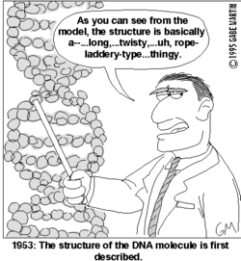
DNA – What is it?
Deoxyribonucleic Acid
Long, double-stranded chain of nucleotides
Contains genetic code
  Instructions for making
  the proteins that control
  cell function and physical
  traits of an organism.

Slide 3
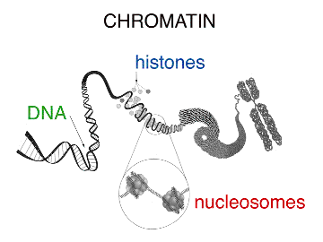
Structure of DNA
Physical
  Double helix (twisted ladder)
  Tightly coiled DNA + histones (proteins) = chromatin
  Before cell division, chromatin coils more tightly into chromosomes

Slide 4
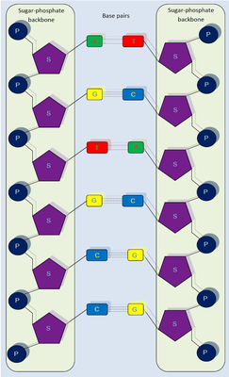
More DNA Structure
Chemical
  5-carbon sugar (deoxyribose)
  Phosphate group
  Nitrogen base

Slide 5
What’s a Nitrogen Base?
    The part of a nucleotide that bonds with a partner to make up the “rungs of the ladder” in a double helix
    Introducing the nitrogen bases of DNA~~~
    Adenine (A)
    Thymine (T)
    Cytosine (C)
    Guanine (G)
    A – T always pair and C – G always pair – these are the rungs of the ladder

Slide 6
What is the job of DNA?
Stores all the information, “genetic code”
The code is used to make proteins, which control almost everything that happens in your body
A gene is a specific sequence of DNA that codes for a specific protein
Replication – when the strands of DNA unwind and an exact copy of the entire length of DNA forms during cell division. This is important so that the new cell has the exact same info as the other cell.

Slide 7
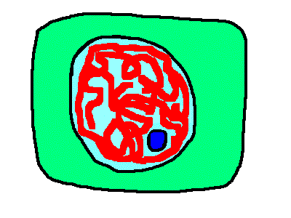
Where in the cell is your DNA?
Nucleus
DNA is the master plan for a cell, and the cell wants to keep it safe. So the DNA stays inside the nucleus of the cell

Slide 8
RNA (DNA’s distant cousin)
What is it?
Ribonucleic Acid
Long chain of nucleotides, with 5- carbon sugar, phosphate group, and nitrogen base (similar to DNA)
Since the all-important DNA has to stay safely tucked away in the nucleus, we need RNA to make a copy of the code to travel to other parts of the cell, where the action happens…

Slide 9
What’s the difference?
How is RNA different than DNA???
  5-carbon sugar is Ribose
  (instead of Deoxyribose)
  Nitrogen base Uracil (instead of Thymine). The others (Adenine, Cytosine, and Guanine) are the same as DNA.
  A – U pair and C – G pair
  Single-stranded
  It does not stay in the nucleus.

Slide 10
There are 3 types of RNA
Messenger RNA (mRNA)
  Carries the genetic code from the DNA in the nucleus in the nucleus through the cytoplasm to the ribosome, so it can get translated into a protein
Ribosomal RNA (rRNA)
  Becomes part of the structure of a ribosome
Transfer RNA (tRNA)
  Carries the specific amino acids to the mRNA on the ribosome.

Slide 11
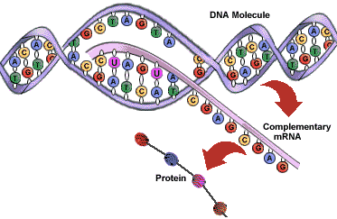
Hey Hey Hey, RNA…
What are you going to do today?
I’m going to take that DNA code and turn it into a protein!
How?
First, I copy DNA’s code.
(DNA -> RNA =Transcription)
Then, I use that code to stick
certain amino acids together.
The string of amino acids is called a polypeptide, which forms a protein
(RNA -> protein = Translation)

Slide 12
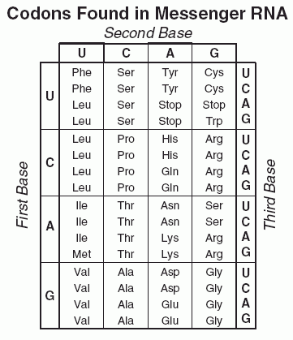

Breaking the code!
RNA is read 3 bases
at a time (codon)
(why?)
AUG = start
UAA = stop
UAG = stop
UGA = stop

Slide 13
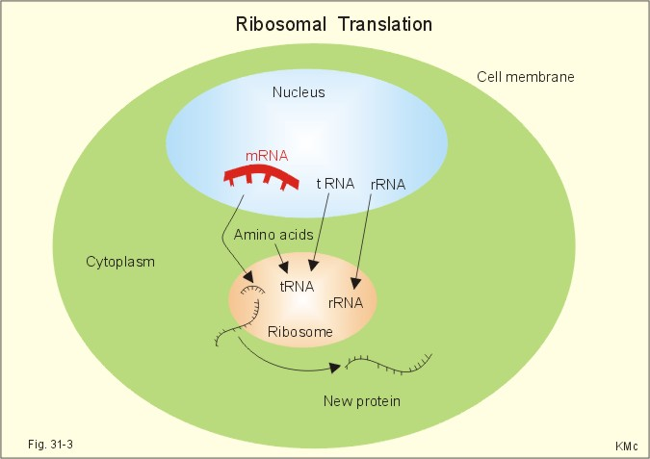
Protein Synthesis
The process of “translating” the RNA code into a chain of amino acids that form a protein is called Translation
Where in the cell?
  Protein synthesis occurs on the ribosome.

Slide 14
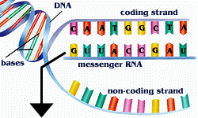
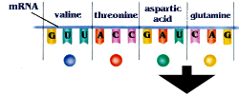
Making proteins
  1. DNA unwinds and a matching copy of mRNA forms (Transcription).
  2. Messenger RNA carries the
  code from the nucleus into
  the cytoplasm to the ribosome
  (the site of protein synthesis)
  3.The genetic code on the mRNA is read 3 letters at a time (codon). Each 3-letter code matches up with a specific amino acid (the building blocks of proteins).

Slide 15
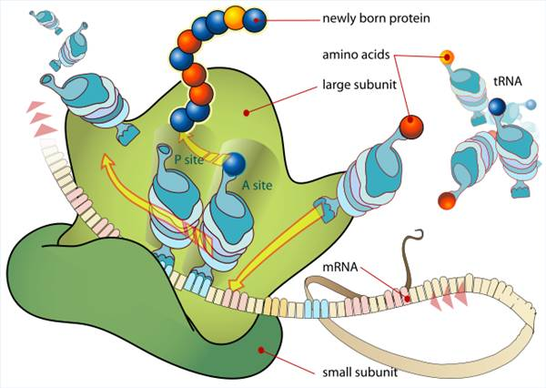
Making proteins (continued)
  Transfer RNA carries the amino acid to the specific codon on the mRNA.
  5. The amino acids bond together to form a long chain called a polypeptide, which forms a protein.

Slide 16
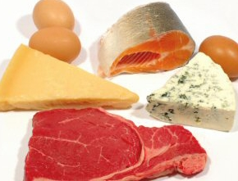
What’s the point of all this?
When you eat protein, it gets
broken down in your digestive
system, into amino acids. Your
body uses those amino acids as building blocks
to build the proteins you need!
(you are what you eat…)
Proteins control almost everything in a cell.
Proteins define what the cell looks like, how it functions, how it grows, and how it passes the information on
Ex. Enzyme action, transport, motion, protection, support, communication, and regulation

Slide 17
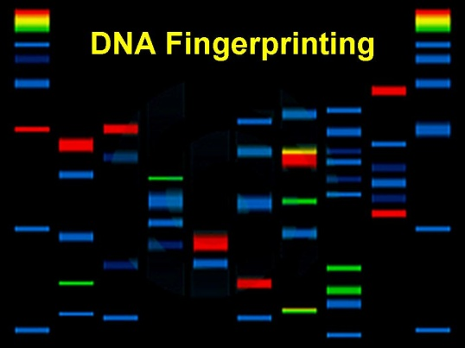

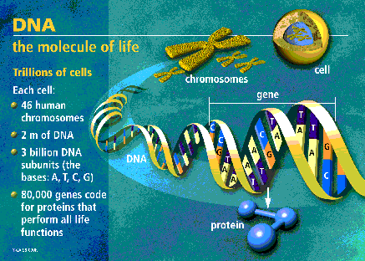
How does the study of DNA, RNA and proteins affect our society today?
DNA “fingerprinting”
Human Genome Project
Medical research
Disease detection and cures
Genetically modified food
Cloning

