Slide 1
2.A – ENERGY & MATTER
Growth, reproduction and maintenance of the organization of living systems requires free energy & matter

Slide 2
2.A.1 – Input of Energy
All living systems require constant input of free energy

Slide 3
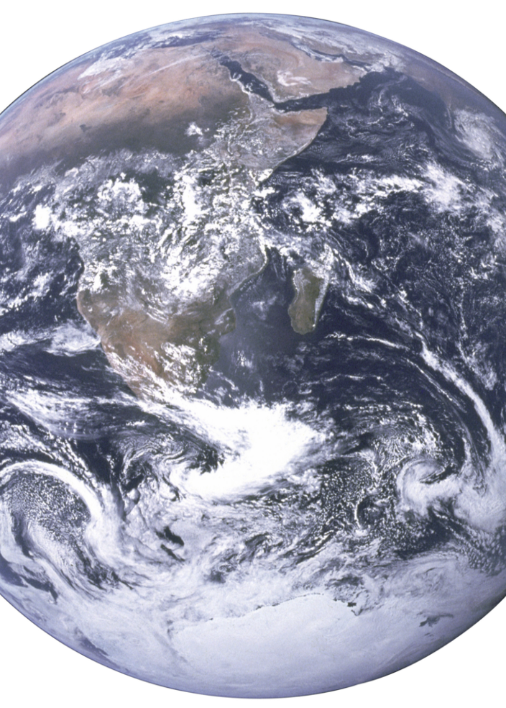
AP BIOLOGY
3
In order to exist, life requires a highly ordered system.
Systems are groups of components that interact with each other within a defined area.
The biozone (Earth) is considered a closed system because:
Energy is exchanged with surroundings (space)
Matter is not exchanged with surroundings
2.A.1 (a)
Free Energy
Key Terms
System
Closed System
https://upload.wikimedia.org/wikipedia/commons/thumb/4/43/The_Earth_seen_from_Apollo_17_with_transparent_background.png
https://upload.wikimedia.org/wikipedia/commons/thumb/4/43/The_Earth_seen_from_Apollo_17_with_transparent_background.png

Slide 4
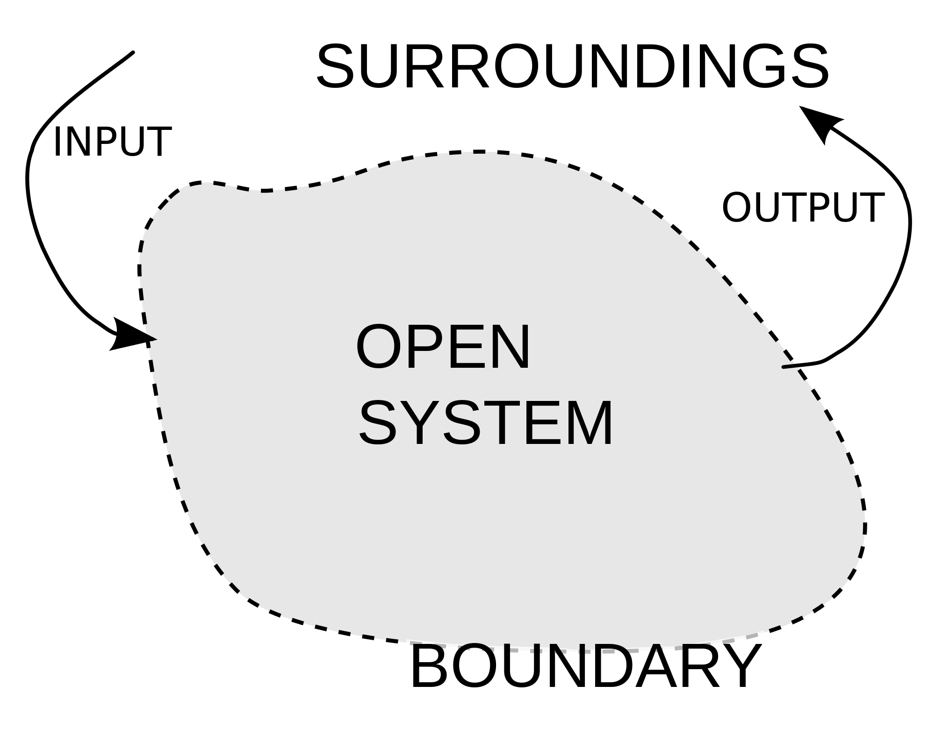
AP BIOLOGY
4
Living systems are considered open systems because both matter and energy are exchanged with the environment. Organisms transform matter/energy and output it to their surroundings.
2.A.1 (a)
Free Energy
Key Terms
System
Closed System
Open System
https://upload.wikimedia.org/wikipedia/commons/thumb/4/43/The_Earth_seen_from_Apollo_17_with_transparent_background.png
https://upload.wikimedia.org/wikipedia/commons/thumb/4/43/The_Earth_seen_from_Apollo_17_with_transparent_background.png

Slide 5
AP BIOLOGY
5
Within a system, entropy is a measure of order and disorder. In organisms, order is maintained by the constant input of free energy into the system. This energy is available for use in reactions.
2.A.1 (a)
Free Energy
Key Terms
System
Closed System
Open System
Entropy
Free Energy
https://upload.wikimedia.org/wikipedia/commons/9/91/Order_and_disorder.svg

Slide 6
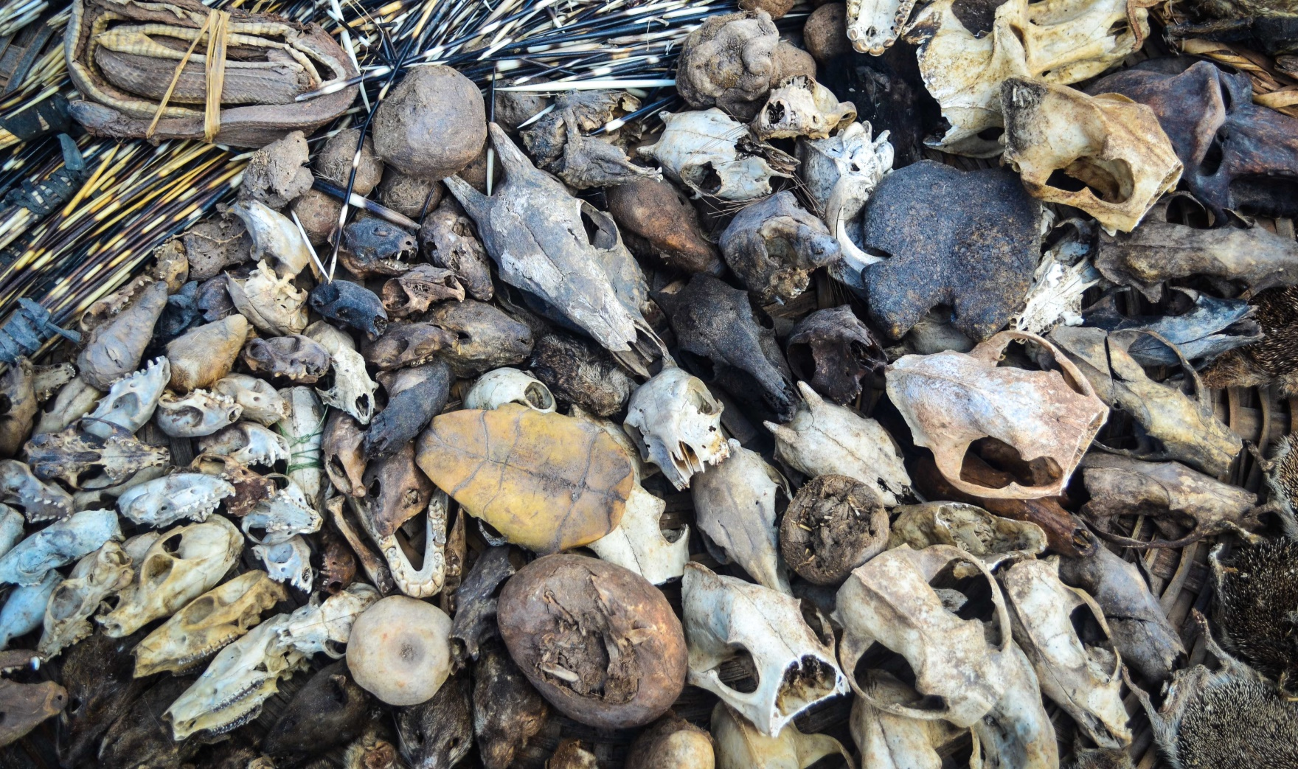
AP BIOLOGY
6
The loss of order or free energy flow results in the death of an organisms. This is because no energy is available for reactions.
2.A.1 (a)
Free Energy
Key Terms
System
Closed System
Open System
Entropy
Free Energy
https://upload.wikimedia.org/wikipedia/commons/thumb/4/43/The_Earth_seen_from_Apollo_17_with_transparent_background.png
https://upload.wikimedia.org/wikipedia/commons/c/c8/Dead_organisms_in_Benin.jpg

Slide 7
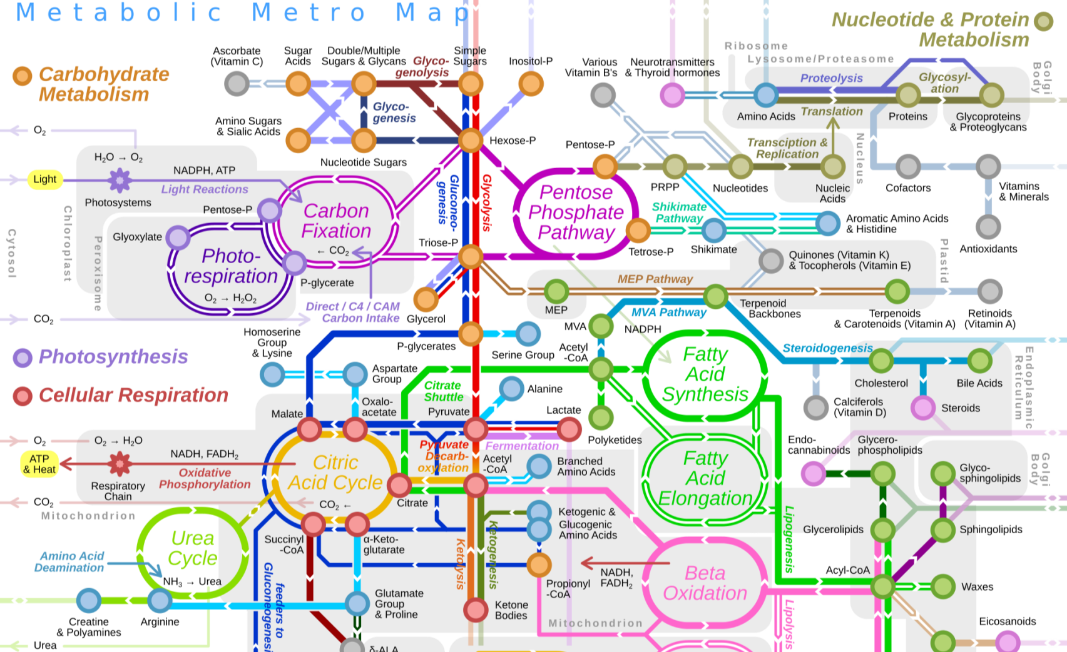
AP BIOLOGY
7
Increases in entropy and disorder are offset by biological processes that maintain or increase order. This is done with free energy.
2.A.1 (a)
Free Energy
Key Terms
System
Closed System
Open System
Entropy
Free Energy
https://upload.wikimedia.org/wikipedia/commons/thumb/4/43/The_Earth_seen_from_Apollo_17_with_transparent_background.png
https://upload.wikimedia.org/wikipedia/commons/thumb/6/6e/Metabolic_Metro_Map.svg/2000px-Metabolic_Metro_Map.svg.png

Slide 8
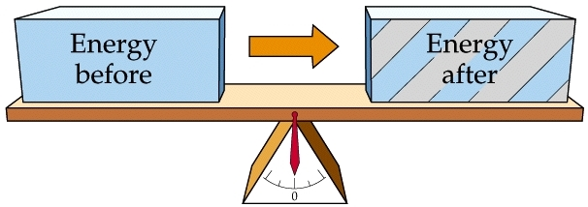
AP BIOLOGY
8
Thermodynamics is a branch of science that studies the relationship between heat and other forms of energy.
The first law of thermodynamics states:
2.A.1 (b)
Free Energy
Key Terms
Thermo-dynamics
First Law
of Thermo.
Energy can neither be created nor destroyed
Energy can be transferred and transformed.
http://www231.pair.com/fzwester/courses/bis10v/week2/2webimages/figure-06-03a.jpg

Slide 9
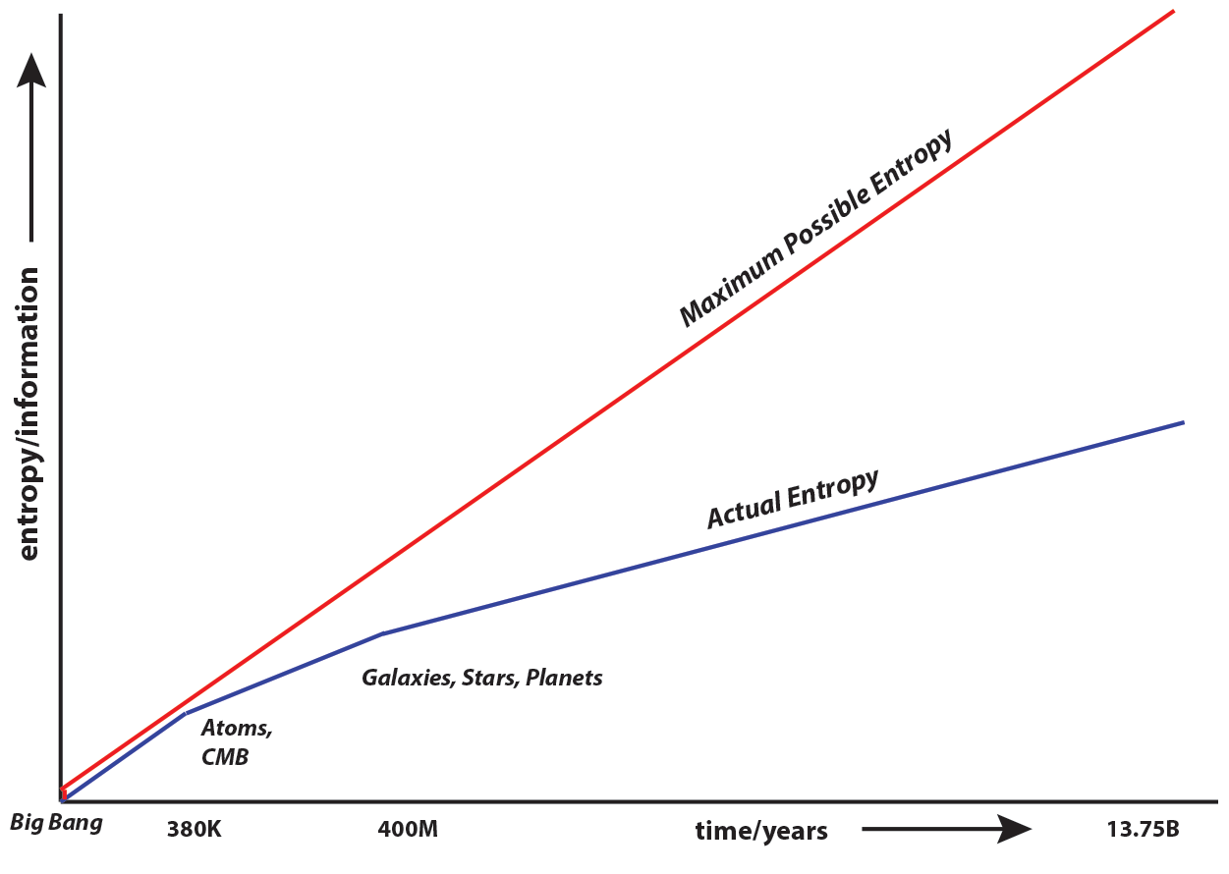
AP BIOLOGY
9
The second law of thermodynamics states that entropy (disorder) of a system can only increase over time. The more energy is transferred or transformed, the more energy is wasted over time.
2.A.1 (b)
Free Energy
Key Terms
Thermo-dynamics
First Law
of Thermo.
Second Law
of Thermo.
http://www.informationphilosopher.com/introduction/information/Growth_of_Info.png

Slide 10
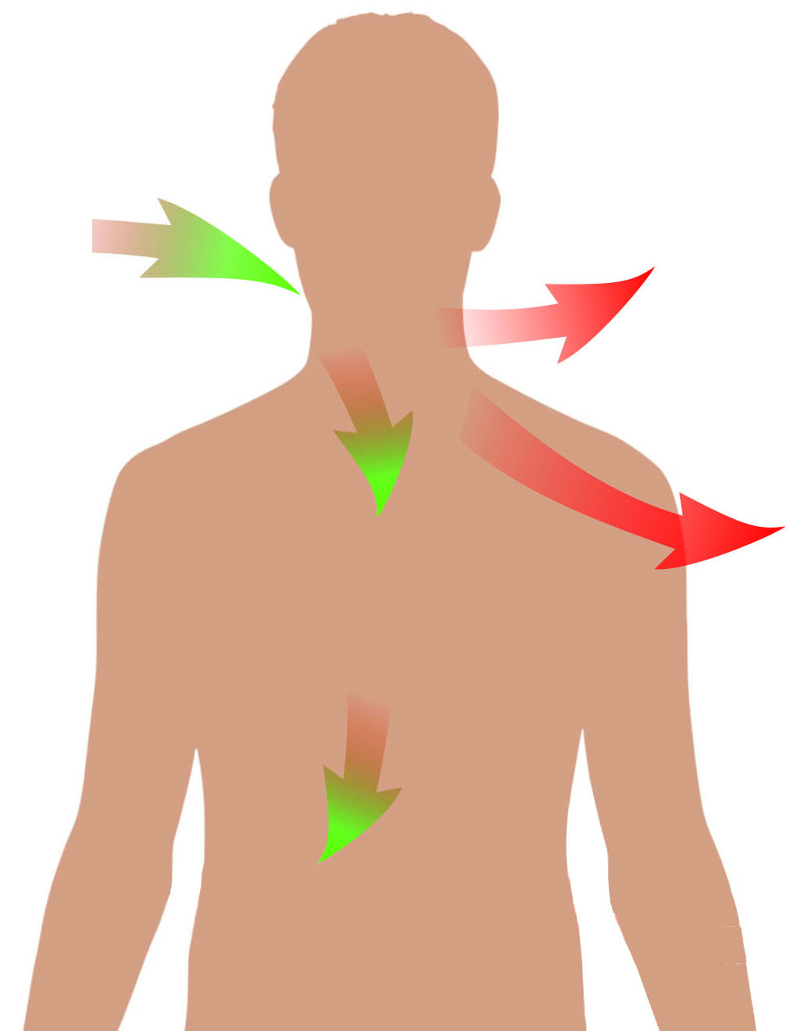
AP BIOLOGY
10
Living systems do not violate the second law of thermodynamics.
Although they are highly ordered, their processes increase overall disorder.
This is accomplished through:
Coupling processes
Excess energy input
Exergonic reactions
2.A.1 (b)
Free Energy
Key Terms
https://upload.wikimedia.org/wikipedia/commons/thumb/4/4c/Energy_and_life.svg/2000px-Energy_and_life.svg.png

Slide 11
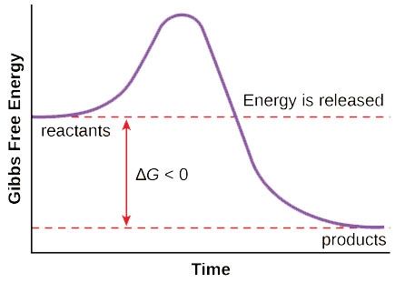
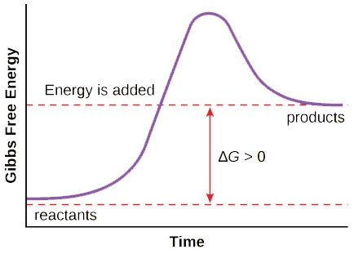
AP BIOLOGY
11
In organisms, order is maintained by coupling exergonic processes with endergonic processes. This maintains levels of free energy in the living system.
2.A.1 (b)
Free Energy
Key Terms
Endergonic
Exergonic
Exergonic reactions increase entropy, which results in negative changes in free energy
Endergonic reactions decrease entropy, which results in positives changes in free energy
https://upload.wikimedia.org/wikipedia/commons/9/9a/Figure_06_03_03.jpg

Slide 12
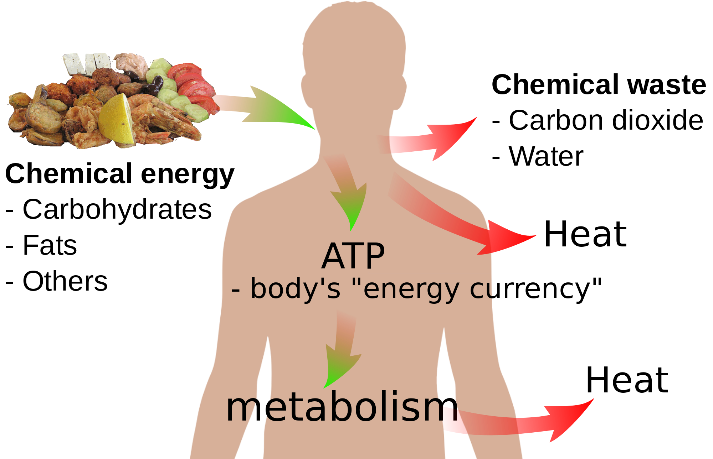
AP BIOLOGY
12
Energy input must exceed free energy lost to entropy to maintain order and power cellular processes
2.A.1 (b)
Free Energy
Key Terms
Endergonic
Exergonic
https://upload.wikimedia.org/wikipedia/commons/thumb/4/4c/Energy_and_life.svg/2000px-Energy_and_life.svg.png
Notes:
metabolism is the sum of all chemical reactions that occur in living organisms

Slide 13
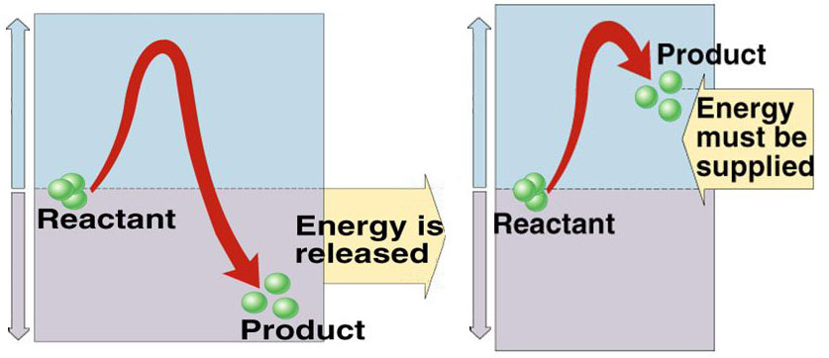
AP BIOLOGY
13
Energetically favorable energetic reactions with a negative change in free energy can be used to maintain or increase order in a system by being coupled with reactions with positive changes.
Energy released by one reaction can be used by another. This maintains overall order.
2.A.1 (b)
Free Energy
Key Terms
Endergonic
Exergonic
http://slideplayer.com/slide/6899511/23/images/7/Endergonic+vs.+exergonic+reactions.jpg

Slide 14
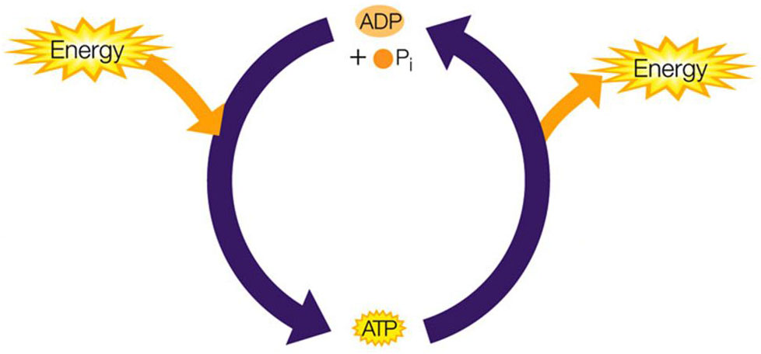
AP BIOLOGY
14
The reaction converting ATP to ADP both takes in energy produced by exergonic reactions and releases energy to endergonic reactions
2.A.1 (b)
Free Energy
Energy absorbed is released by:
- Cell respiration - Catabolism
Energy released is absorbed by:
- Active transport - Anabolism, etc.
Key Terms
Endergonic
Exergonic
http://images.slideplayer.com/25/8005358/slides/slide_9.jpg
Notes:
Catabolism is the breakdown of complex molecules in living organisms to form simpler ones, together with the release of energy
Anabolism is the synthesis of complex molecules in living organisms from simpler ones together with the storage of energy
Pi is inorganic phosphate

Slide 15
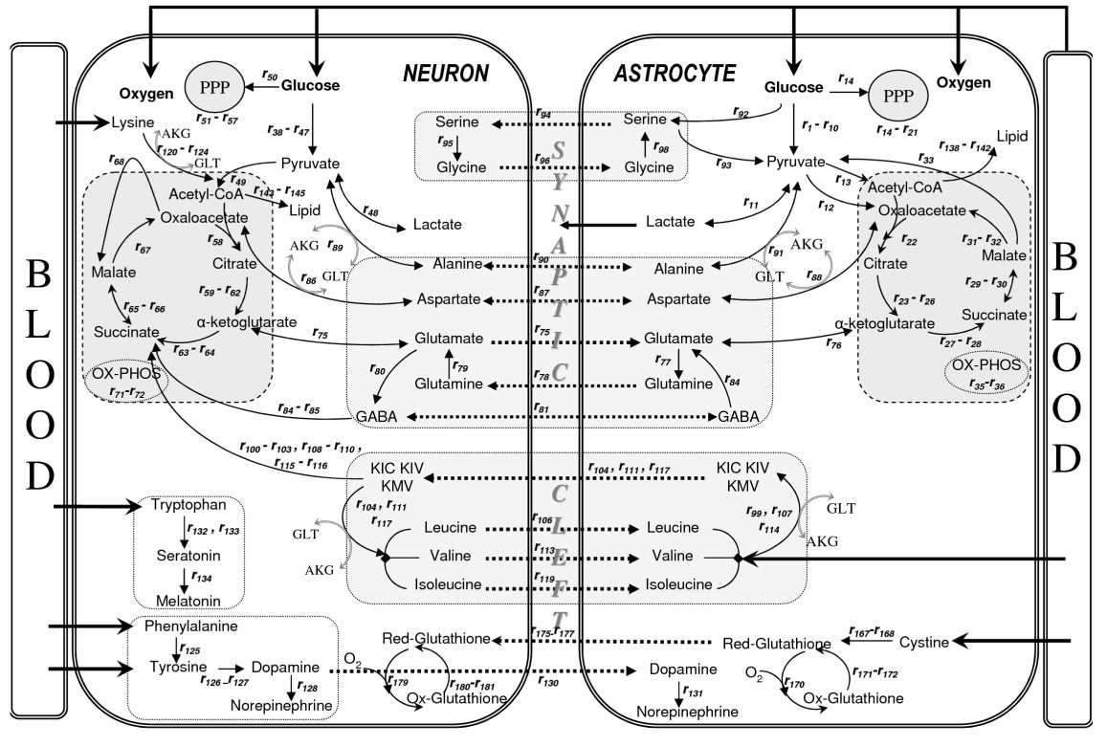
AP BIOLOGY
15
Energy-related pathways in biological systems are sequential. Because of this, they can be entered at multiple points.
2.A.1 (c)
Free Energy
Key Terms
Endergonic
Exergonic
https://s3.amazonaws.com/test.classconnection/823/flashcards/391823/jpg/hydrolysis.jpg

Slide 16
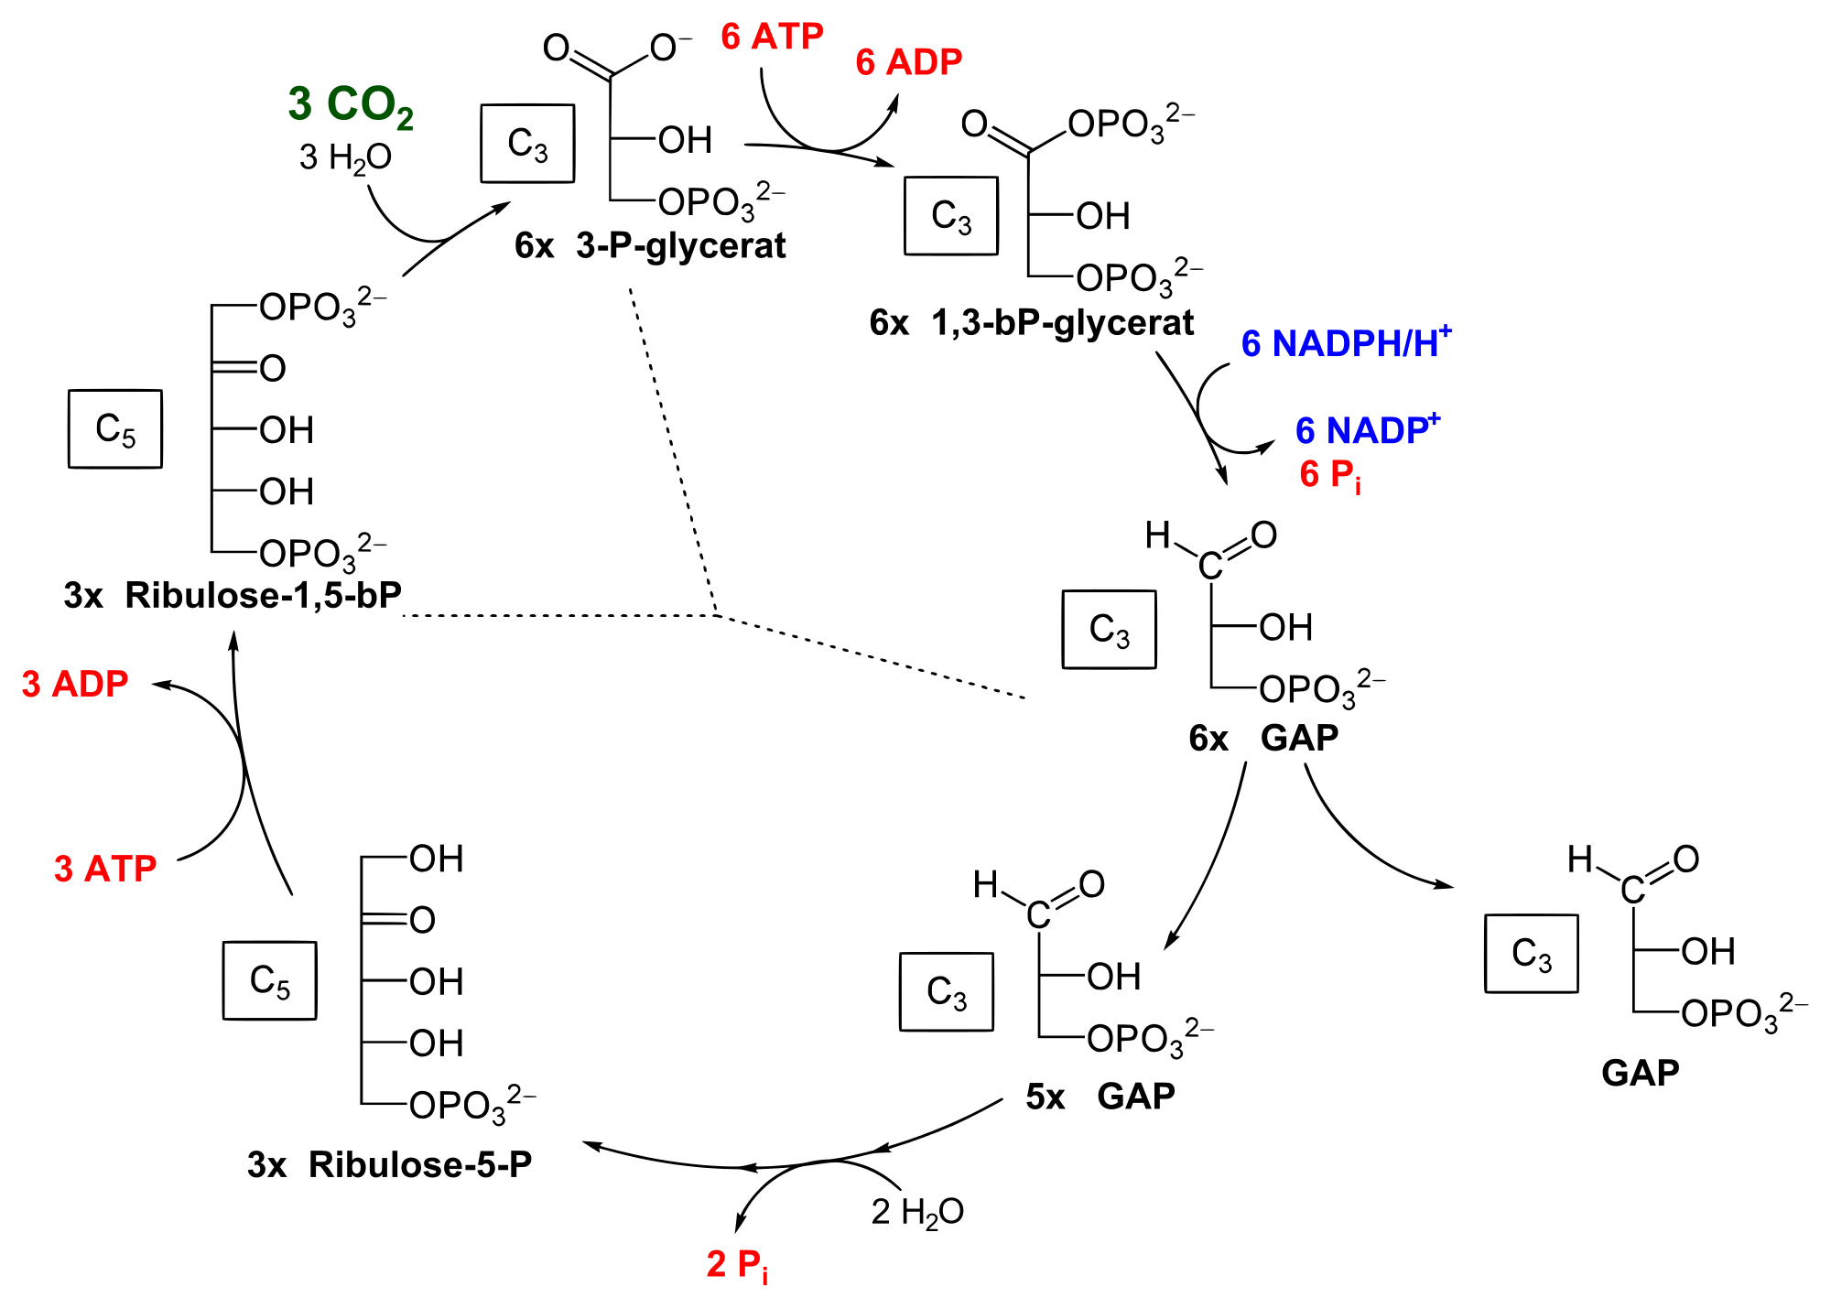
AP BIOLOGY
For example, the Calvin Cycle is a pathway involved in photosynthesis. Because it is sequential and cyclic molecules can enter at any point.
16
2.A.1 (c)
Free Energy
Key Terms
Endergonic
Exergonic
https://upload.wikimedia.org/wikipedia/commons/thumb/8/82/Calvin_cycle.svg/2000px-Calvin_cycle.svg.png

Slide 17
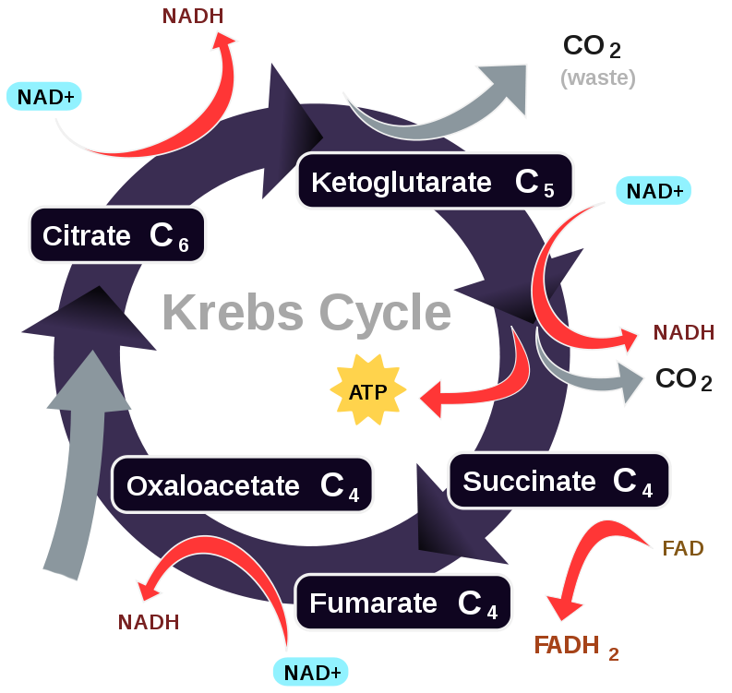
AP BIOLOGY
17
The same is true of the Kreb Cycle, which involved in the production of ATP through anaerobic respiration.
2.A.1 (c)
Free Energy
Key Terms
Endergonic
Exergonic
https://lifeofbiochem.files.wordpress.com/2013/04/tca-simple.png

Slide 18
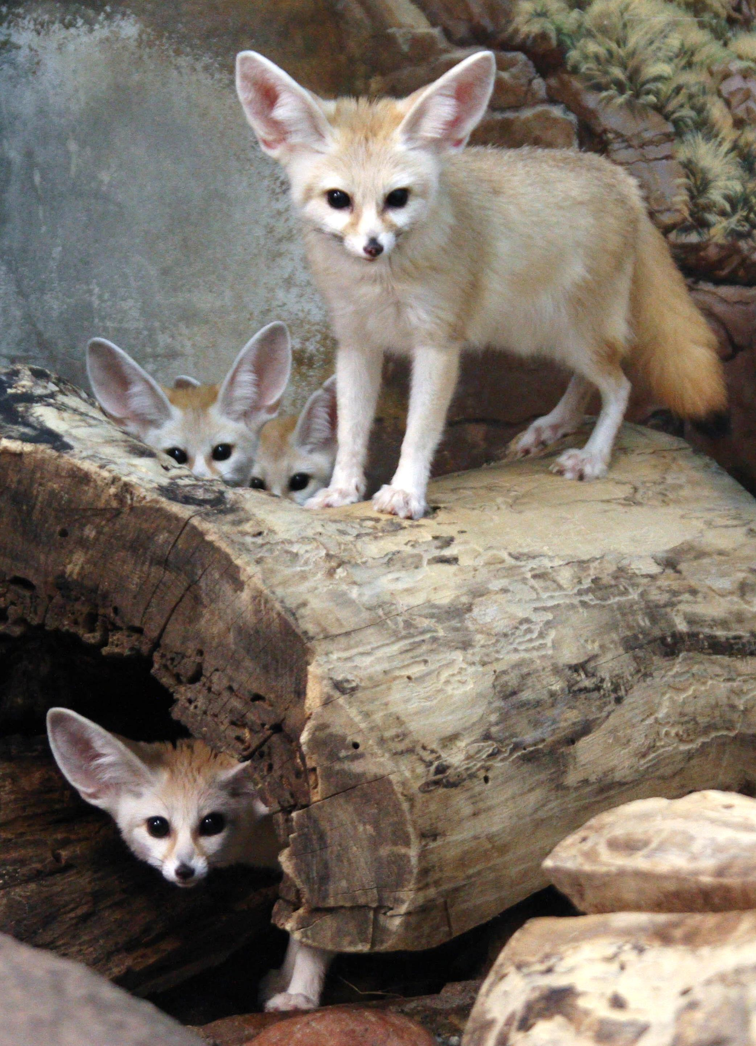
AP BIOLOGY
18
Organisms require free energy in order to:
Maintain organization
Grow
Reproduce
This is seen in:
Body temperature regulation
Reproductive strategies
Metabolic rate
2.A.1 (d)
Free Energy
Key Terms
https://upload.wikimedia.org/wikipedia/commons/0/0f/Fennec_Fox_Family.jpg

Slide 19
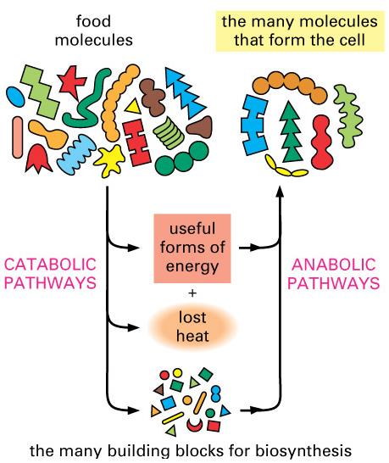
AP BIOLOGY
Within organisms, molecules are constantly being made and broken down via enzymes.
The web of all these reactions is called the metabolism.
There are two types of pathways:
Catabolic
Anabolic
19
2.A.1 (d.1)
Free Energy
Key Terms
Metabolism
https://o.quizlet.com/HqSxXrED7kByY00Hpv6mSw_m.jpg

Slide 20
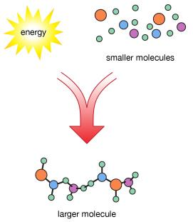
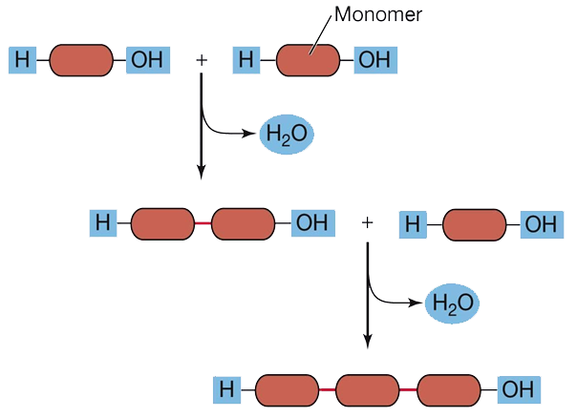
AP BIOLOGY
20
Anabolic reactions use energy to build complex molecules from simpler ones. Many do so through condensation reactions.
These reactions remove water (H₂O) between monomers and then form a new covalent bond. This builds polymer chains.
2.A.1 (d.1)
Free Energy
Key Terms
Metabolism
Anabolism
https://s3.amazonaws.com/classconnection/133/flashcards/7987133/jpg/condensation-reactions-1537519D1103E4682F8.jpg

Slide 21
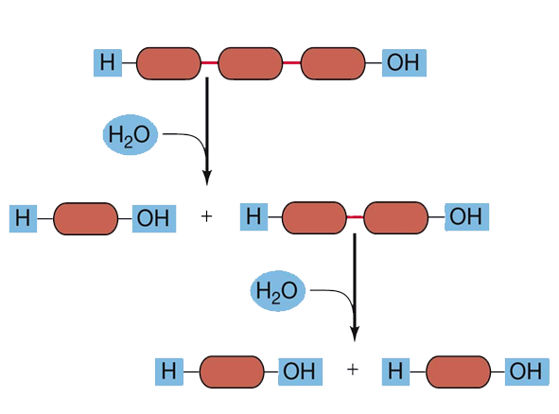
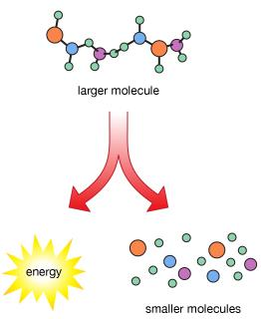
AP BIOLOGY
21
Catabolic reactions break down complex molecules into simpler ones, which releases energy. Many do so through hydrolysis.
Hydrolysis is the opposite of condensation. Polymers are broken down by adding H2O and breaking covalent bonds.
2.A.1 (d.1)
Free Energy
Key Terms
Metabolism
Anabolism
Catabolism
https://s3.amazonaws.com/test.classconnection/823/flashcards/391823/jpg/hydrolysis.jpg

Slide 22
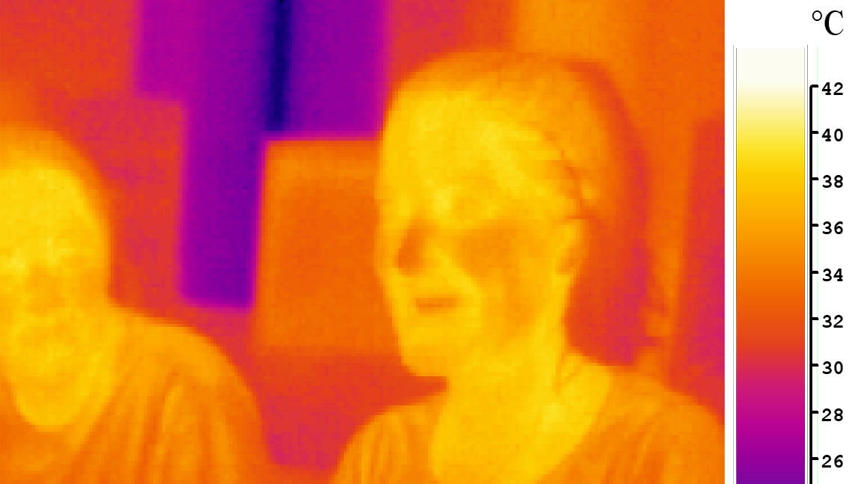
AP BIOLOGY
22
Organisms use various strategies to regulate body temperature. Since catabolic reactions release energy as heat, the total amount of reactions affects the temperature of an organism as a whole.
2.A.1 (d.1)
Free Energy
Key Terms
Metabolism
Anabolism
Catabolism
https://upload.wikimedia.org/wikipedia/commons/c/cf/Ir_girl.png

Slide 23
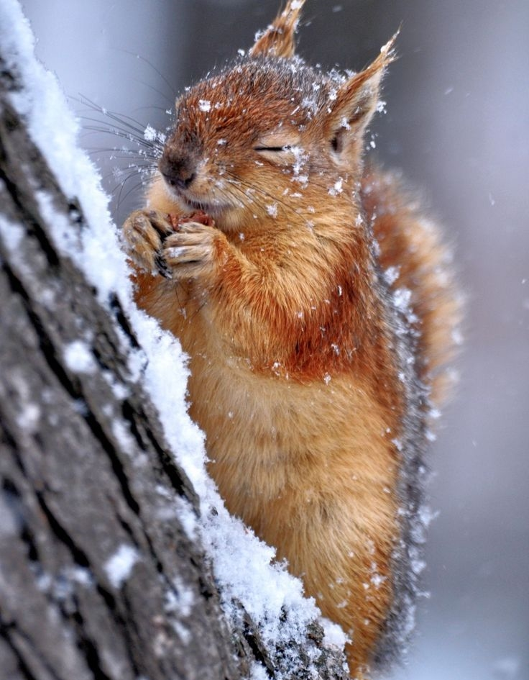
AP BIOLOGY
23
Endotherms use the heat generated by metabolism to maintain a homeostatic body temperature.
For example, many animals shiver when their temperature drops.
This small/quick movements of the skeletal muscles generate heat through catabolic reactions.
2.A.1 (d.1)
Free Energy
Key Terms
Metabolism
Anabolism
Catabolism
Endothermy
https://s-media-cache-ak0.pinimg.com/736x/db/af/c5/dbafc5c1b2e1d4ca50bdd3dcde9b78a5--cute-squirrel-squirrels.jpg

Slide 24
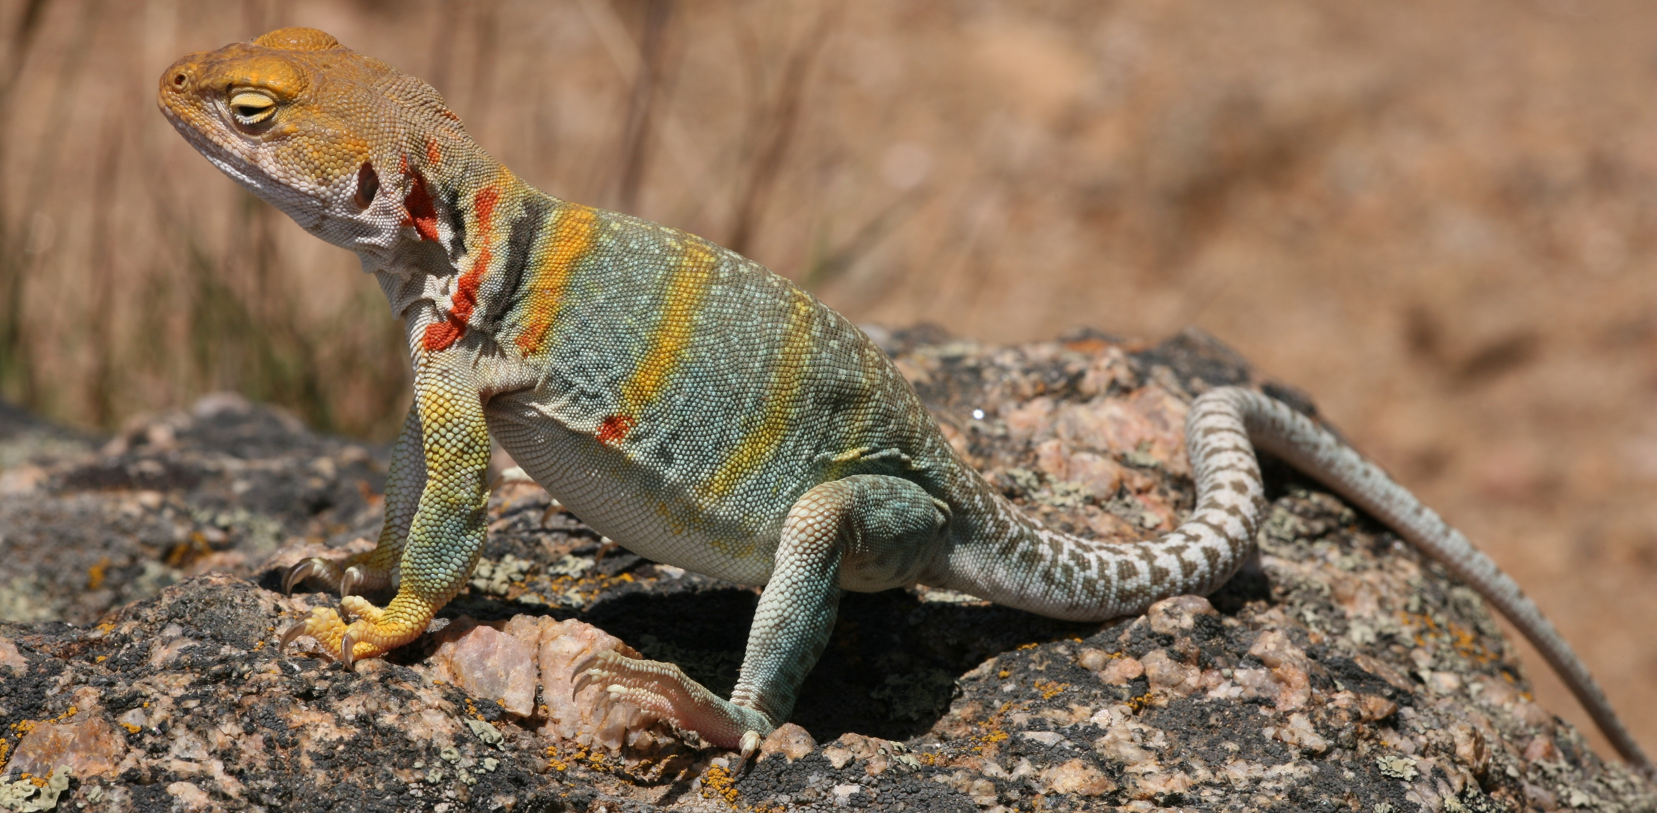
AP BIOLOGY
24
Ectotherms use heat from the environment to regulate body temperature. They are typically cold-blooded.
For example, reptiles use warm themselves by seeking areas with sun exposure. Marine ectotherms inhabit areas with little temperature fluctuation.
2.A.1 (d.1)
Free Energy
Key Terms
Metabolism
Anabolism
Catabolism
Endothermy
Ectothermy
https://upload.wikimedia.org/wikipedia/commons/9/9d/Collared_Lizard_1.jpg

Slide 25
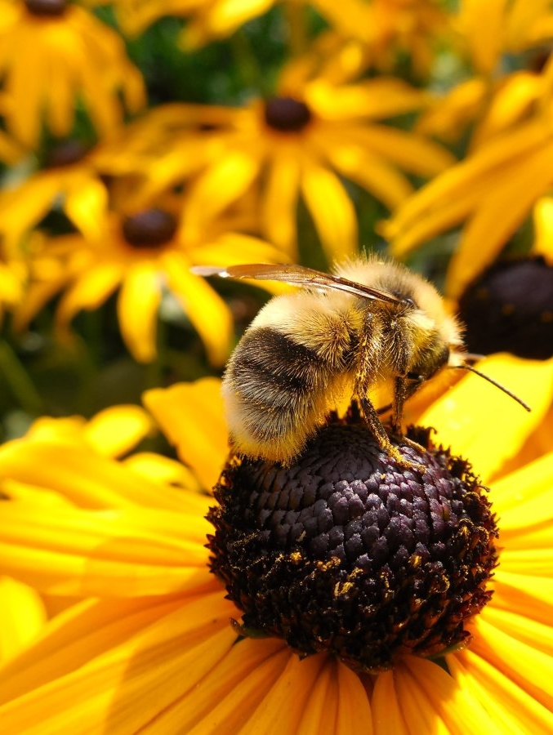
AP BIOLOGY
25
In some species of plants, elevated flower temperatures are used to attract pollinators to them (insects).
These plants provide warmth in addition to nectar.
For example, it has been shown that bees prefer these types of plants if available.
2.A.1 (d.1)
Free Energy
Key Terms
Metabolism
Anabolism
Catabolism
Endothermy
Ectothermy
https://c.pxhere.com/photos/45/13/hummel_bee_sun_blossom_bloom_flower_insect_close-649126.jpg!d

Slide 26
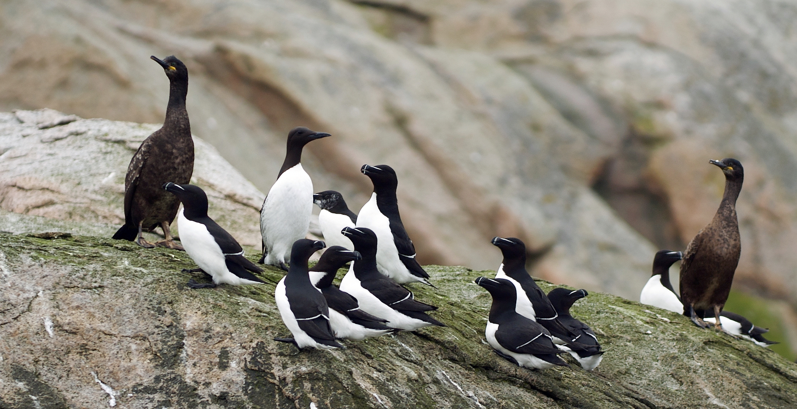
AP BIOLOGY
26
The free energy needed for reproduction and rearing than that needed for maintenance and growth.
As a result, different organisms use various reproductive strategies in response to the amount of energy available.
2.A.1 (d.2)
Free Energy
Key Terms
https://upload.wikimedia.org/wikipedia/commons/6/65/Seabirds_LC0141.jpg

Slide 27
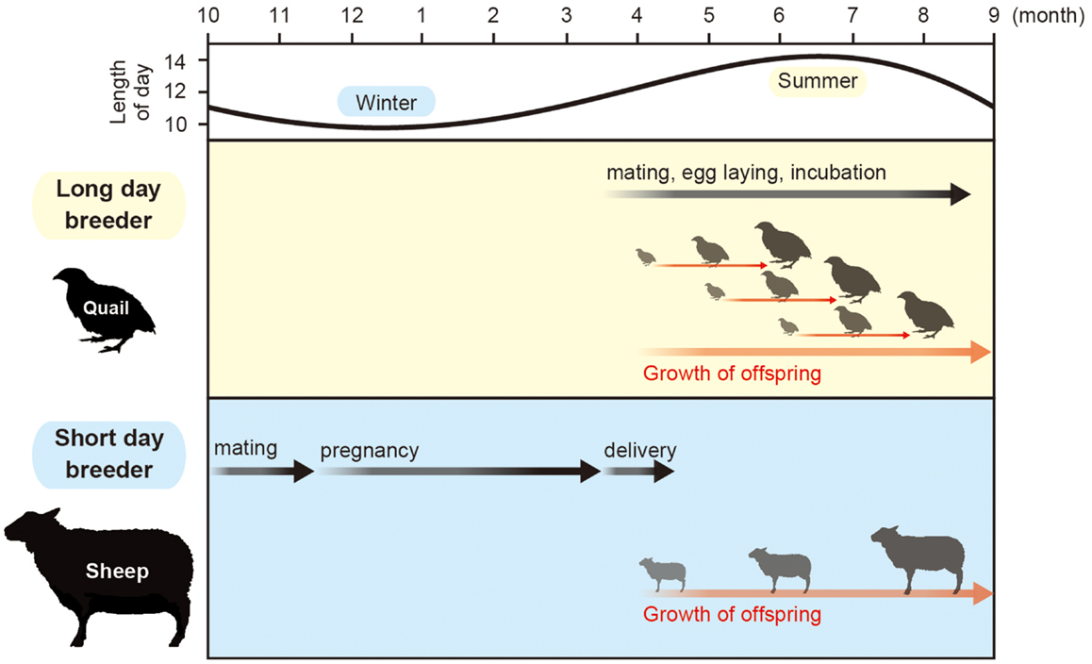
AP BIOLOGY
27
For example, some species reproduce seasonally in order to better balance the energy available due to seasonal changes.
Seasonal reproduction also affects the conditions under which offspring are raised, which affects energy requirements.
2.A.1 (d.2)
Free Energy
Key Terms
http://www.frontiersin.org/files/Articles/79791/fendo-05-00012-HTML/image_m/fendo-05-00012-g001.jpg

Slide 28
AP BIOLOGY
28
Biennial plants are those that take two years to complete their life cycles.
This spreads out their energy budget.
They grow roots and leaves in the first year and then flower in the second year of life.
2.A.1 (d.2)
Free Energy
Key Terms
http://www.frontiersin.org/files/Articles/79791/fendo-05-00012-HTML/image_m/fendo-05-00012-g001.jpg

Slide 29
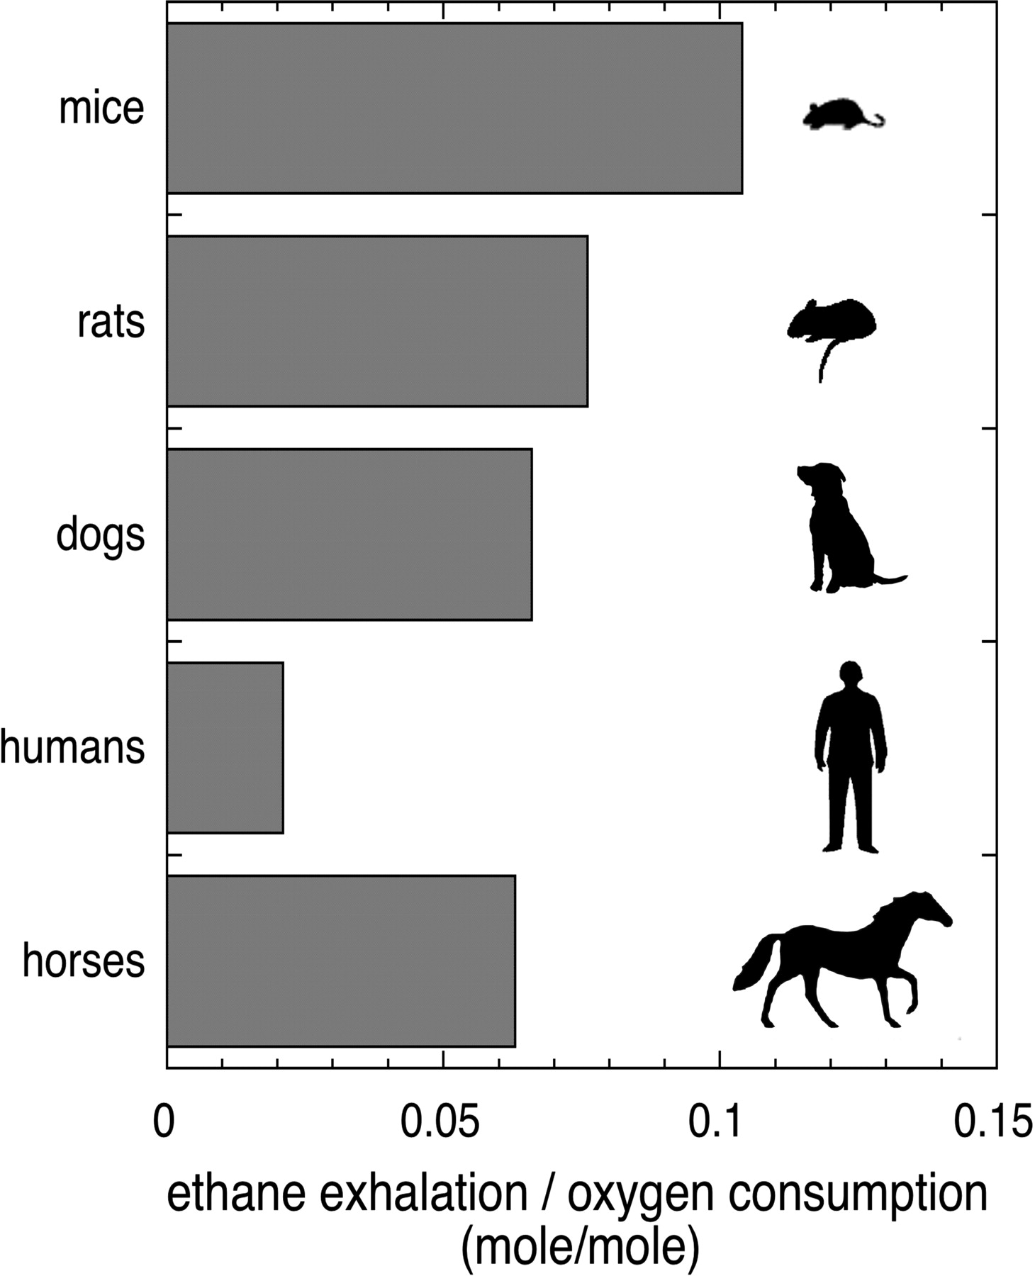
AP BIOLOGY
29
An organism’s metabolic rate is the amount of energy that it uses in a given unit of time.
Generall, the smaller the organism, the higher the metabolic rate.
* In this graph, rate is measured in O₂ consumption, a reactant in cell respiration.
2.A.1 (d.3)
Free Energy
Key Terms
http://jeb.biologists.org/content/jexbio/208/9/1621/F1.large.jpg

Slide 30
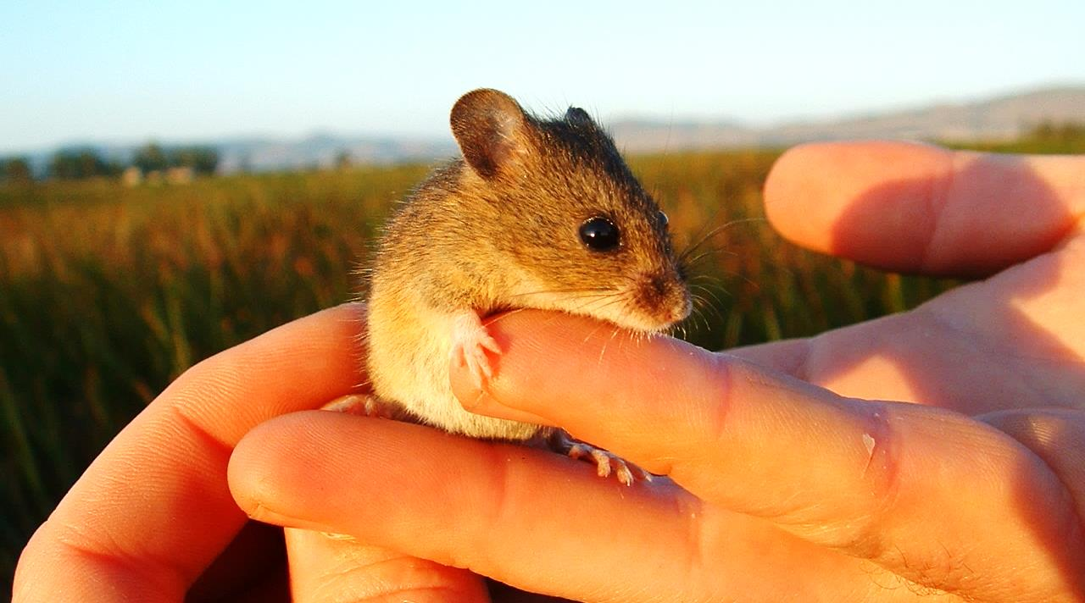
AP BIOLOGY
30
This is because smaller organisms have a low surface area to volume ratio and so lose heat relatively quickly. As a result, they must metabolize food quickly.
2.A.1 (d.3)
Free Energy
Key Terms
https://upload.wikimedia.org/wikipedia/commons/d/d1/Salt_Marsh_Harvest_Mouse.jpg

Slide 31
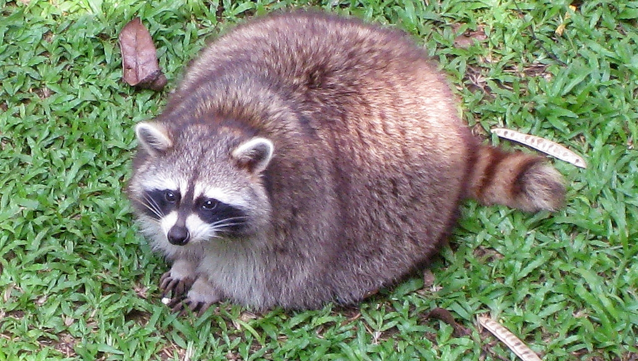
AP BIOLOGY
31
Excess free energy that is acquired in excess of required free energy is stored or used for growth. These reserves are used when free energy is less available in the future.
2.A.1 (d.4)
Free Energy
Key Terms
https://upload.wikimedia.org/wikipedia/commons/thumb/1/1d/Racoon_Ragunan_Zoo.jpg/1280px-Racoon_Ragunan_Zoo.jpg

Slide 32
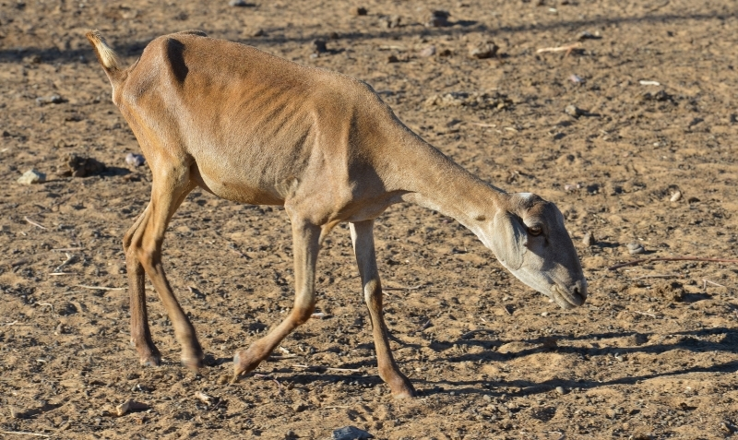
AP BIOLOGY
32
If the acquired free energy is less than the required amount, there will be a loss in mass and ultimately the organism will die.
2.A.1 (d.5)
Free Energy
Key Terms
https://upload.wikimedia.org/wikipedia/commons/4/45/Seca_no_semi%C3%A1rido.jpg

Slide 33
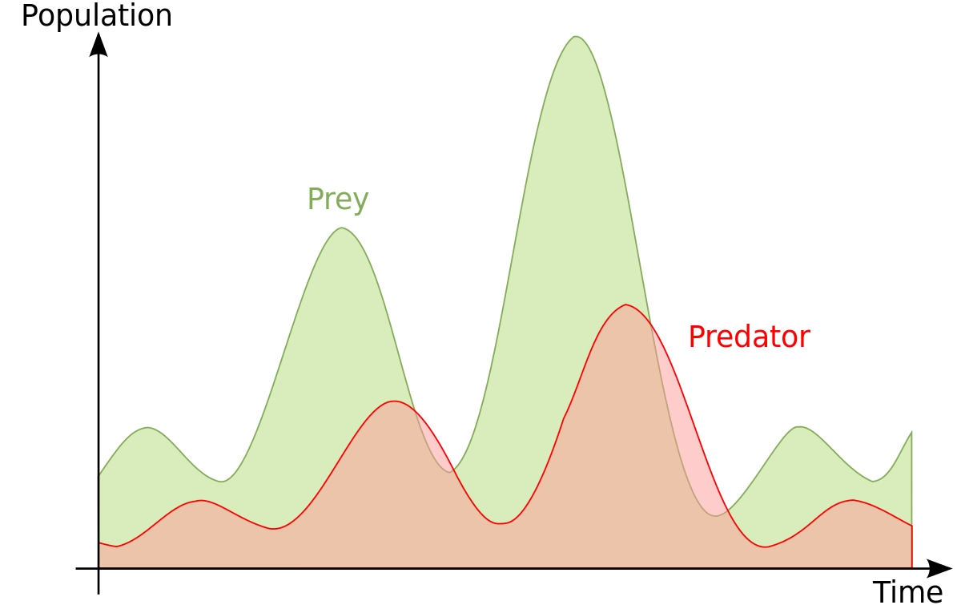
AP BIOLOGY
33
Changes in free energy availability can result in changes in population size. For example, if a prey species population declines, there is less energy for the predator, which declines shortly after.
2.A.1 (e)
Free Energy
Key Terms
https://upload.wikimedia.org/wikipedia/commons/thumb/6/62/LotkaVolterra_en.svg/1200px-LotkaVolterra_en.svg.png

Slide 34
AP BIOLOGY
34
If the overall amount of free energy is changed, there can be disruptions in an ecosystem.
Aspects that can change can include:
Level of producers
Energy resources such as sunlight
2.A.1 (f)
Free Energy
Key Terms
https://upload.wikimedia.org/wikipedia/commons/5/52/Cloud_blocking_the_sun.jpg

Slide 35
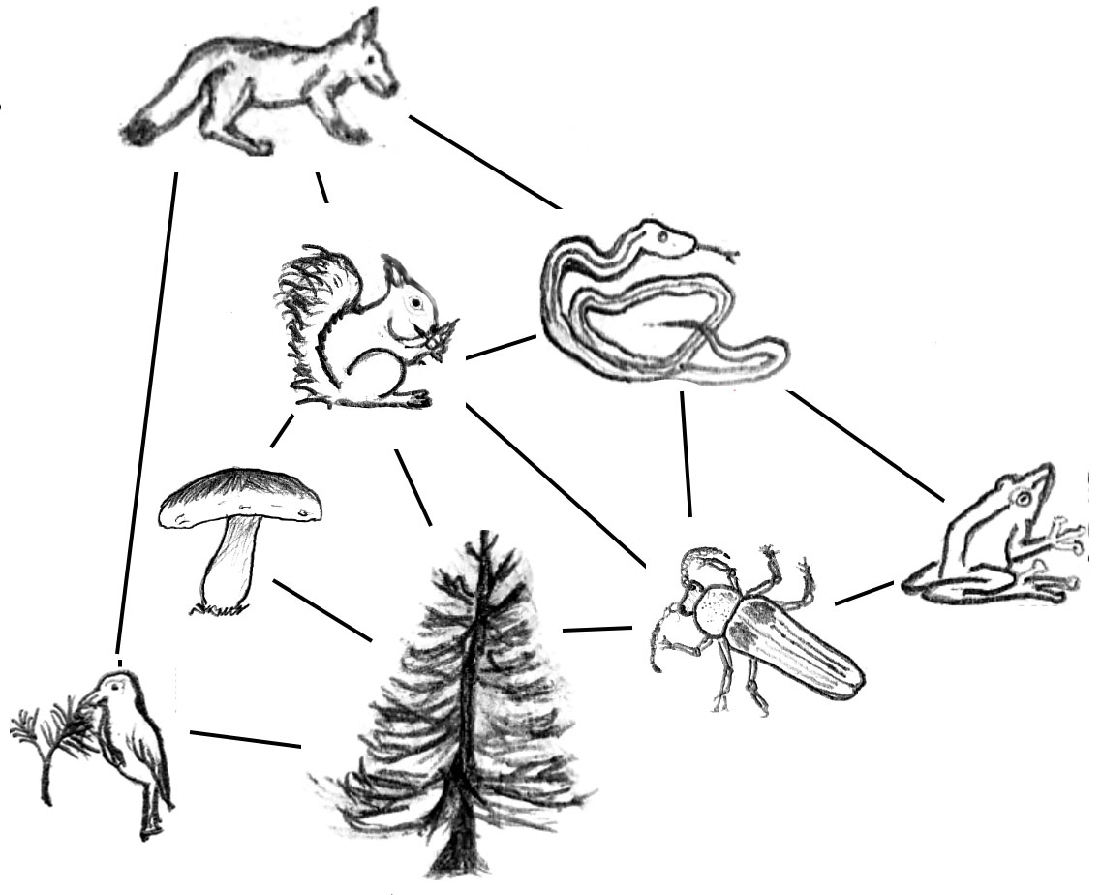
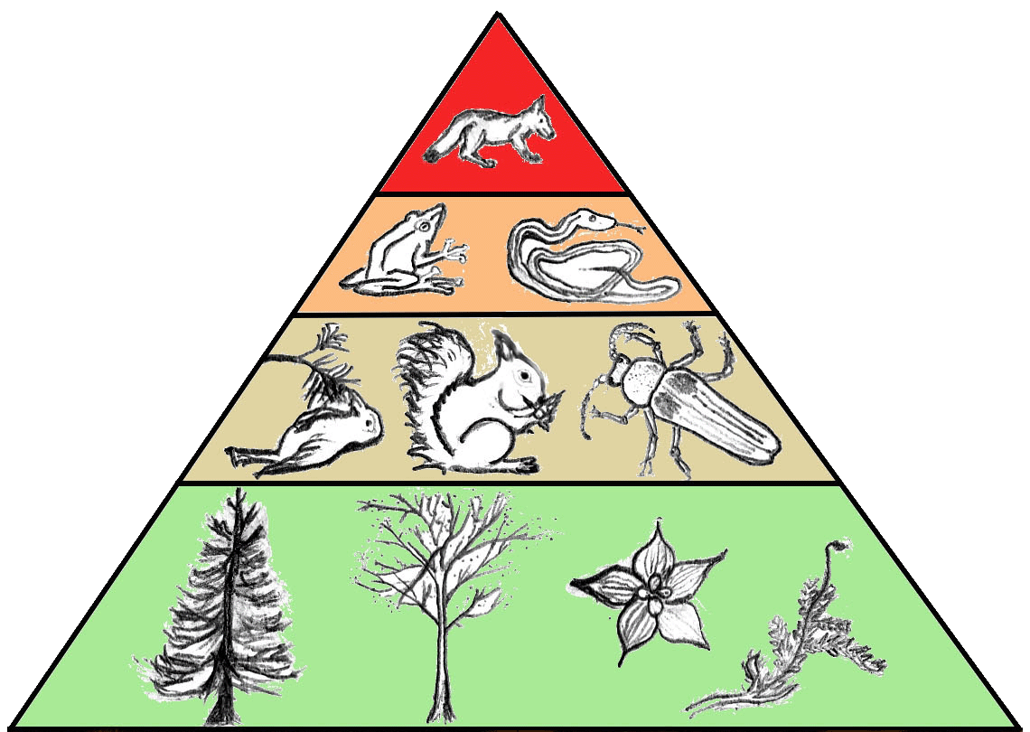
AP BIOLOGY
35
Variations in producer levels can affect the number and size of other trophic levels. As shown below, if the amount of plants decreases, less matter would be available for herbivores and predators.
2.A.1 (f)
Free Energy
Key Terms
https://upload.wikimedia.org/wikipedia/commons/1/13/TrophicWeb.jpg

Slide 36
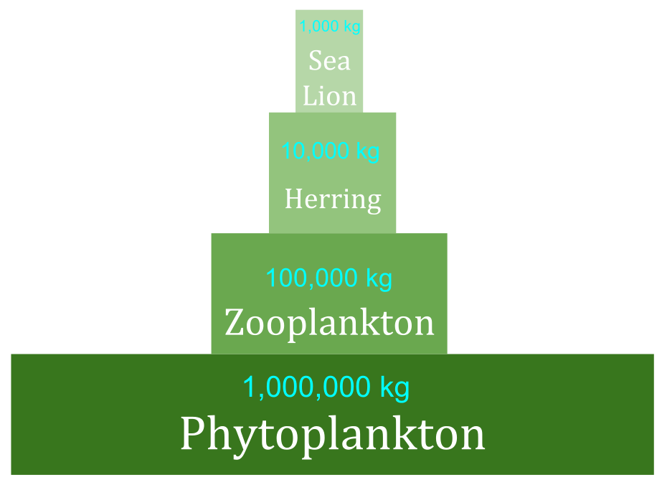
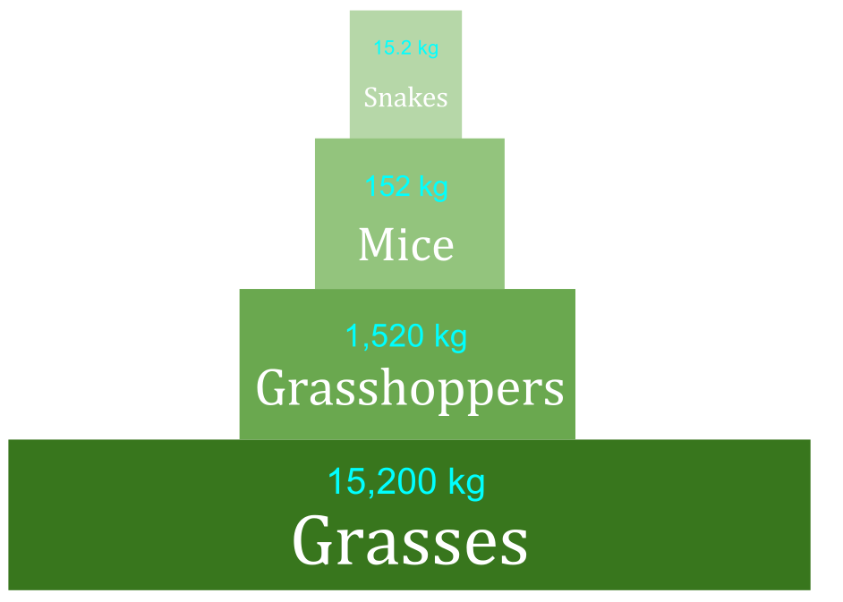
AP BIOLOGY
36
Changes in energy resources, also affects the size of trophic levels by limiting the amount of overall available energy.
For example:
If sunlight decreases, less energy is available for photosynthesis.
Then organisms in higher trophic levels have less energy available.
The size of each trophic level decreases.
2.A.1 (f)
Free Energy
Key Terms
https://upload.wikimedia.org/wikipedia/commons/thumb/9/93/Biomass_Pyramid.svg/2000px-Biomass_Pyramid.svg.png

Slide 37
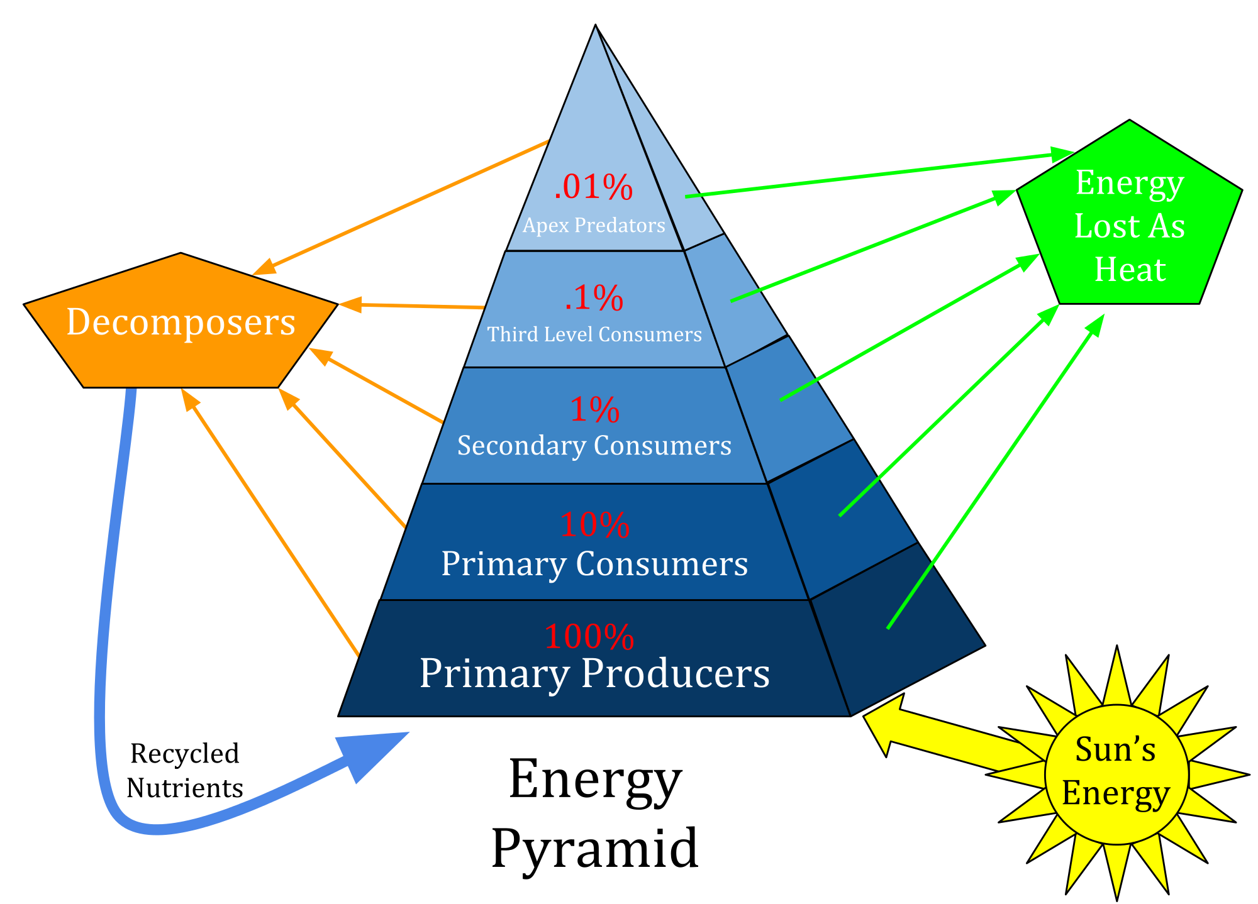
AP BIOLOGY
37
Approximately 10% of energy is tranferred between each trophic level. So, the amount of energy available at higher levels is determined by the amount contained within lower levels.
2.A.1 (f)
Free Energy
Key Terms
https://upload.wikimedia.org/wikipedia/commons/1/13/TrophicWeb.jpg

