Slide 1
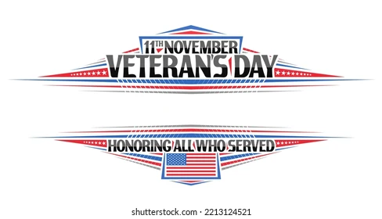
7th Grade Lesson Plan
7th Grade Lesson Plan

Slide 2
OBJECTIVES: CCSS.ELA-LITERACY.W.4.7; 5.7 Conduct short research projects that build knowledge through investigation of different aspects of a topic. CCSS.ELA-LITERACY.W.4.8 Recall relevant information from experiences or gather relevant information from print and digital sources. CCSS.ELA-LITERACY.W.5.8 Recall relevant information from experiences or gather relevant information from print and digital sources; summarize or paraphrase information in notes and finished work.
STRATEGIES: Writing Think/Pair/Share Collaboration
MATERIALS: Smart TV, Copies of the History of Armistice/Veterans Day Information Reading Activity; Copies of the History of Veterans Day Writing and Questions Worksheet
Engage: Students will complete the Veterans Day K-W-L Worksheet to produce in written form what they learned about Armistice/Veterans Day. If the students have any questions from the “What I Want to Know” section of the K-W-L worksheet, go over those questions with the class. Students will draw a timeline of the history of Veterans Day noting how Armistice Day evolved to Veterans Day, as the United States became involved in other combat operations. Students will answer questions from the History of Veterans Day Reading Activity. Students will complete the Veterans Day Word Search Puzzle.
Explore: Students will brainstorm a way to serve veterans in their local communities on Veterans Day. See the last page of this lesson plan for suggestions for service.
Evaluate: assessment. Teachers should choose which activities to use as formal/informal assessments.
Enrichment/ServiceLearning Project: Students will participate in an activity to Remember and Honor Veterans on Veterans Day. Students are encouraged to participate in the Wreaths Across America Oral History Project

Slide 3
Think/Pair/Share Worksheet: KWL
Name: _______________________________________________________________
What I KNOW What I WANT to know What I LEARNED

Slide 4
History of Armistice/Veterans Day Information Sheet
Veterans Day is a holiday in the United States observed on November 11, to honor and thank all military personnel who serve or have served in the armed forces of the United States in times of war and peace. November 11 is the anniversary of the signing of the armistice that ended World War I between the Allied nations and Germany in 1918-on the 11th hour, of the 11th day, of the 11th month.
On November 11, 1919, Armistice Day was celebrated for the first time. President Woodrow Wilson proclaimed the day should be “filled with solemn pride in the heroism of those who died in the country’s service and with gratitude for the victory.” There were plans for parades, public meetings, and a brief suspension of business activities at 11am.
In 1926, the United States officially recognized the end of World War I and declared that the anniversary of the armistice should be commemorated with prayer and thanksgiving. Congress also requested that the president should “issue a proclamation calling upon the officials to display the flag of the United States on all Government buildings on November 11 and inviting the people of the United States to observe the day in schools and churches, or other suitable places, with appropriate ceremonies of friendly relations with all other peoples.”
On May 13, 1938, Congress passed an Act, which made November 11 a legal holiday, known as Armistice Day. This day was originally intended to honor veterans of World War I. A few years later, World War II required the largest mobilization of service men in the history of the United States and the American forces fought in Korea.

Slide 5
History of Armistice/Veterans Day Information Sheet page 2
In 1954, the veterans service organizations urged Congress to change the word “Armistice” to “Veterans.” Congress approved this change and on June 1, 1954, November 11 became a day to honor all American veterans, wherever and whenever they had served. In 1968, Congress passed the Uniform Monday Holiday Act, which sought to ensure three-day weekends for federal employees—and encourage tourism and travel—by celebrating four national holidays (Washington’s Birthday, Memorial Day, Veterans Day, and Columbus Day) on Mondays. The observation of Veterans Day was set as the fourth Monday in October. The first Veterans Day under the new law was Monday, October 25, 1971; confusion ensued, as many states disapproved of this change, and continued to observe the holiday on its original date.
In 1975, after it became evident that the actual date of Veterans Day carried historical and patriotic significance to many Americans, President Gerald Ford signed a new law returning the observation of Veterans Day to November 11th beginning in 1978.
Veterans Day is observed in many places by parades and ceremonies. Other places have a period of silence lasting two minutes at 11am. Some schools are closed on Veterans Day. Other schools do not close but choose to mark the occasion with special assemblies and other activities.

Slide 6
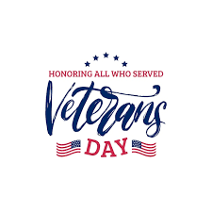
History of Armistice/Veterans Day Information Sheet page 3
Veterans Day is officially observed on November 11. However, if it falls on a weekday, many communities hold their celebrations on the weekend closest to this date. This is to enable more people to attend and participate in the events. Federal Government offices are closed on November 11. If Veterans Day falls on a Saturday, they are closed on Friday November 10. If Veterans Day fall on a Sunday, they are closed on Monday November 12.
Every Veterans Day, Arlington National Cemetery holds an annual memorial service. The cemetery is home to graves of over 400,000 people, most of whom served in the military. The difference in Veterans Day and Memorial Day, Memorial Day pays tribute to all American veterans who have died. Great Britain, France, Australia, and Canada also commemorate the veterans of World War I and II on or near November 11th: Canada has Remembrance Day, while Britain has Remembrance Sunday (the second Sunday of November). In Europe, Great Britain, and the Commonwealth countries it is common to observe two minutes of silence at 11 a.m. every November 11.

Slide 7
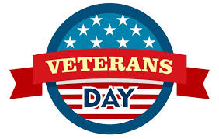
Name____________________________________
Veterans Day Timeline
1. Create a timeline on the back of this paper illustrating the key events in the history of Veterans Day. For each event, write a brief explanation about why it is important.
2. Answer the following questions:
• Why does Veterans Day take place on November 11 each year? ________________________________________________________________________________
________________________________________
• Veterans Day was originally known as Armistice Day. Why was this changed? ________________________________________________________________________________
________________________________________
• Is Veterans Day celebrated in other countries? If so, when? ________________________________________________________________________________
________________________________________
• What’s the difference between Veterans Day and Memorial Day?____________________________________________________________________________________________________________________

Slide 8
