Slide 1
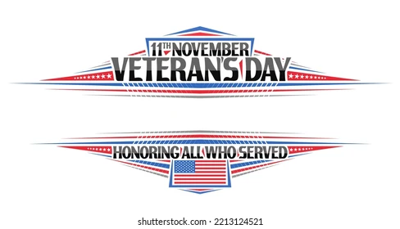
6th Grade Lesson Plan

Slide 2
OBJECTIVES: CCSS.ELA-LITERACY.W.4.7; 5.7 Conduct short research projects that build knowledge through investigation of different aspects of a topic. CCSS.ELA-LITERACY.W.4.8 Recall relevant information from experiences or gather relevant information from print and digital sources. CCSS.ELA-LITERACY.W.5.8 Recall relevant information from experiences or gather relevant information from print and digital sources; summarize or paraphrase information in notes and finished work.
STRATEGIES: Writing Think/Pair/Share Collaboration
MATERIALS: Smart TV, Copies of the K-W-L Worksheet; Copies of the Veterans Day Word Search Puzzle
Engage: Hand out the Veterans Day K-W-L. Allow students time to fill in the first and second section of the K-W-L worksheet. Before playing the video clip, tell the students to take notes during the video, this information can go in the “L” column of their K-W-L worksheet. Play the YouTube video, What Does Being a Veteran Mean to You? https://youtu.be/floZanYgCTk After viewing the video, ask students to share with the rest of the class one thing they learned about veterans from the video.
Explore: Students will brainstorm a way to serve veterans in their local communities on Veterans Day. See the last page of this lesson plan for suggestions for service.
Evaluate: assessment. Teachers should choose which activities to use as formal/informal assessments.
Enrichment/ServiceLearning Project: Students will participate in an activity to Remember and Honor Veterans on Veterans Day. Students are encouraged to participate in the Wreaths Across America Oral History Project

Slide 3
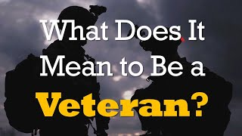

Slide 4
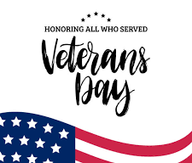
Think/Pair/Share Worksheet: KWL
Name: _______________________________________________________________
What I KNOW What I WANT to know What I LEARNED

Slide 5
