Slide 1
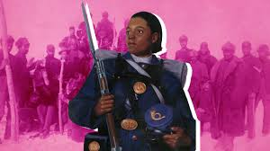
Cathay Williams
Buffalo Soldier

Slide 2
Veterans Day November 11th
OBJECTIVES: CCSS.ELA-LITERACY.W.4.7; 5.7 Conduct short research projects that build knowledge through investigation of different aspects of a topic. CCSS.ELA-LITERACY.W.4.8 Recall relevant information from experiences or gather relevant information from print and digital sources. CCSS.ELA-LITERACY.W.5.8 Recall relevant information from experiences or gather relevant information from print and digital sources; summarize or paraphrase information in notes and finished work.
STRATEGIES: Writing Think/Pair/Share Collaboration
MATERIALS: Smart TV, Copies of The Story of Cathay Williams,Copies of Reading Comprehension Questions, movie short
Engage: Think/Pair/Share Activity- Pair the students with a partner. Explain the T/P/S directions. The students will think of their answer, get with their partner, and share their answer. Explain to students: a veteran is a person who has served in the military. T/P/S Questions: What do you think of when you hear the word veteran? Do you have family members who have served in the military? Are any of them female? Explain women could not officially serve in the military until 1948. Out of the 19 million veterans in the United States today, 2 million are women. But the formal legislation allowing women into the military was not passed until 1948 (even though tens of thousands had served in both world wars, and women like Harriet Tubman and Mary Walker had served in the Civil War as nurses, spies, and even soldiers disguised as men like the woman you will learn about today).
Explore: Students will read the story of Cathay Williams. When the students have completed reading the text, the students will complete the Reading Comprehension Questions Worksheet.
Evaluate: assessment. Teachers should choose which activities to use as formal/informal assessments.
Enrichment/ServiceLearning Project: Students will participate in an activity to Remember and Honor Veterans on Veterans Day. Students are encouraged to participate in the Wreaths Across America Oral History Project

Slide 4
Female Veterans-The Story of Cathay Williams
Directions: Read both of the following text passages. Answer the Reading Comprehension questions that follow.
The Story of Cathay Williams aka William Cathay Cathay Williams had many “firsts” in her lifetime. As far as we know, she was the first African American woman to secretly join the United States Army when she enlisted on November 15, 1866. Since females were still not allowed to enter the Armed Forces at that time, she joined under the fake name William Cathay. She was the first and only woman to fight in the unit nicknamed the Buffalo Soldiers.
Born in Missouri in 1842, Williams was a slave until the Civil War broke out in the spring of 1861. During the war, captured slaves were forced to work for the military as support staff, like nurses and cooks. Therefore, Williams worked as a cook and washerwoman. She marched with the infantry during the Civil War. After the Civil War, she was no longer a slave. She had to support herself financially.
Joining the Army as a soldier seemed like a good line of work for Williams. In 1866, soon after the Civil War ended, a new law started the first peacetime units of African American male soldiers in the U.S. Army. These units would later be called the Buffalo Soldiers. These soldiers had great riding skills and participated in long, hard marches. The Buffalo Soldiers participated in wars and peacetime activities in the Great Plains. This new law opened the door for Williams to pretend to be a man and join the Army.

Slide 5
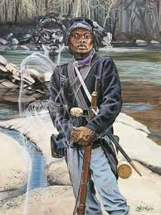
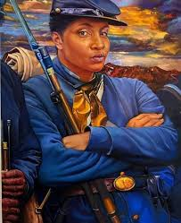
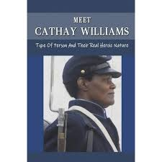
Soon after she enlisted as William Cathay, she contracted smallpox, which was a common viral disease at the time. During multiple hospitalizations, no one discovered she was female until she got sick in New Mexico. The surgeon located in Fort Bayard discovered her secret. Once her commanding officer learned she was female, she was honorably discharged due to a disability. After her discharge in New Mexico, she worked odd jobs as a cook, laundress, and seamstress in that same state.
While Cathay Williams had a lot of firsts in her life, she was more than those facts. She was a gutsy woman. She served her country and did all she could to survive after slavery. After Congress passed the Women’s Armed Services Integration Act on June 12, 1948, women could finally join the military. They could be full-time service members. Women like Cathay Williams, with their competent service, helped pave the way for future female heroes to serve their country as well. Even though Williams served in the Army under a fake name, she is still a veteran worthy of gratitude for her service.

Slide 6
Name_____________________________________
Reading Comprehension Questions/ Female Veterans/ The Story of Cathay Williams 6. Why is it important to know Hook was a female service member in 1861? 8. Why do you think the author wrote about Hook?
1. What obstacle(s) did Cathay Williams face?
2. What influence did the obstacle(s) have on Williams’ life decisions?
3. Why is it important to know Williams was a female service member in 1866?
4. Why do you think the author wrote about Williams?
5. How /what do you think you would have done in this situation?

Slide 7
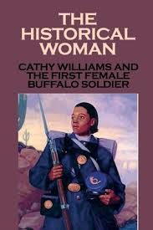
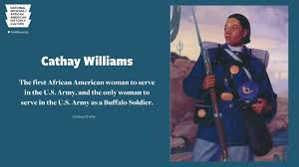
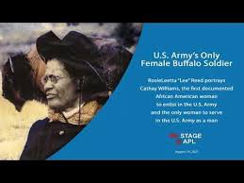
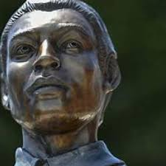
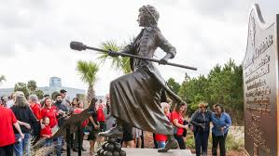
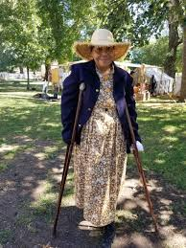
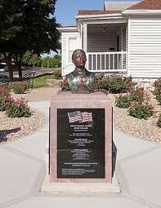
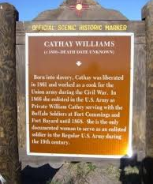

Slide 8
“Find a Way to Serve” on Veterans Day
• Make Thank You cards to Veterans you know in your community, or in a local VA Home or VA Hospital. Let them know you appreciate their service to our country.
• Help an elderly veteran with yard work.
• Collect items for “Survival Back-Packs” for homeless veterans with socks, caps, gloves, toothpaste, a toothbrush, and other toiletries to be distributed to homeless vets in your community. Many large cities
hold Operation Stand Downs for Veterans.
• Organize a Checkers, board game or card game tournament at your local VA Home. Coordinate with the nursing home staff and plan a fun afternoon for the residents and students alike!
• Write letters to be included in soldier care packages. Operation Gratitude sends over 250,000 packages to Servicemen and Women, and First Responders annually, the link above provides guidelines for participation in their program.
• Organize a Zoom Meeting between your class at school and a local VA Home. Discuss what their childhoods were like growing up, what kind of classes they took in school. Did they live in town or in the country, what kinds of chores and activities did they participate in when they were your age. Document their responses and share with other classes in your school. If some of your interviewees have a talent like singing or playing the piano, maybe they could share those talents with the class the next time you Zoom. Once you have met the veterans, select a “pin-pal” you can correspond with by letter every few weeks.
• Be a companion to a local senior citizen who is a veteran. Make cards, surprise them with visits around their birthday or sing carols for them around the holidays.

