Slide 1
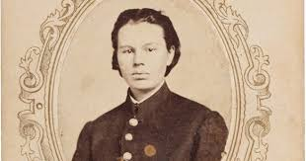
Frances Hook
Union Soldier

Slide 2
Veterans Day November 11th
OBJECTIVES: CCSS.ELA-LITERACY.W.4.7; 5.7 Conduct short research projects that build knowledge through investigation of different aspects of a topic. CCSS.ELA-LITERACY.W.4.8 Recall relevant information from experiences or gather relevant information from print and digital sources. CCSS.ELA-LITERACY.W.5.8 Recall relevant information from experiences or gather relevant information from print and digital sources; summarize or paraphrase information in notes and finished work.
STRATEGIES: Drawing/Coloring Writing Think/Pair/Share Collaboration
MATERIALS: Smart TV, Copies of The Story of Frances Hook,Copies of Reading Comprehension Questions, movie short
Engage: Think/Pair/Share Activity- Pair the students with a partner. Explain the T/P/S directions. The students will think of their answer, get with their partner, and share their answer. Explain to students: a veteran is a person who has served in the military. T/P/S Questions: What do you think of when you hear the word veteran? Do you have family members who have served in the military? Are any of them female? Explain women could not officially serve in the military until 1948. Out of the 19 million veterans in the United States today, 2 million are women. But the formal legislation allowing women into the military was not passed until 1948 (even though tens of thousands had served in both world wars, and women like Harriet Tubman and Mary Walker had served in the Civil War as nurses, spies, and even soldiers disguised as men like the woman you will learn about today).
Explore: Students will read the story of Frances Hook. When the students have completed reading the text, the students will complete the Reading Comprehension Questions Worksheet.
Evaluate: assessment. Teachers should choose which activities to use as formal/informal assessments.
Enrichment/ServiceLearning Project: Students will participate in an activity to Remember and Honor Veterans on Veterans Day. Students are encouraged to participate in the Wreaths Across America Oral History Project

Slide 4
Female Veterans-The Story of Frances Hook
The Story of Frances Hook aka Private Frank Miller Frances Hook was born in Illinois in 1847. When she was three years old both of her parents died, leaving only her and her older brother, who brought her up until the start of the Civil War.
At the time the Civil War began, Hook and her brother were living in Chicago, Illinois. When her brother decided to enlist in the Union Army. Hook, not wanting to be left alone, decided to disguise herself as a man and enlisted with her brother. When Hook claimed to have enlisted in the Union Army, she was fourteen years old, but says she told recruiters she was twentytwo. She cut her hair and enlisted in the 11th Illinois Infantry Regiment (or the 65th Illinois Home Guard depending on the source) using the alias Private Frank Miller on April 30, 1861. Hook and her brother served their 90-day term without being discovered.
On July 30, 1861, Hook, and her brother re-enlisted in the 11th Illinois Infantry for three more years. Their regiment fought at Fort Henry, Fort Donelson, and then at the Battle of Shiloh (April 6–7, 1862) where Hook's brother was killed. Hook was so devastated by her brother's death that she could no longer bear to serve in the same regiment he had died in. However, Hook wished to continue her military service. Under a new alias, Frank Henderson, she enlisted in the 33rd Illinois Infantry regiment. After a few months of service, she was wounded in the shoulder at the Battle of Fredericktown (October 21, 1861, Missouri. While being treated at the regimental hospital the doctor discovered her sex; she was discharged from the army and told to go home.

Slide 5
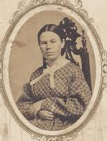
Having no family to go home to, Hook enlisted in the 90th Illinois Infantry Regiment. While serving in the 90th Infantry (fighting quite often), the regiment saw combat at Holly Springs, Coldwater, the Siege of Vicksburg, the Siege of Jackson, and Missionary Ridge. The regiment was marching through Florence, Alabama in the late summer of 1863. While on the march Hook entered a seemingly empty house to search for supplies; while she was searching, two Confederate soldiers hiding in the house surprised and captured her.
Hook was imprisoned, as a man, in Atlanta, Georgia. Soon after her imprisonment she attempted an escape but was shot in the thigh and taken to the prison hospital. While being treated another doctor discovered her true sex. Hook was moved to a separate room and put on a list of prisoners to be exchanged. On February 17, 1864, Hook was one of twenty-seven Union prisoners exchanged at Graysville, Georgia.
During her imprisonment she told her story to Confederate doctors and officers. The Confederacy was so impressed by her actions she received a letter from Confederate President Jefferson Davis offering her a commission if she would fight for the Confederate army.
Hook refused stating she would rather serve in the Union Army as a private than
in the Confederate army as a lieutenant. She went on to state she would rather be
hanged than fight against the Union.

Slide 6
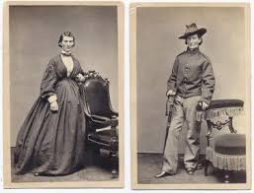
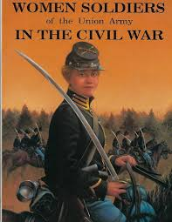
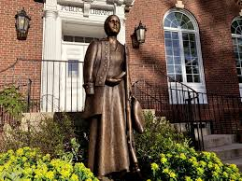
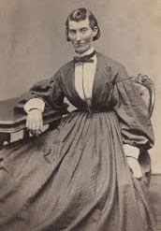
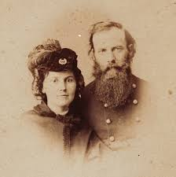
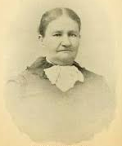
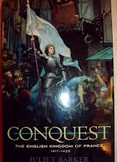

Slide 7
Name_____________________________________
Reading Comprehension Questions/ Female Veterans/ The Story of Frances Hook
1. What obstacle(s) did Frances Hook face?
2. What influence did the obstacle(s) have on Hook’s life decisions?
3. Why is it important to know Hook was a female service member in 1861?
4. Why do you think the author wrote about Hook?
5. How /what do you think you would have done in this situation?

Slide 8
“Find a Way to Serve” on Veterans Day
• Make Thank You cards to Veterans you know in your community, or in a local VA Home or VA Hospital. Let them know you appreciate their service to our country.
• Help an elderly veteran with yard work.
• Collect items for “Survival Back-Packs” for homeless veterans with socks, caps, gloves, toothpaste, a toothbrush, and other toiletries to be distributed to homeless vets in your community. Many large cities
hold Operation Stand Downs for Veterans.
• Organize a Checkers, board game or card game tournament at your local VA Home. Coordinate with the nursing home staff and plan a fun afternoon for the residents and students alike!
• Write letters to be included in soldier care packages. Operation Gratitude sends over 250,000 packages to Servicemen and Women, and First Responders annually, the link above provides guidelines for participation in their program.
• Organize a Zoom Meeting between your class at school and a local VA Home. Discuss what their childhoods were like growing up, what kind of classes they took in school. Did they live in town or in the country, what kinds of chores and activities did they participate in when they were your age. Document their responses and share with other classes in your school. If some of your interviewees have a talent like singing or playing the piano, maybe they could share those talents with the class the next time you Zoom. Once you have met the veterans, select a “pin-pal” you can correspond with by letter every few weeks.
• Be a companion to a local senior citizen who is a veteran. Make cards, surprise them with visits around their birthday or sing carols for them around the holidays.

