Slide 1
Self Control
Standard: Manages Overwhelming Thoughts or Emotions

Slide 2
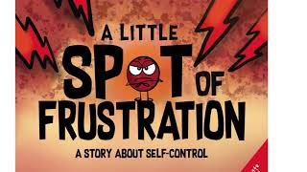
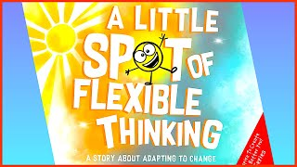
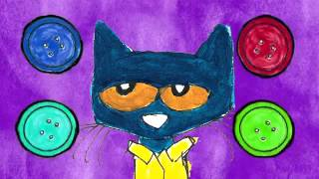
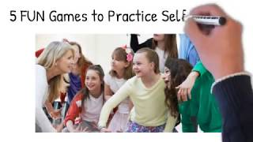

Slide 3
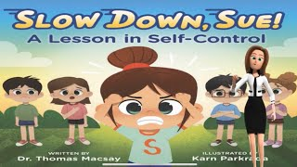
Building Empathy for Kids Gr 3-6

Slide 4
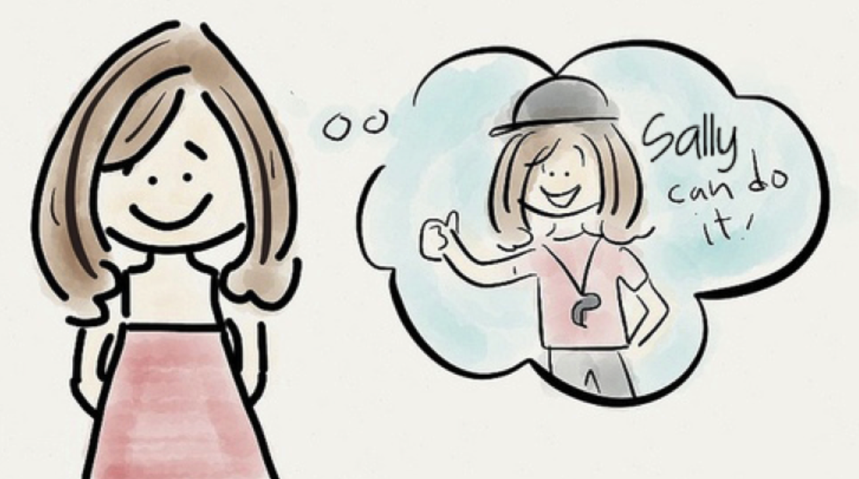
VOCABULARY
Manages Overwhelming Thoughts & Emotions
thoughts: ideas unique to the
person who thinks them; opinions
or ideas created by thinking
Inner voice: the way you talk
To yourself in your mind
obsessive: thinking about the
Same thought over and over again, leading to constant worrying

Slide 5
VOCABULARY
Manages Overwhelming Thoughts & Emotions
Emotional trigger: the way you talk
To yourself in your mind
Emotional self-regulation ideas unique to the
person who thinks them; opinions
or ideas created by thinking

Slide 6
VOCABULARY
Manages Overwhelming Thoughts & Emotions
focus: to give all your attention
to someone or something
calm: a feeling of calm, ease, quiet,
relaxation and peace

Slide 7
Self Control…

