Slide 1
RESPONSIBILITY
Standard/Theme-Holds Oneself Accountable

Slide 2
Responsibility
Elementary K-2
Standard:
Selects the Best Option Among Choices For Suitable Outcome

Slide 3
GK-2

Slide 4
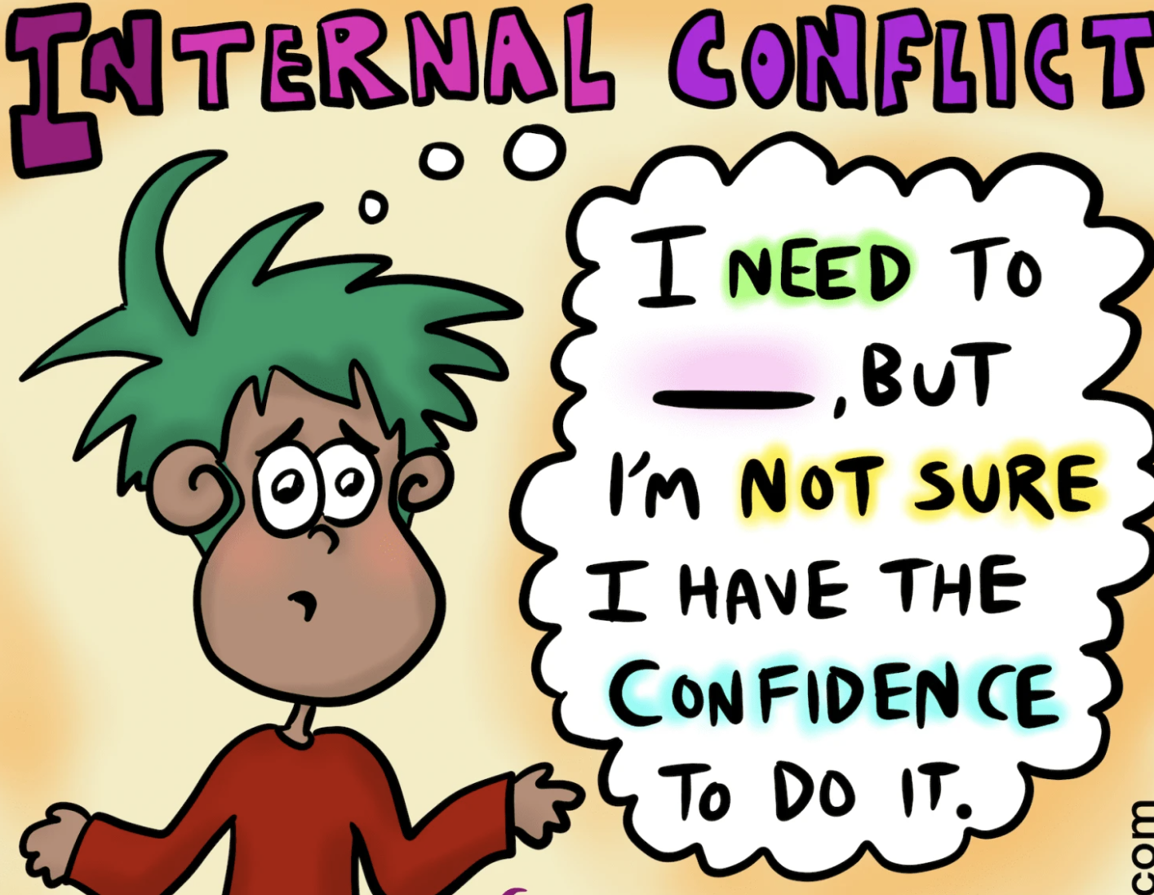
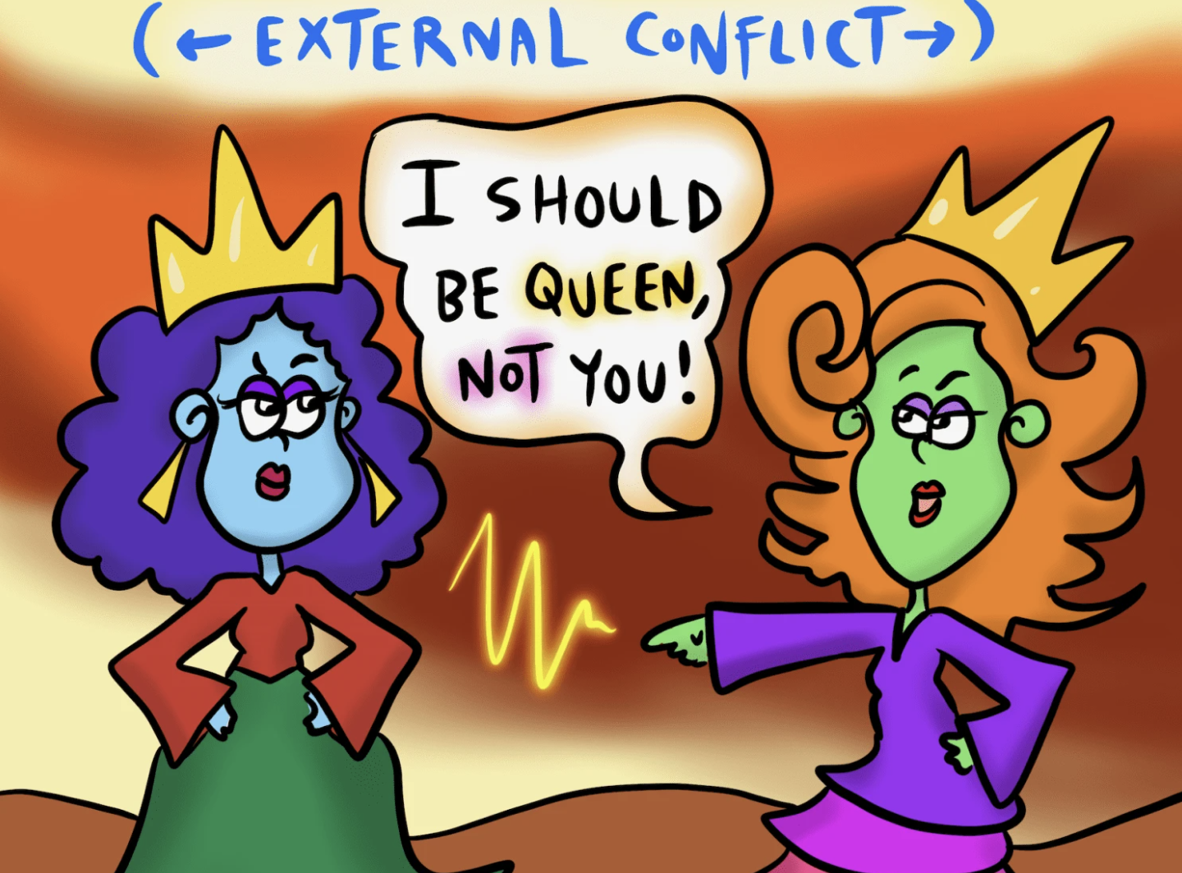
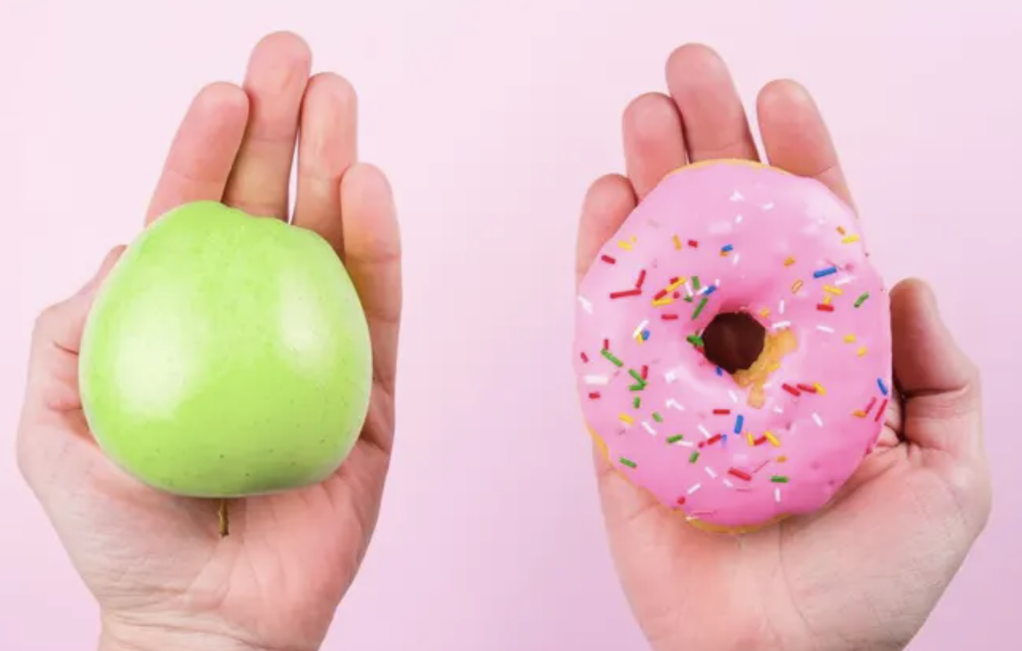
Vocabulary
Selects the Best Option Among Choices for a Suitable Outcome
Internal conflict: conflicting desires, wants, or beliefs that cause a struggle within oneself
External conflict:a struggle between individual and another person
Choice: selecting when given multiple options
Responsibility: a duty, task, or expectation someone must fulfill or meet

Slide 7
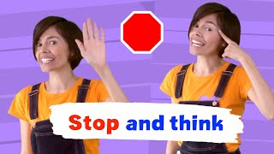
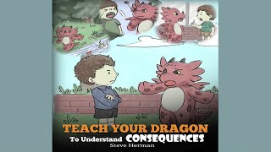
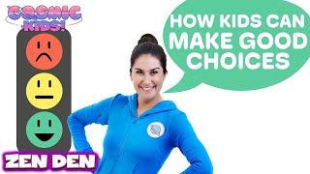
Videos & Read Alouds - Selects the Best Option Among Choices for a A Suitable Outcome
Good Choices Gr PreK/K
The Choices I Make Gr Prek/K
Stop & think Gr PreK/K
Teach Your Dragon To Understand Consequences Gr K-2
How To Make Good Choices Gr K-5
The Power To Choose Gr: 3-8
EPIC-Making Good Choices Gr K-2
PebbleGo Making Choices K-3

Slide 9
Responsibility
Upper Elementary 3-4
Middle School 5-8
Standard:
Selects the Best Option Among Choices For Suitable Outcome

Slide 10
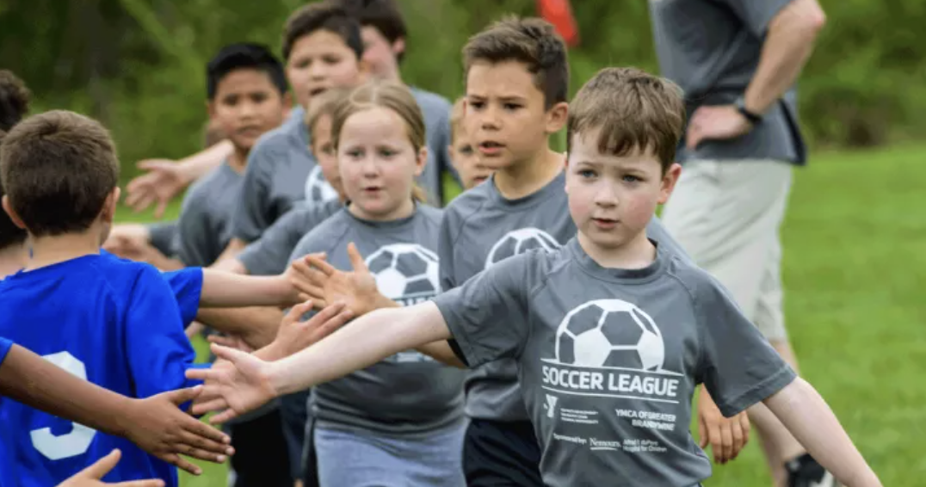
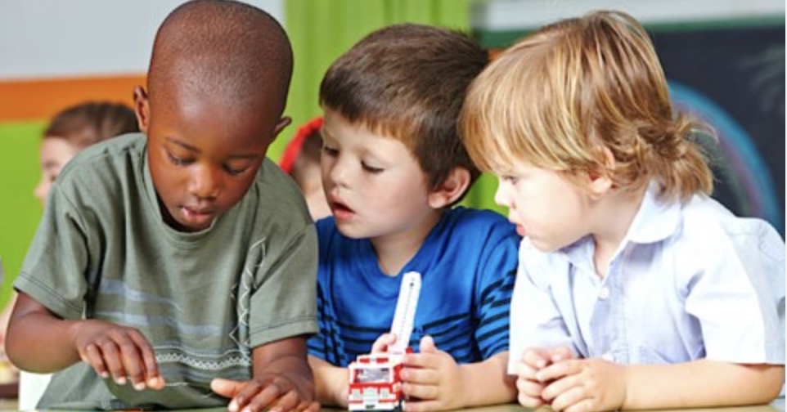
Vocabulary
Selects the Best Option Among Choices For A Suitable Outcome
G3/4
Consequence (n.): the results or
outcome of an action or decision
Outcome (n.): the end result
Planner (n.) a list, a chart or
notebook to write down
important tasks, information
and schedules
Prioritize (v.): organizing items
in order of importance

Slide 11
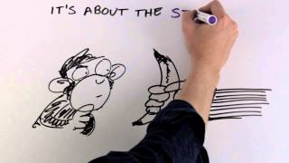
Videos & Read Alouds - Selects the Best Option Among Choices for a A Suitable Outcome
Responsibility Affirmations G 3/4
Stop & think Gr PreK/K
How To Make Good Choices Gr K-5
The Power To Choose Gr: 3-8
Responsibility Gr 3/4

Slide 12
Imani’s Sure Thing Student Journal Gr 3 (SJ 81-84) Read Aloud
G3/4
Discussion Questions:
What did Imani’s mother tell her to remember to do at school?
What did Imani and her family have to do later that evening?
Why did Imani say “Sure Thing” each time someone told her to remember something?
Student Journal Gr 3(SJ 85) Imani’s Sure Thing Scramble
Have you ever felt overwhelmed with responsibilities
How could using a planner or reminders be helpful

Slide 14
G5-8

Slide 15
*Navigating pressures from other people, as well as our own personal pressure to do the right and safe thing can be tricky.
Read Aloud (SJ GR5 67-68) SJ 69 Making Safe Choices

Slide 16
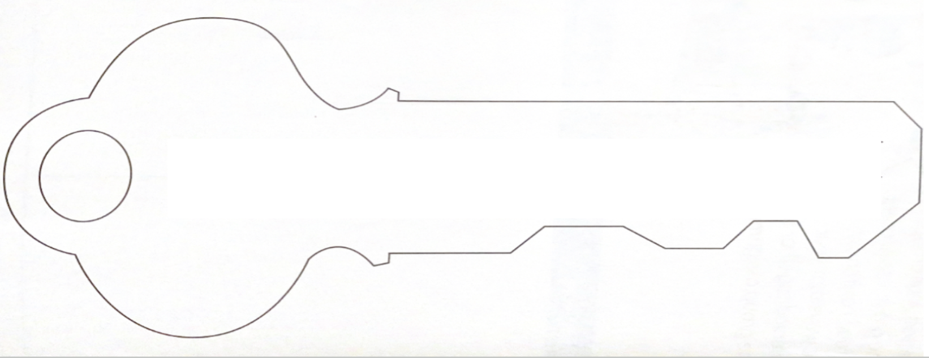
Keys to Making Safe Decisions
Stay Calm: Find ways to maintain your cool while you come to the best choice.
Pay Attention: Listen and observe what is going on around you to know how to avoid harm.
Trust Yourself: Stay strong to trust your gut and don’t be influenced to make bad choices that could harm you or someone else.
Think it Through: Take your time to thin the situation or problem through completely before making a decision.

