Slide 1
Empathy
Standard: Recognizes and Manages One’s Own Emotions and Recognized the Emotions of Others

Slide 2
EMPATHY
K-2

Slide 3
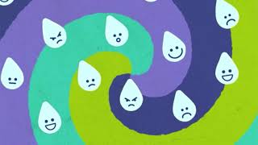
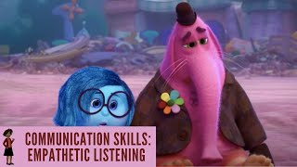
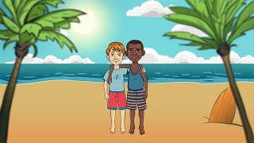
A Little Spot of Empathy Prek-3
The Empathy Song Prek/K
Empathy is Your SuperPower Gr K-3
Empathy is My SuperPower Gr K-3
Empathetic Listening Prek-6
Building Empathy for Kids Gr 3-6

Slide 6
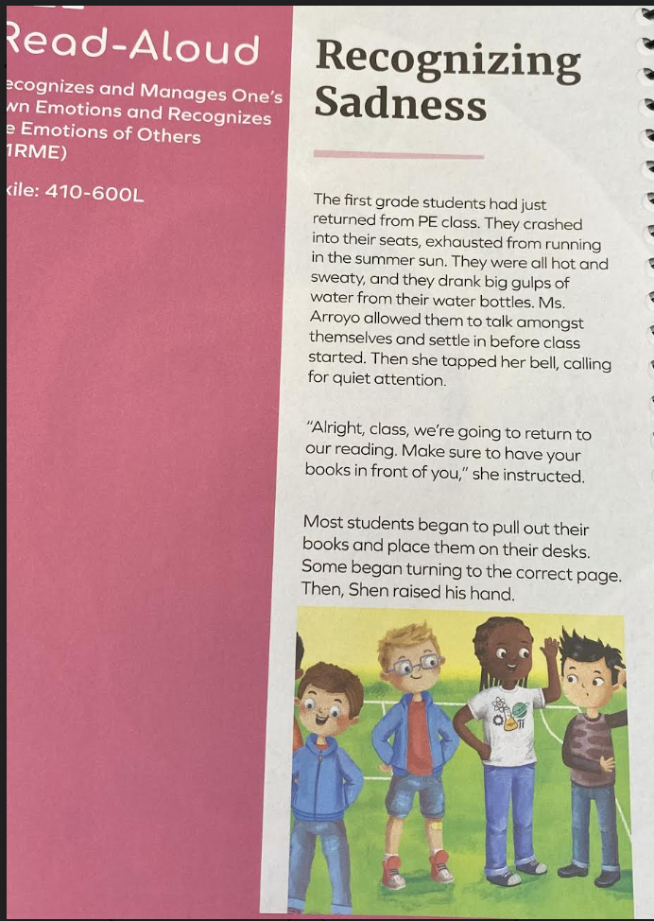
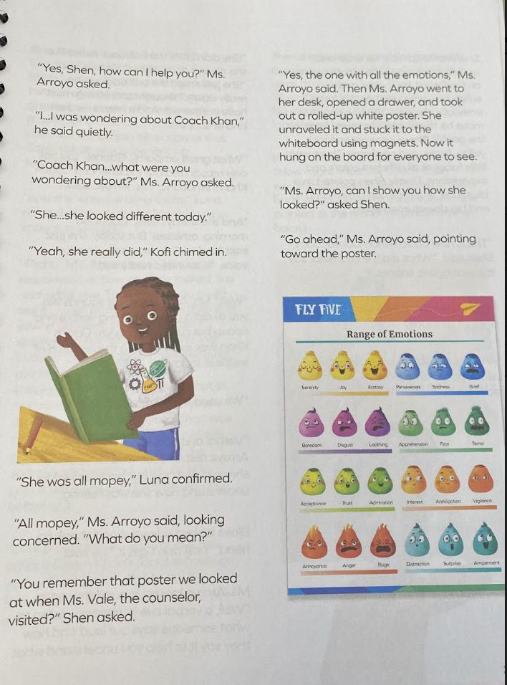

Slide 7
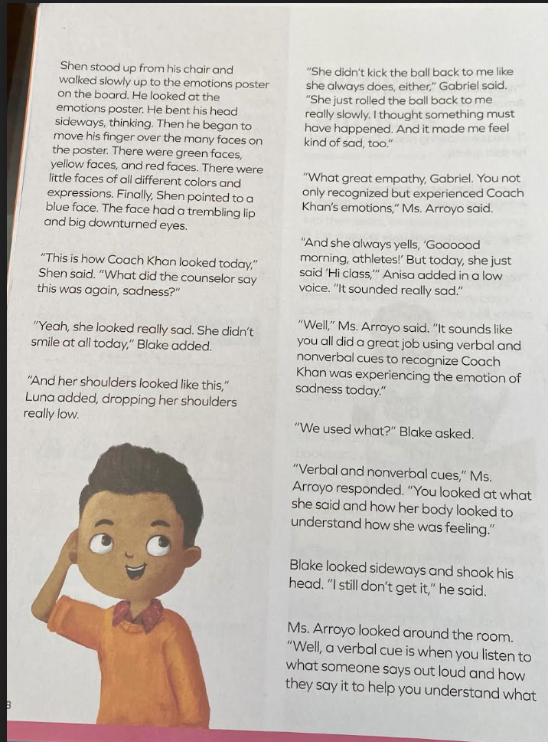
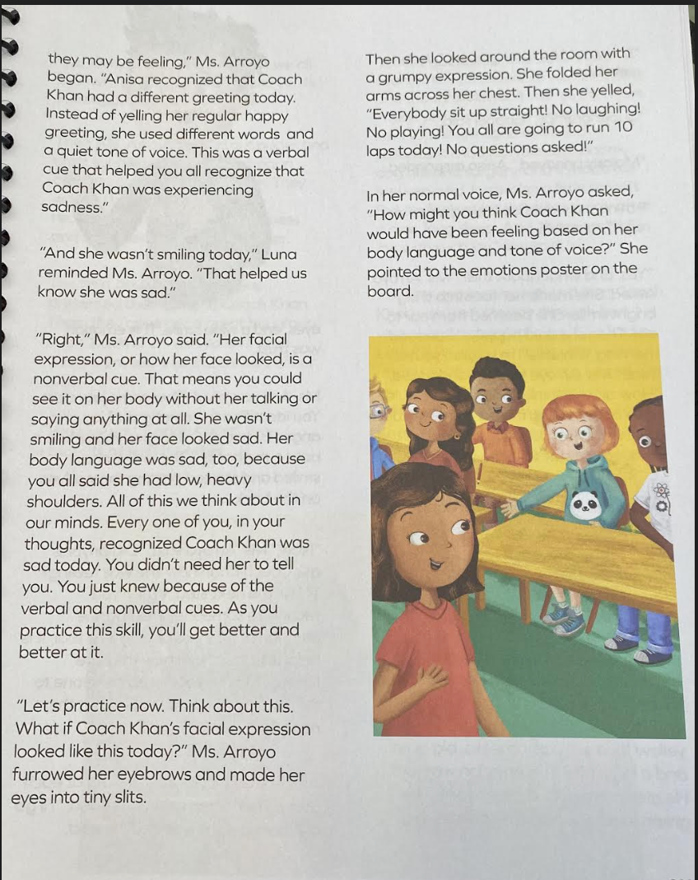

Slide 8
EMPATHY
GR 3-6

Slide 9
All About Empathy (for kids!)
ALL ABOUT EMPATHY FOR KIDS
A Little Spot of Empathy
Empathy is Your SuperPower Gr K-3
Empathy is My SuperPower Gr K-3
Empathetic Listening Prek-6
Building Empathy for Kids Gr 3-6

Slide 10
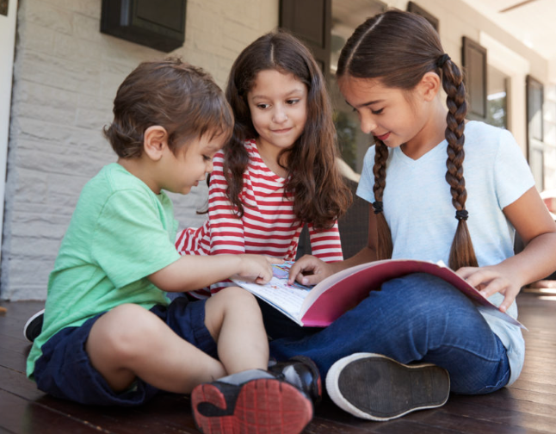
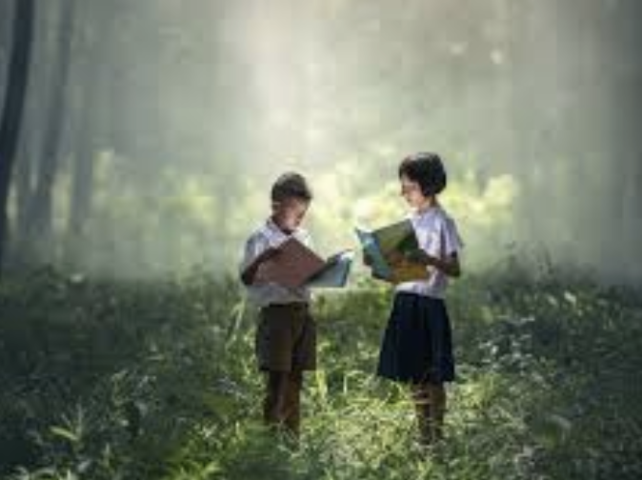
VOCABULARY
impact: the powerful effect that
something has on somebody or
something.
Outside factor: persuasive efforts conditions or situations that somehow affect behaviors, emotions, and opinions.

Slide 11
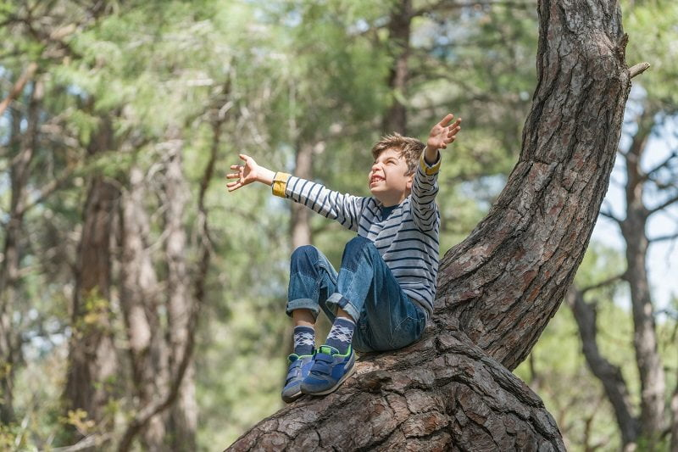
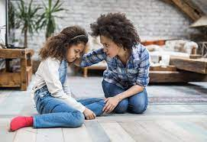
VOCABULARY
grounded: the state of being present and paying attention to surroundings.
uncertain: persuasive efforts, conditions, or situations that someone cannot control that affect behavior, emotion, and opinions

