Slide 2
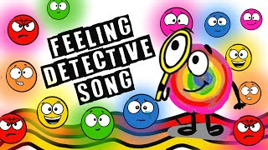
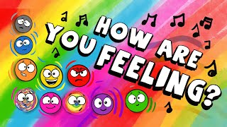
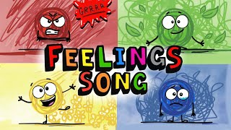
A Little Spot of Feelings Read Aloud 8:17
Feelings Detective Song 2:34
How Are You Feeling Song 2:34
Kids Feelings and Emotions SONG

Slide 3
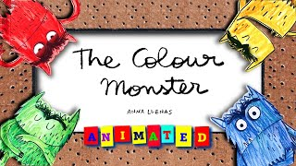
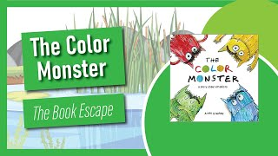
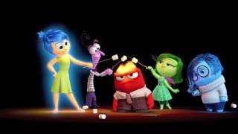
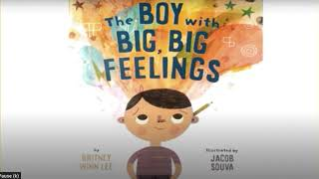
The Color Monster Animated Read Aloud 5:02
The Color Monster Read Aloud 2:49
Inside Out: Guessing the feelings 3:16
The Boy with Big, Big Feelings Read Aloud 4:33

Slide 4
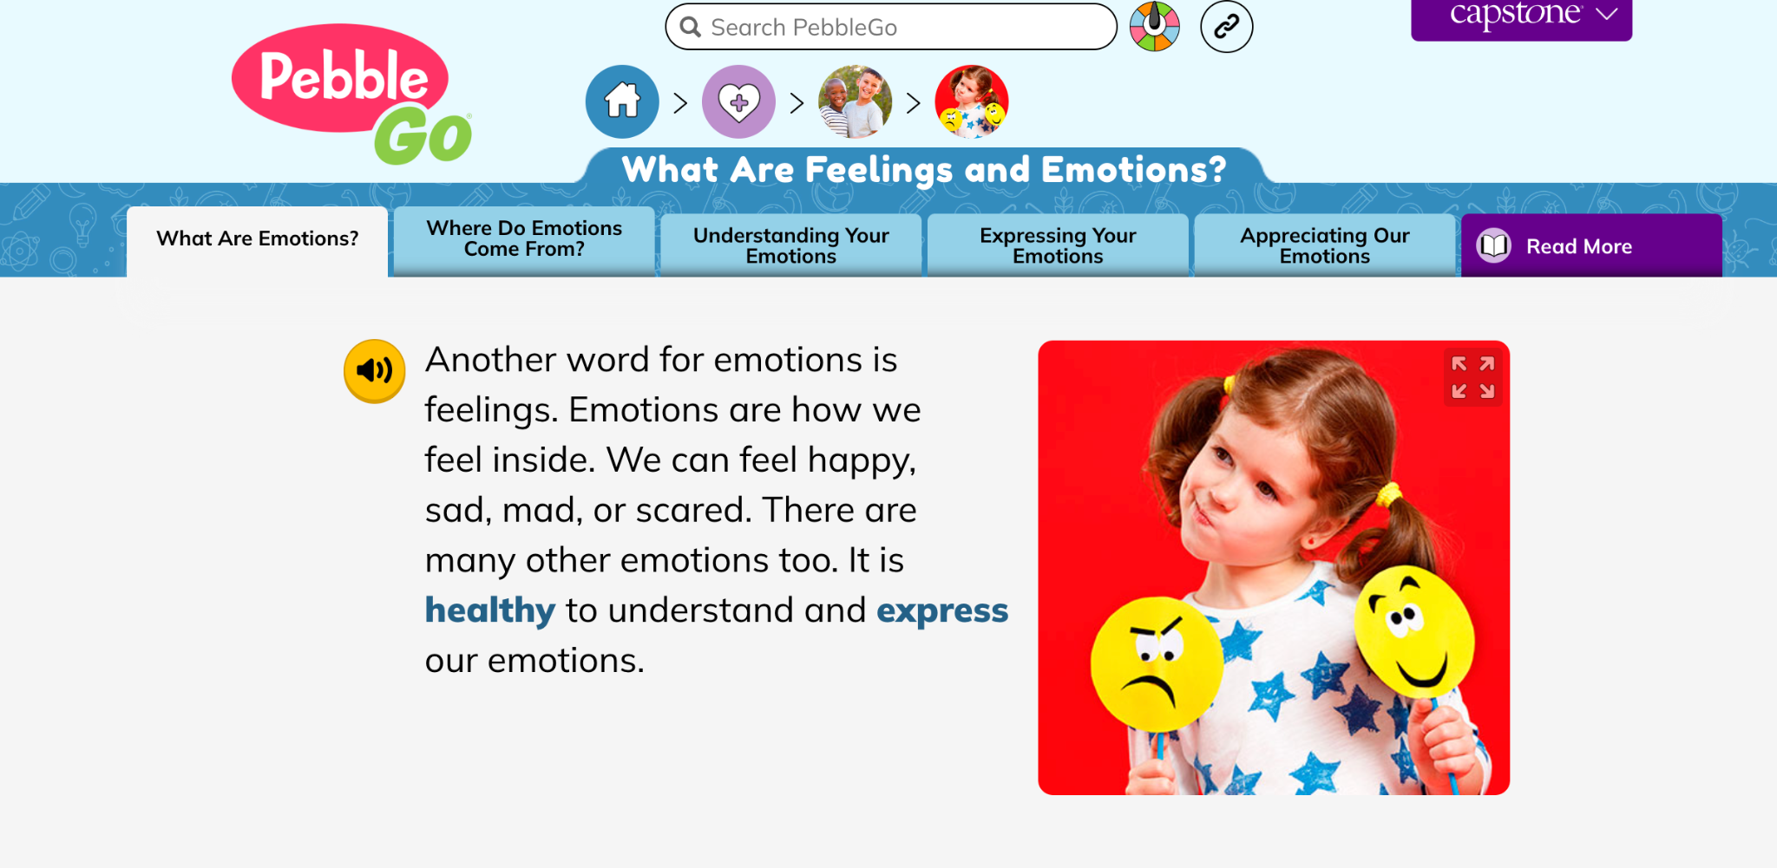
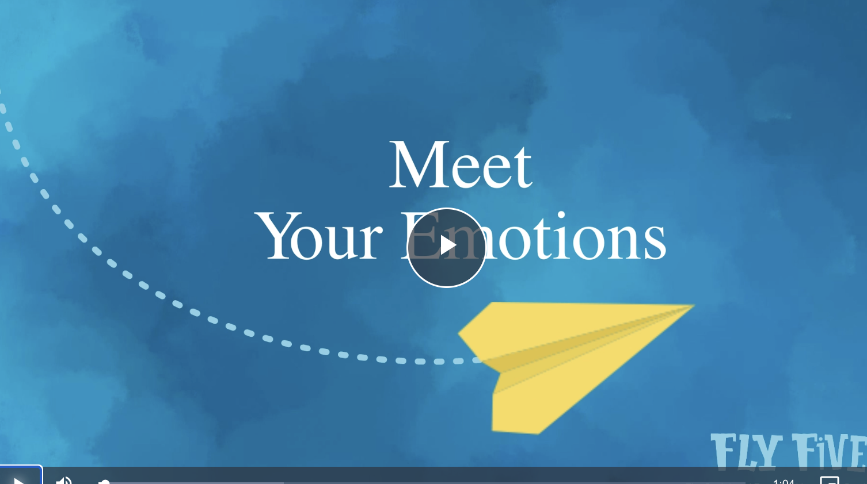
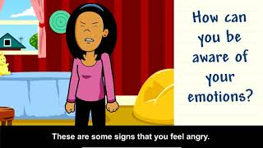
https://pgoplayer.pebblego.com/articles/10441?sqs=d811fc3032ff3abc265eaa2e60efb6d41234b44c5f5624165f2de6434a971f74
https://www.flyfivesel.org/video/mindfulness-and-your-emotions/
*Use the link above to access video 1:04
What are Emotions?- Brainpop Jr. 4:56

Slide 15
*Click on the links below to play the Boom Decks
Identical Matching Emotions Gr: Prek/K
How Would You Feel? Gr: K-6
Emotions ID-happy-sad-mad Gr: Prek-2
Match the Emoji Emotions Memory Game Gr: 4-6
Emotions ID-real photo Gr: K-3
Making inferences about emotions using pictures Gr: 4-6
Matching Feelings/Emotions Gr: 2-4
ID How & Why Emotions w/ Visual prompts Gr: 4-6

