Slide 1
Cooperation

Slide 2
Cooperation-Relationship Skills
The ability to establish new relationships, to maintain positive relationships and friendships, to avoid social isolation, to resolve conflicts, to accept differences, and to be a contributing member of the classroom and community in which one lives, works, learns, and plays.
1. Able to make and keep friends.
2. Works with others toward a common goal.
3. Resolves differences quickly.
4. Cooperates as a group leader or a member of the group.
5. Exhibits helpfulness.

Slide 3
Cooperation
Read Aloud Stories
1. Able to make and keep friends.
Sharing & Taking Turns Read Aloud
Two Headed Monster Takes Turns
Julia Learns to Take Turns
A Little Spot Makes Friends
A Little Spot of Belonging
Being A Good Friend SEL Lesson Healthy Friendships & Relationships
2. Works with others toward a common goal.
The Train Rolls On
TEAMWORK Isn't My Thing & I Don't Like to Share

Slide 4
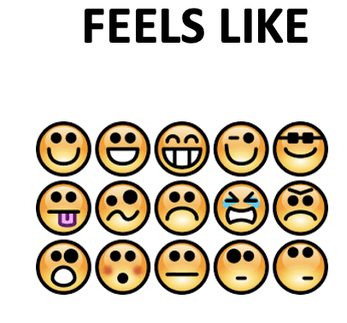

Slide 5
G1
GK/1

Slide 6
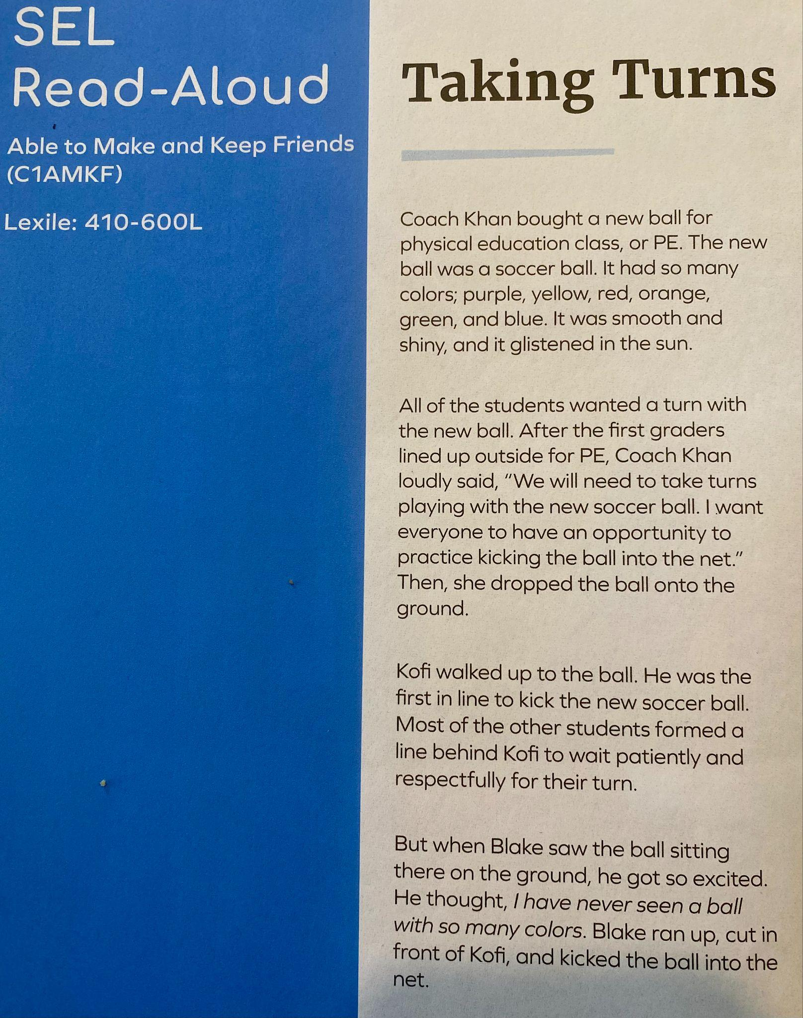
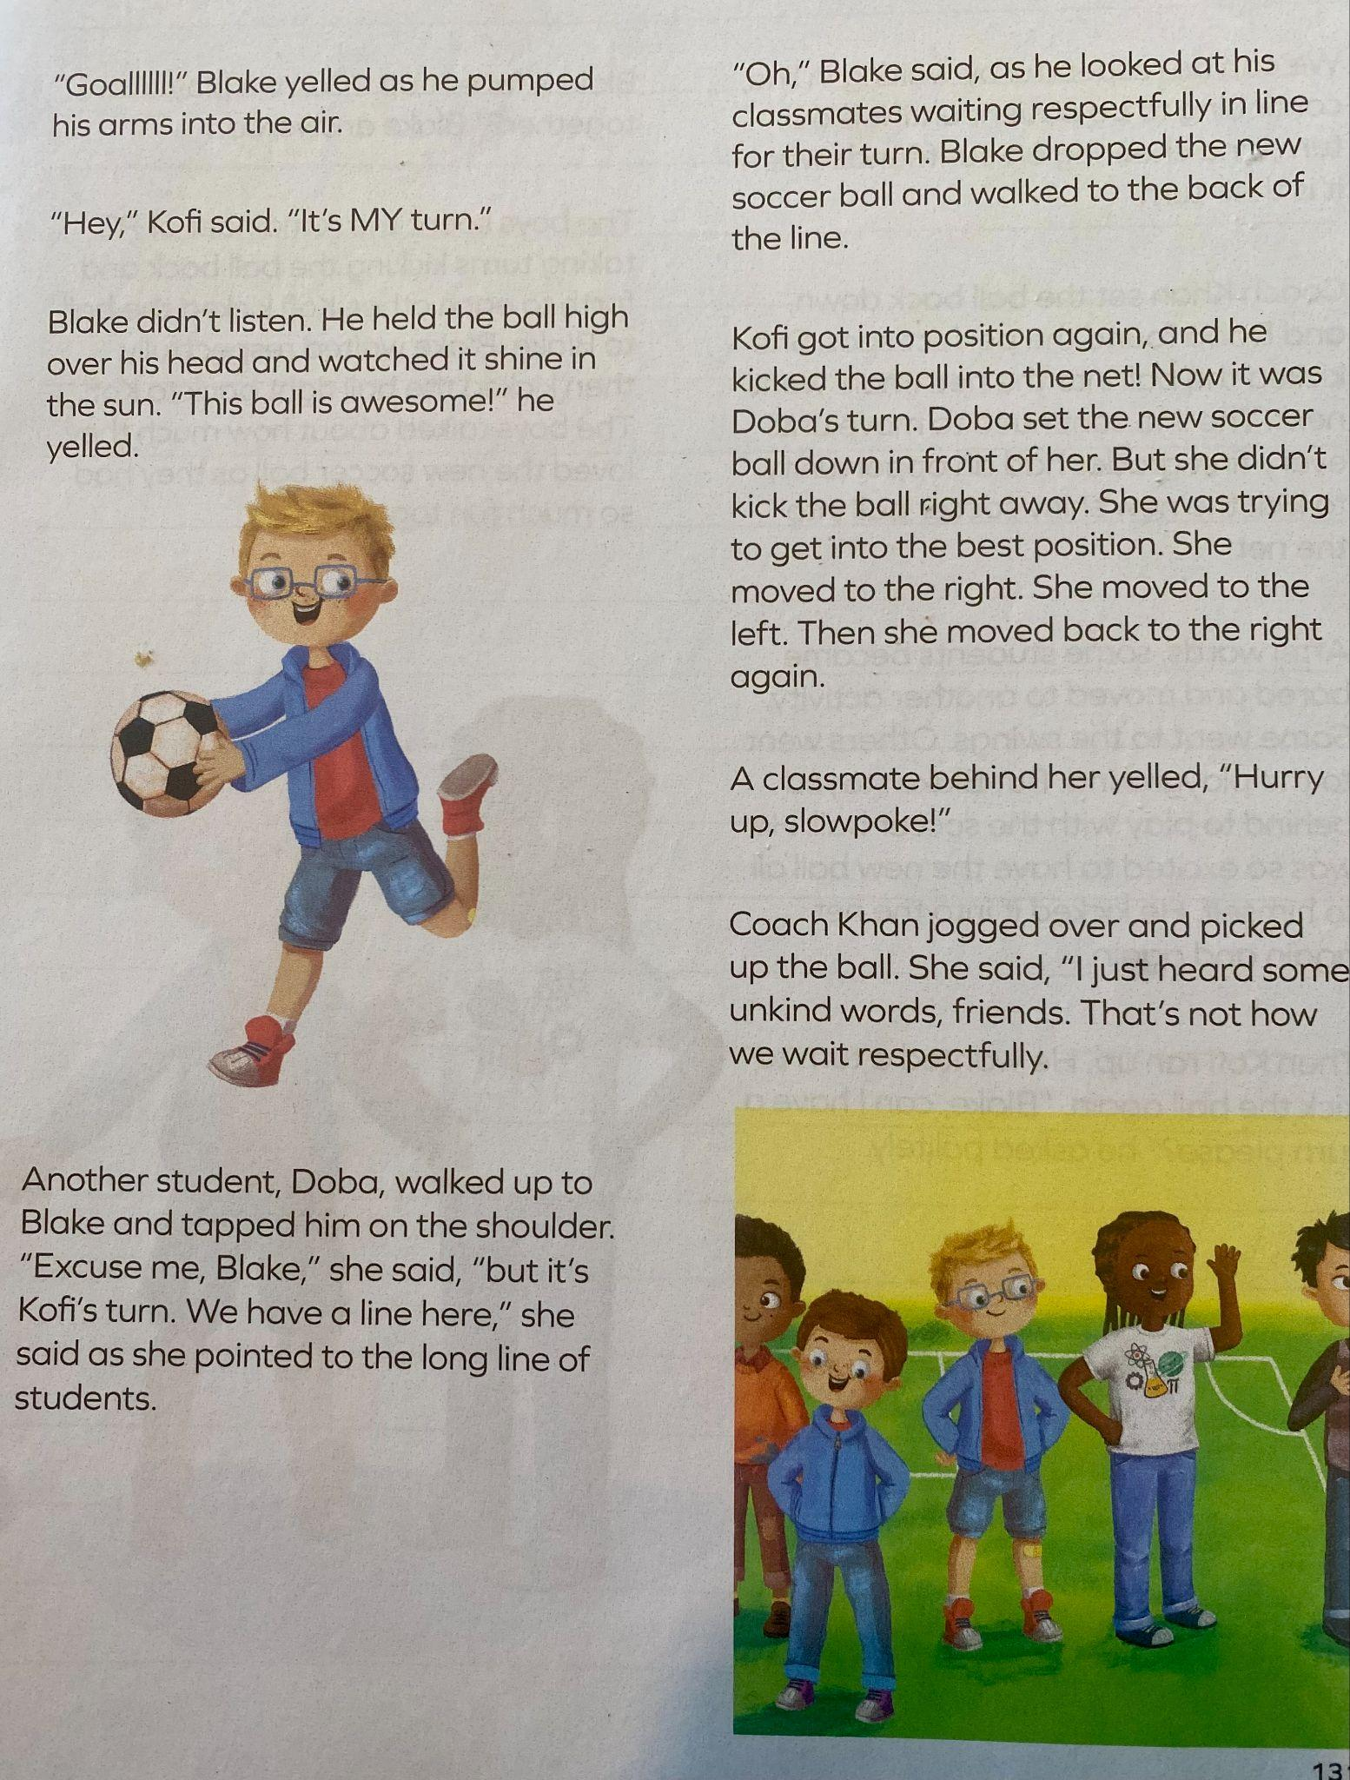
G1 Teacher Guide
p.130-132

Slide 7
G1 Teacher Guide
p.130-132

Slide 8
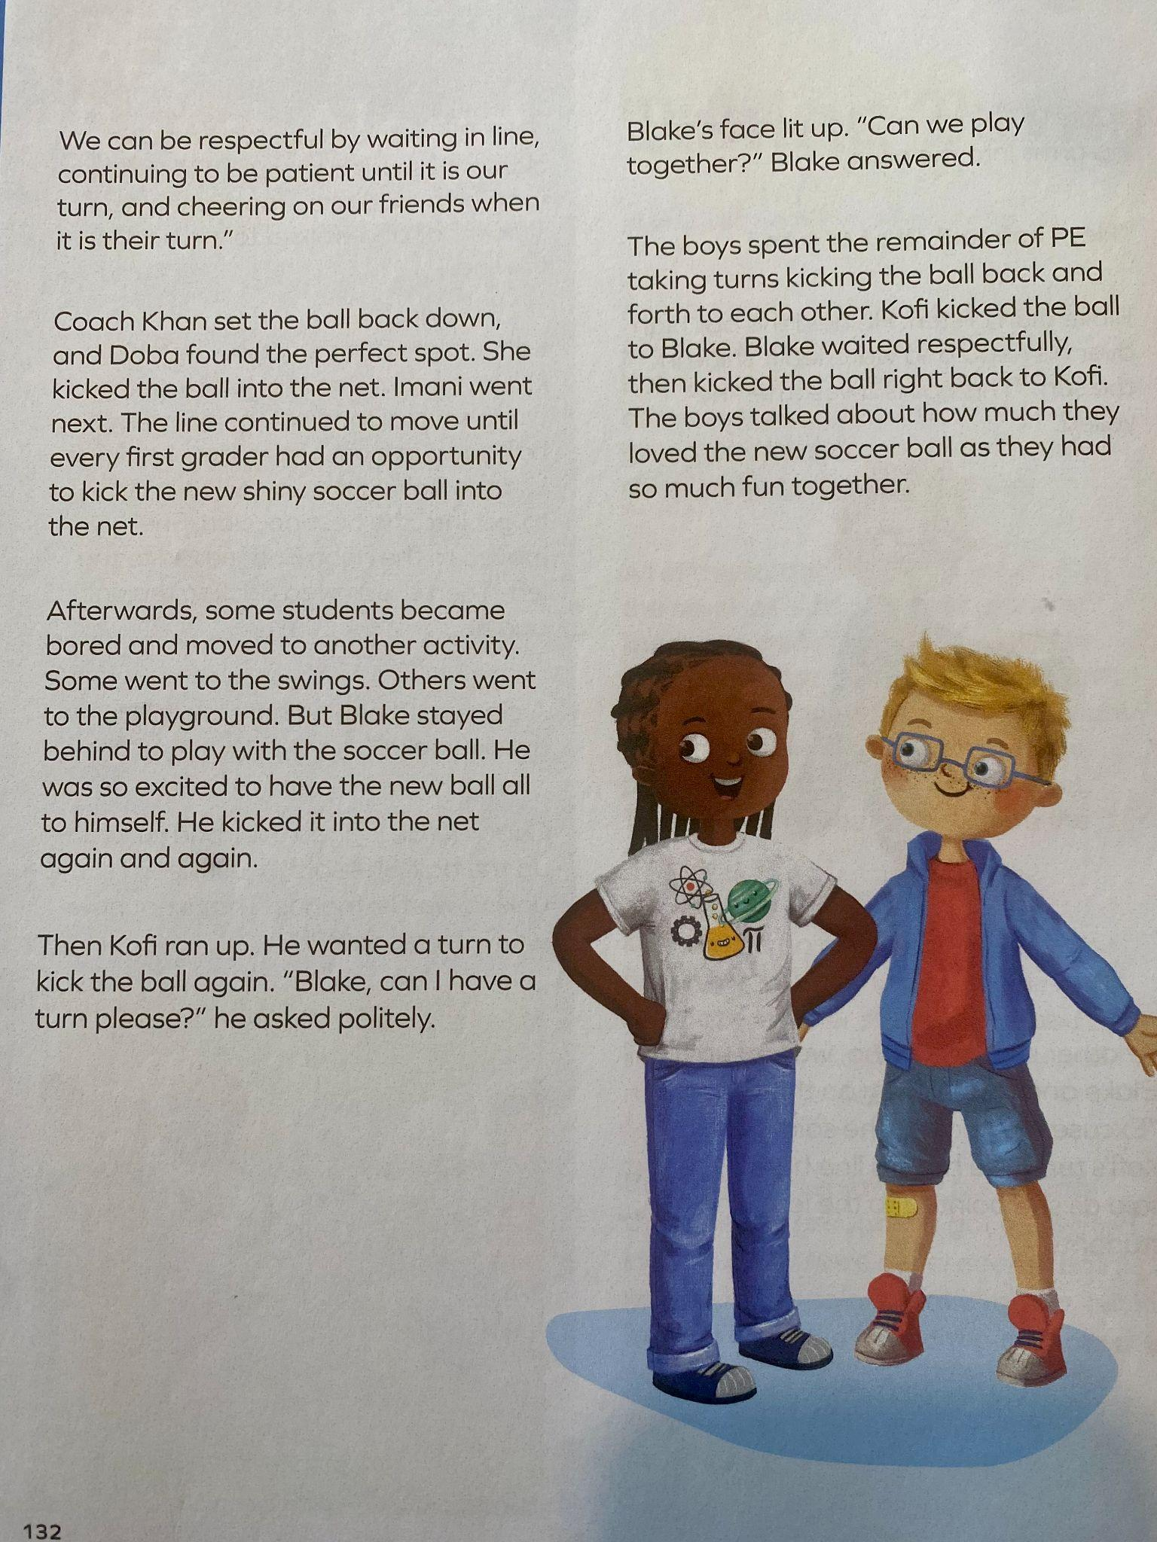
G1 Teacher Guide
p.130-132

Slide 9
When taking turns, it may…

Slide 10
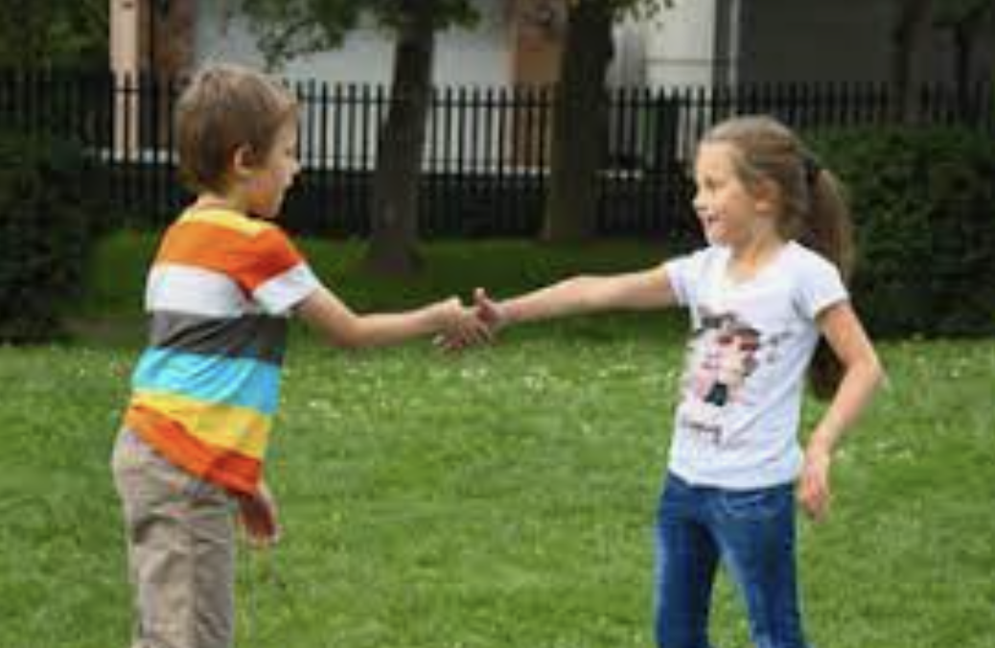
Vocabulary
Works with Others Towards A Common Goal
G1
Compromise (n.):
an agreement between two people or groups in which both sides agree to accept less than they first asked for and to give up something
Agree (v.): to have the same opinion or feel the same way

Slide 12
G1 Teacher Guide
p.130-132

Slide 13
When taking turns, it may…

Slide 14
Vocabulary
Works with Others Towards A Common Goal
G1
Compromise (n.):
an agreement between two people or groups in which both sides agree to accept less than they first asked for and to give up something
Agree (v.): to have the same opinion or feel the same way

Slide 16
G2

Slide 17
G2

Slide 18
A respectful interaction may…

Slide 21
G2

Slide 22
G1

Slide 26
Let’s Be Friends
Directions: Listen to the following questions and answer by giving a thumbs up (for yes) or a thumbs down (for no).
Have you ever stepped outside your comfort zone and asked someone you didn’t know or barely knew to play with you?
Have you ever stepped outside your comfort zone and worked on an assignment or project with someone you didn’t know very well or at all?
Have you ever stepped outside your comfort zone and sat next to someone you didn’t know?

Slide 27
Conversation
Talk to each other regularly
Friendship Triangle
Three Components of Lasting Friendships
Common Interests
Like the same things
Or activities
Cooperation
Get along well together

Slide 28
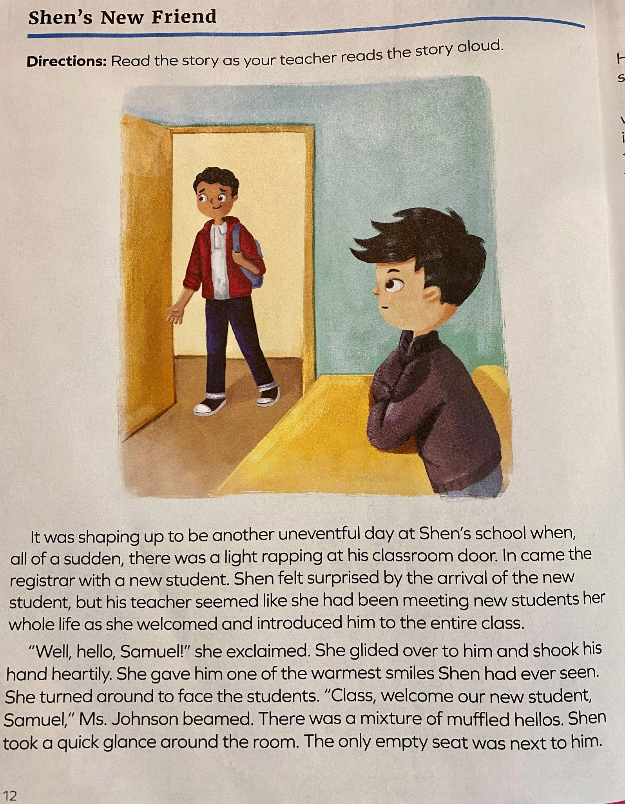
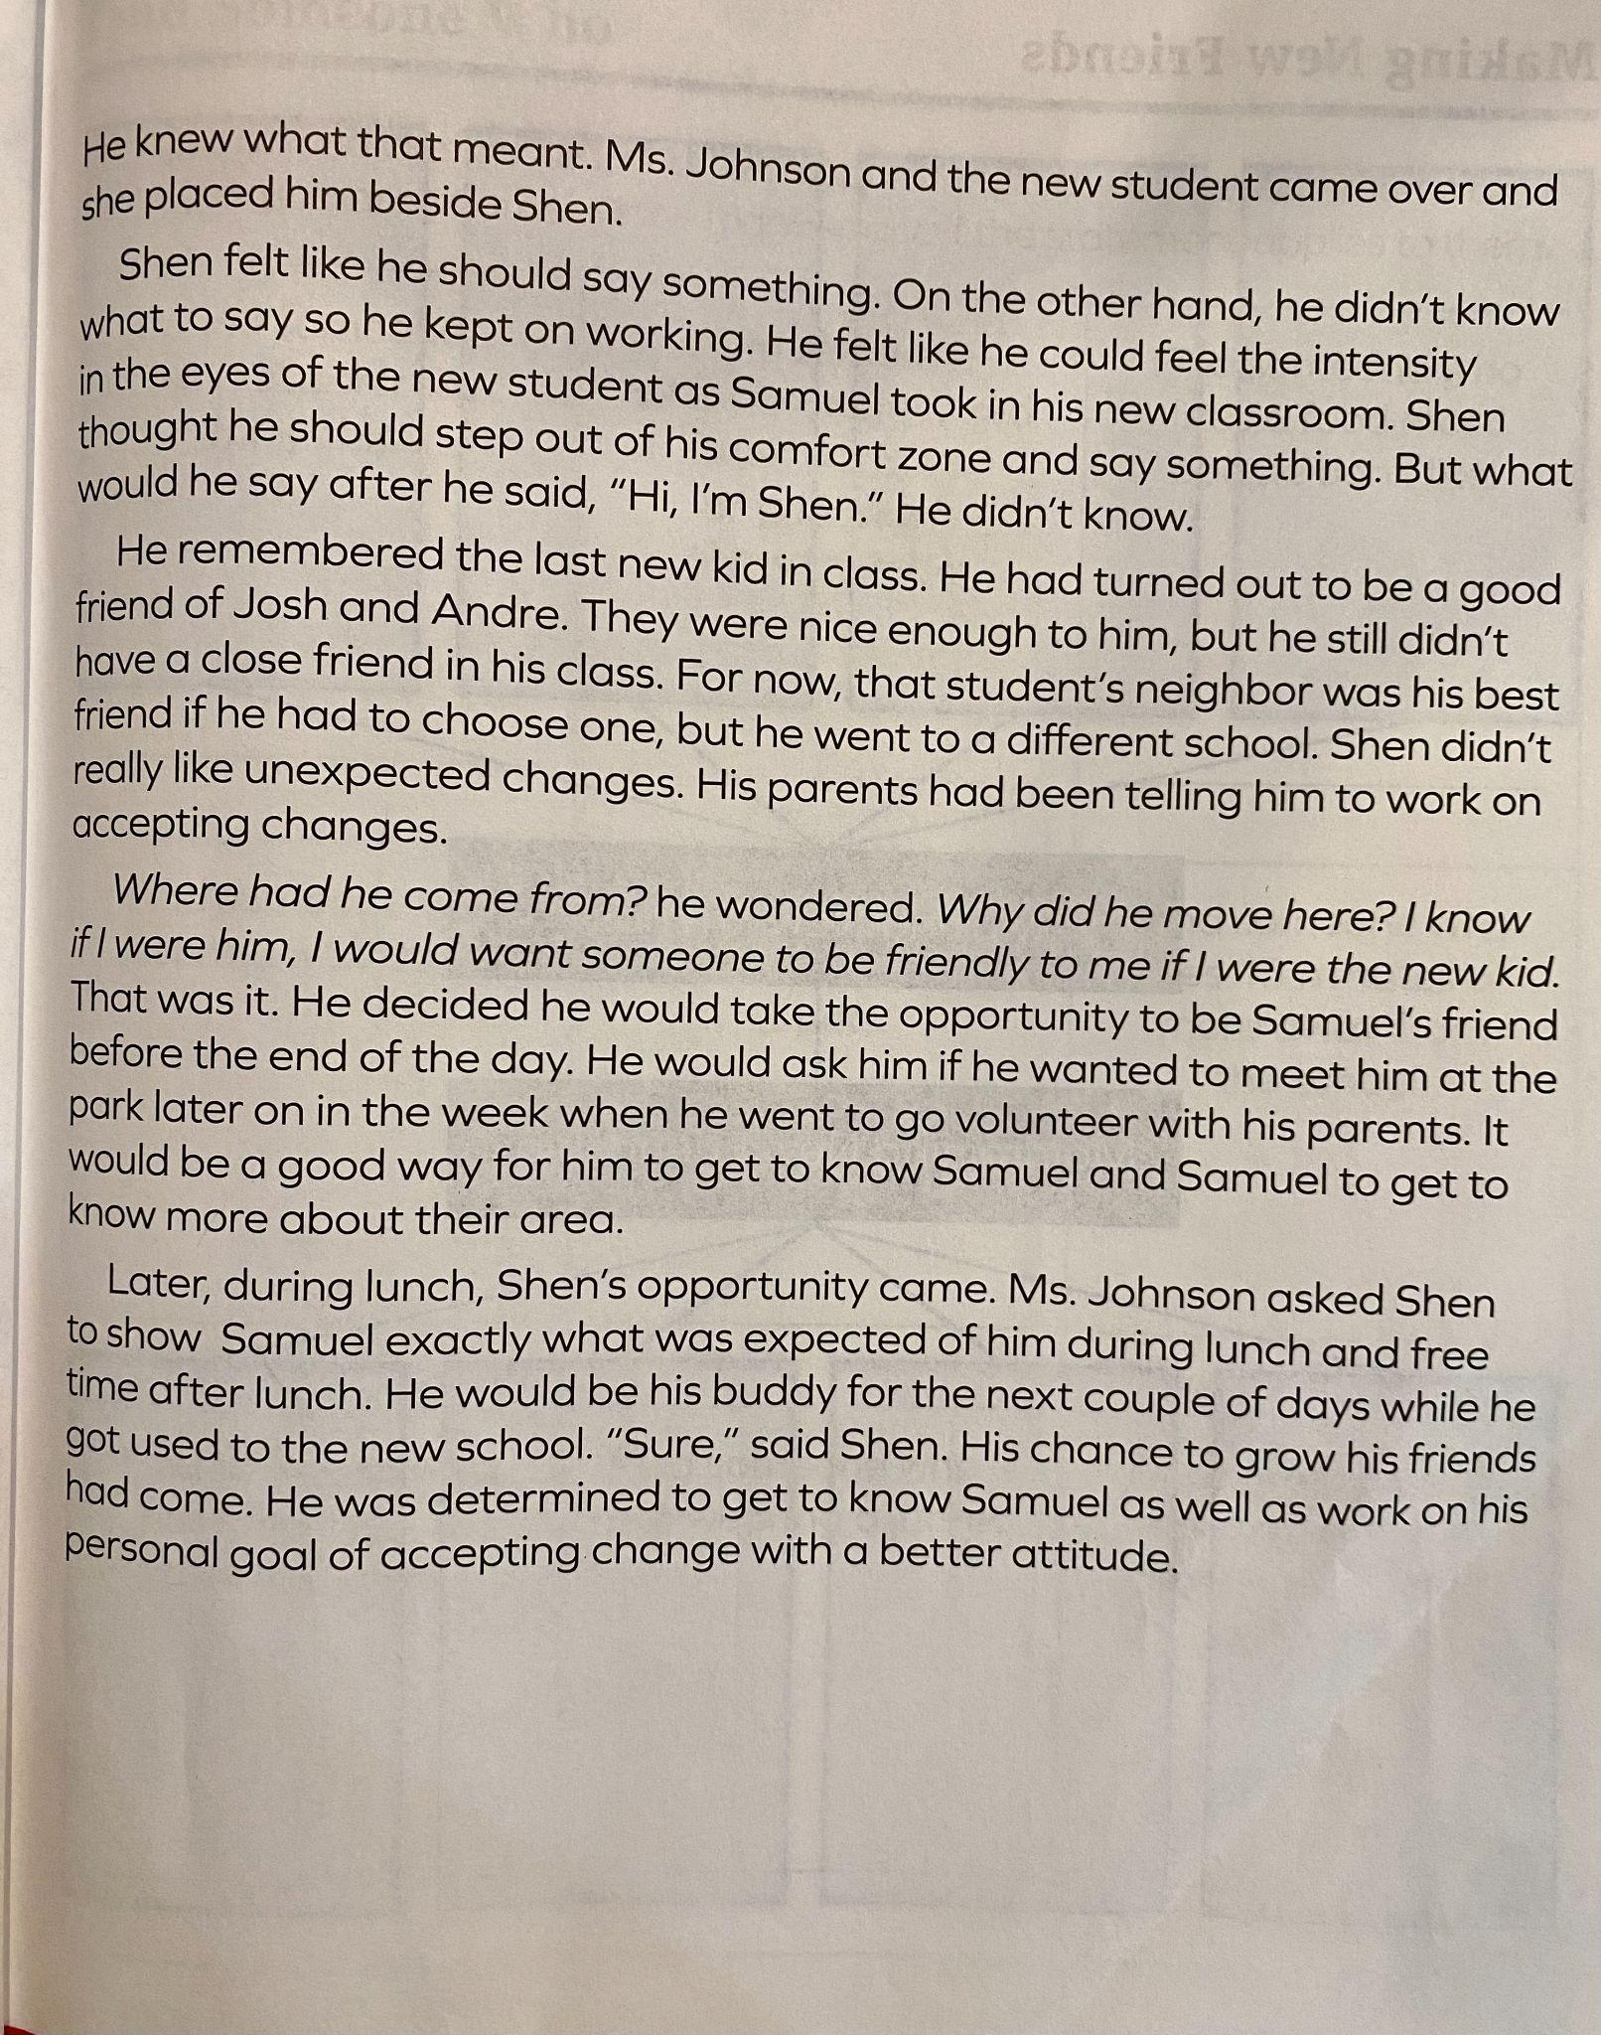
G3
Student Journal
p.12-14

Slide 30
G3/4
Works with Others Toward A Common Goal

Slide 31
G3/4
Works with Others Toward A Common Goal

Slide 36
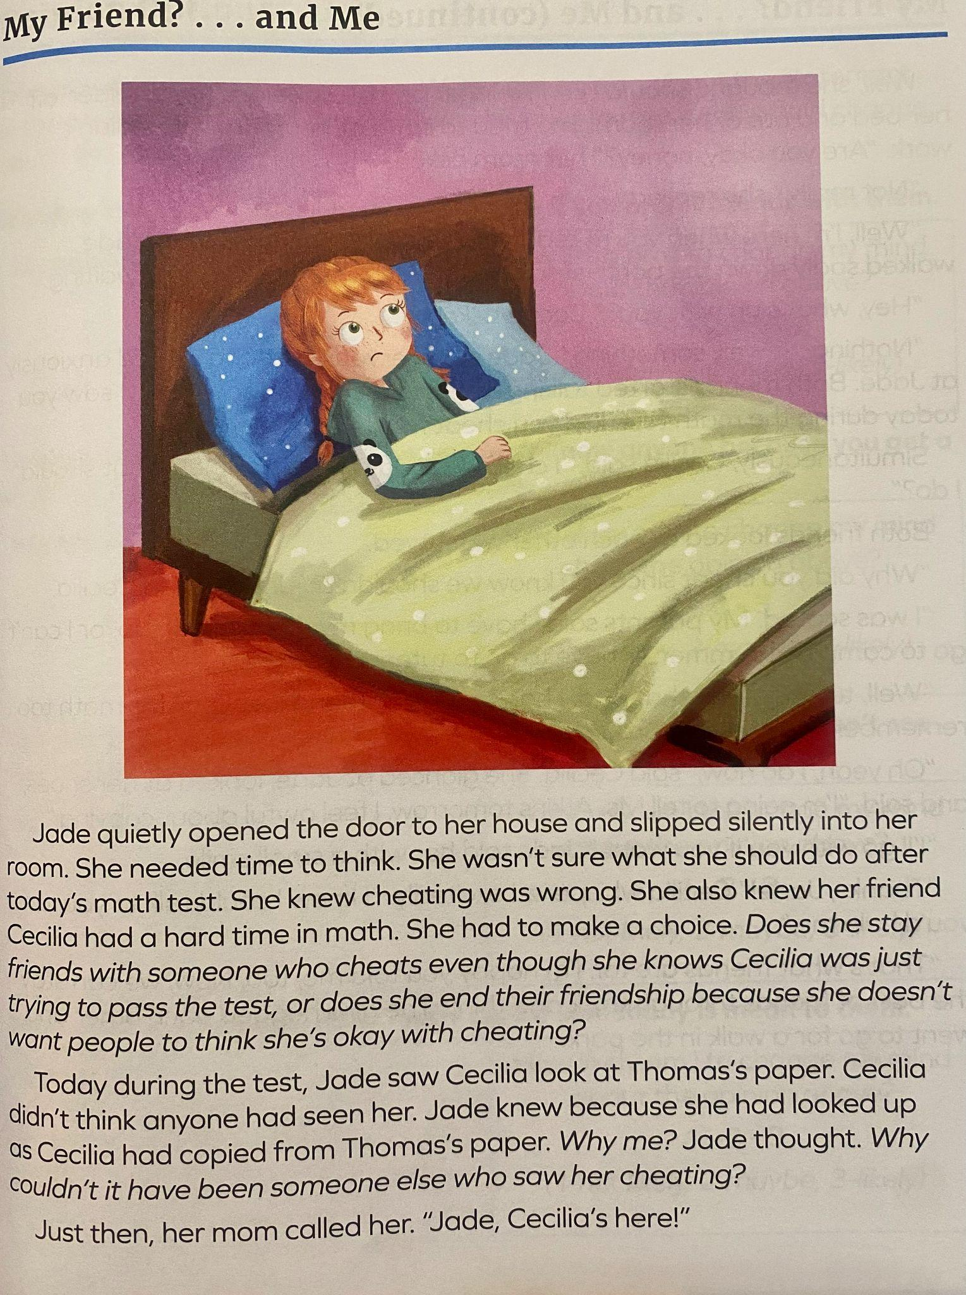
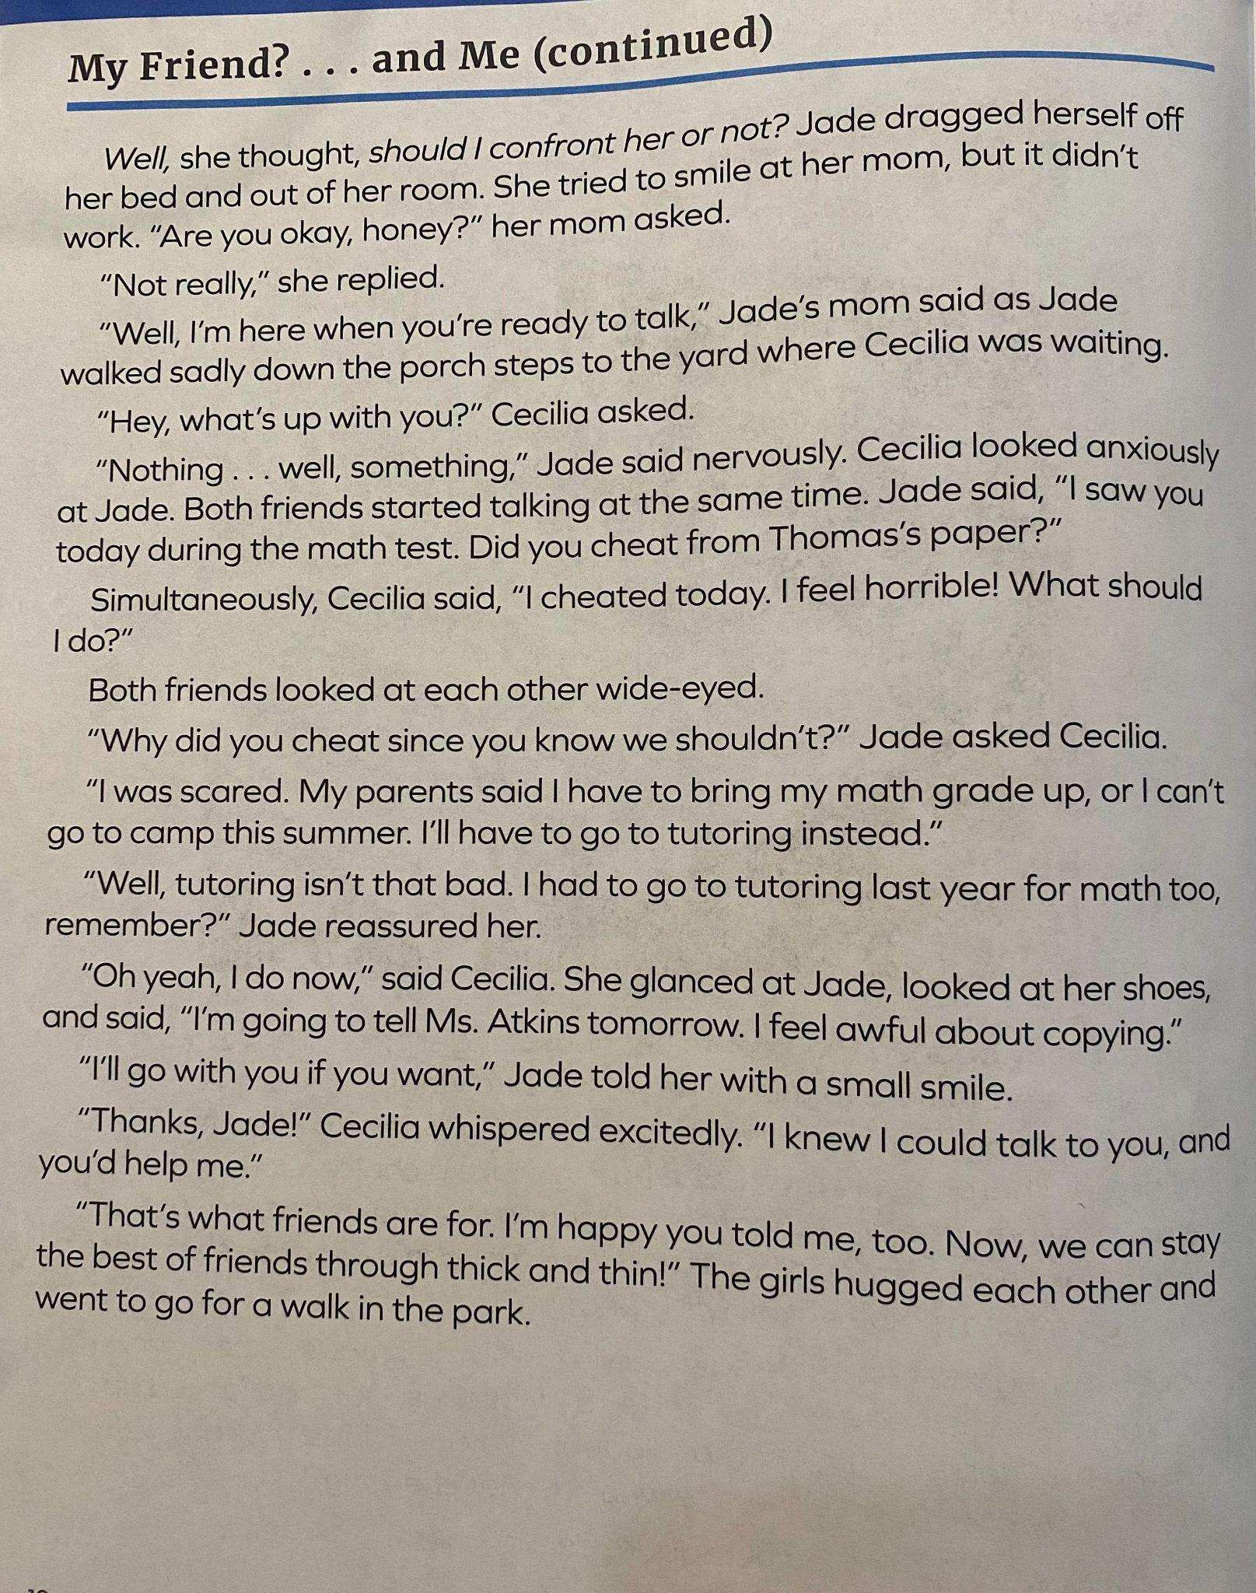
G4
Student Journal p.
p.11-12

Slide 37
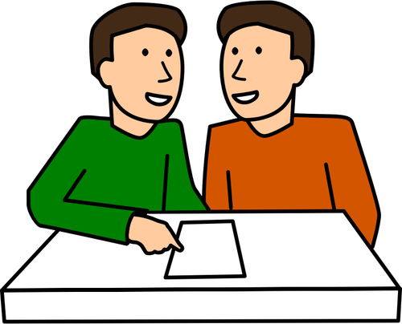
Discussion Questions
How did Jade stick to her own opinion when she learned something about her friend?
What did Jade do to remain secure in her beliefs
What was Jade’s belief about cheating?
What was Celia’s belief about cheating?
What is your belief about cheating? Why?
Is there anything that can change your mind about your opinion on cheating?

Slide 40
G4

Slide 41
A.C.T.S. of Peace
Directions: Put the examples of peaceful statements with the corresponding A.C.T.S. of Peace strategy
G4
A Acknowledge the problem. | C Consider the other person.
T Talk about a solution. | S Solve the problem together.
Saying , “ I can tell…”
Saying , “Let’s work this out”
Remaining calm.
Taking a deep breath and making
eye contact.
Asking, “What would
you like to do?”
Saying, “We need to fix this.”
Saying , “Let’s go sit so we can talk.”
Asking, “What can I
do to help?”
Saying, “Tell me what you think”

Slide 42
G5/6

Slide 43
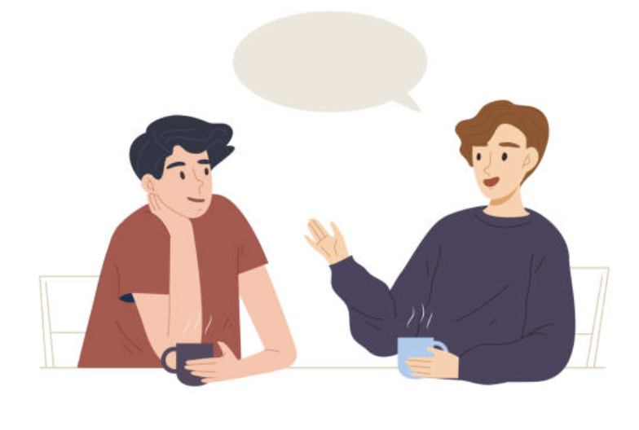
G5/6
“A friend Can tell you things you don’t want to tell yourself”
-Song by Francis Ward Weller
What do you think this quote means?
What qualities in a friend help them to say something to you that is hard to hear?
Healthy friendships require trust.

Slide 44
Directions: Think about what healthy friendships are and how they can benefit you. Write words or phrases to communicate those idas on the wrd web below.
G5/6
Healthy
Relationships
SJ 6
p.11

Slide 45
Vocabulary-Able to Make and Keep Friends
G5/6
Healthy Friendships
Healthy Communication: (n.): the ability to express emotions, experiences, thoughts, and needs in a positive, open, and respectful way
Mutual Respect (n.): acknowledgement that all people in a conversation or relationship bring value
Dependable (adj.): deserving trust or confidence; able to be counted on.
Boundaries (n.) guidelines you set and enforce that let others know how you wat to be treated and where your personal space is

Slide 46
A healthy friendship….
G5/6

Slide 47
G5/6
The 5 Components of a Healthy Friendship
Mutual Respect
Healthy Communication
Boundaries
Honesty
Trust
Which component do you value most in a friendship?

