Slide 2
ASSERTIVENESS
Able To Seek Help
Prek-2

Slide 3
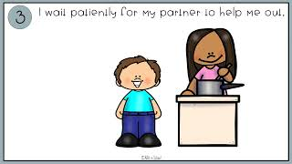
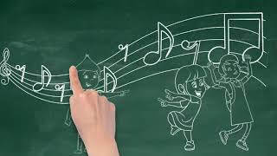
Videos & Read Alouds - Asking For Help
I CAN ASK FOR HELP Preschool Social Skills Story Social Emotional Learning Activity
Gr: Prek-K MD
Asking for help for kids - Paint it out
Gr: K-3
Asking For Help Gr 2-5
Giraffe Asks for Help Read Aloud
Gr: Prek-3
A Little Spot of Confidence
Gr: Prek/K, 1-2
Knowing When To Ask For Help Gr: 2-5

Slide 8
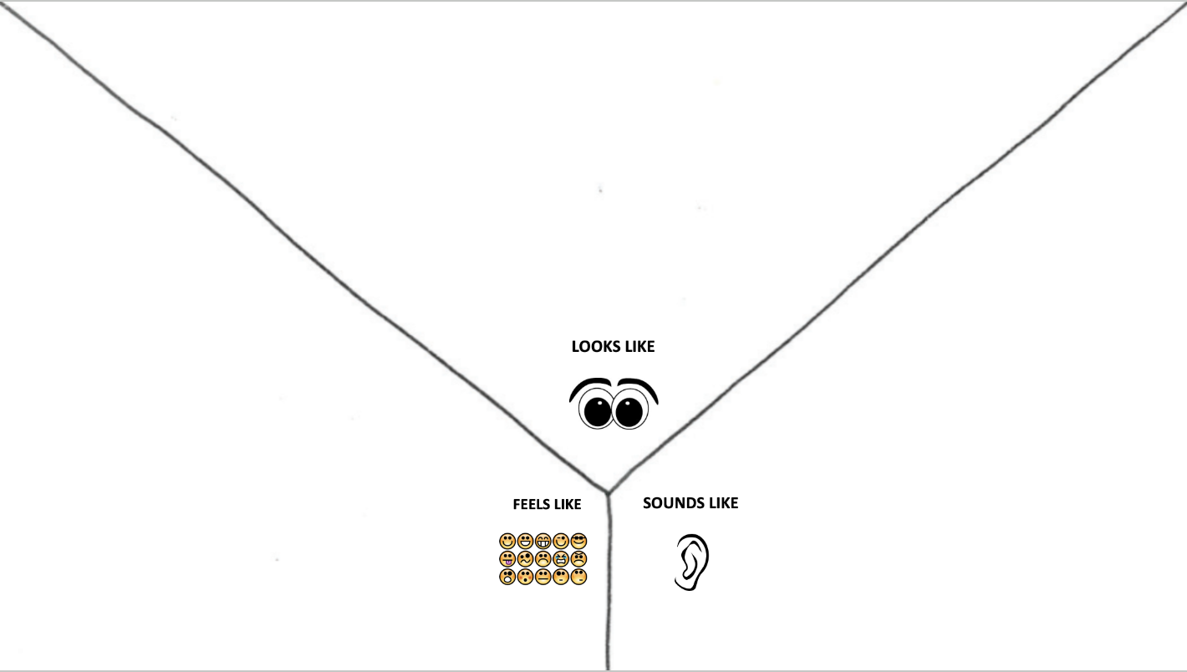
Being Confident…

Slide 9
Gr 3-8

Slide 10
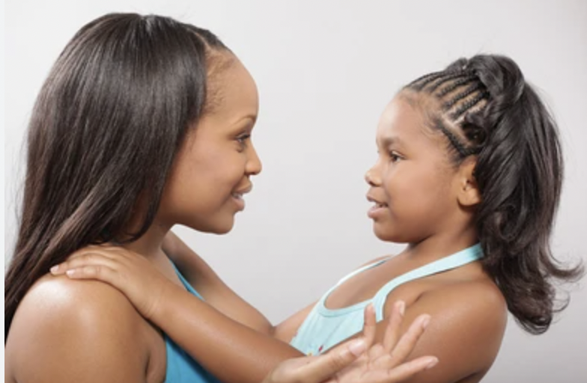
VOCABULARY
Ask to Seek Help
Gr 1/2
Clarify (v.): to provide more information
for better understanding
Help (n): to assist someone, to ask someone else to provide assistance
Confident (adj.): possessing self-assurance and believing you can do what you set your mind to

Slide 12
Gr 1-2

Slide 13
ASSERTIVENESS
Persists Through Challenging Events
(Upper Elementary/Middle School)

Slide 14
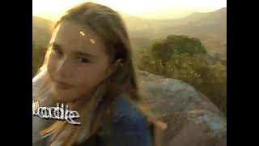
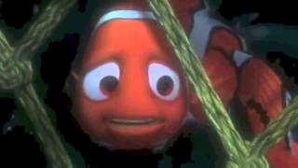
Videos and Read Alouds - Persists Through Challenging Events
Gr 3-8
Spot of Perseverance Read Aloud
Spot of Optimism Read Aloud
Amazing Kids of Character: Portraits of Perseverance
How to Persevere | Never Give Up,
What Does It Take To Find Success?
Train Your Dragon to do Hard Things-Read Aloud
ID Perseverance-Finding Nemo

Slide 15
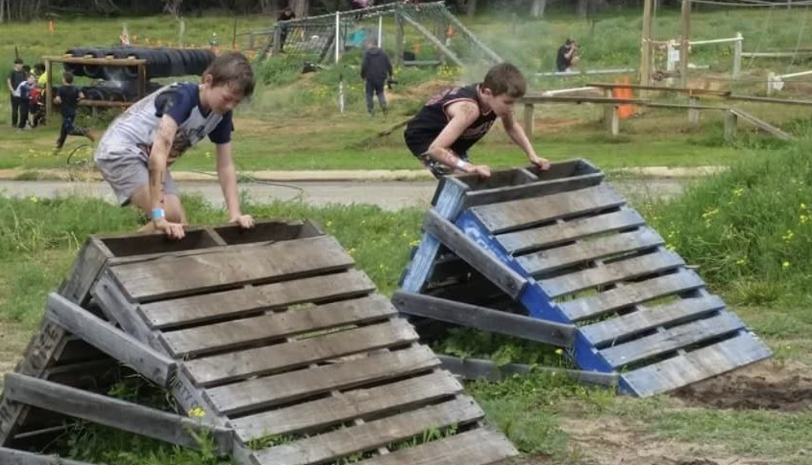
VOCABULARY
Persists Through Challenging Events
Gr 3-8
Self-Talk (n.): communication with oneself through words or thoughts
Effort (n.): the act of consciously applying oneself to an activity

Slide 17
Gr 3-8

