Slide 1
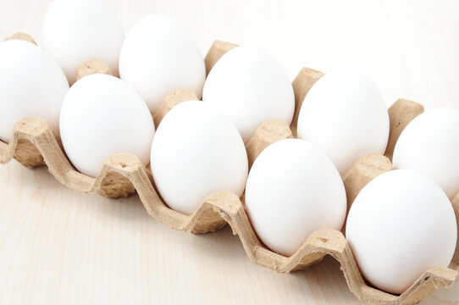
What do you notice about these eggs?

Slide 2
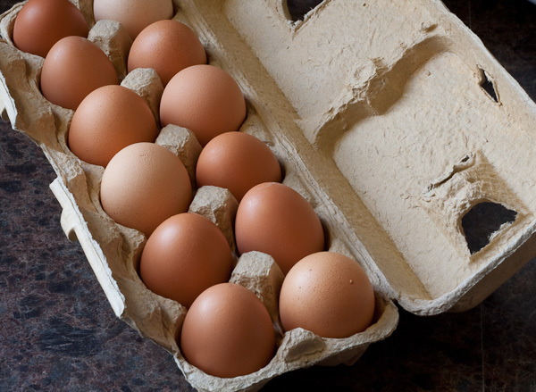
What do you notice about these eggs?

Slide 3
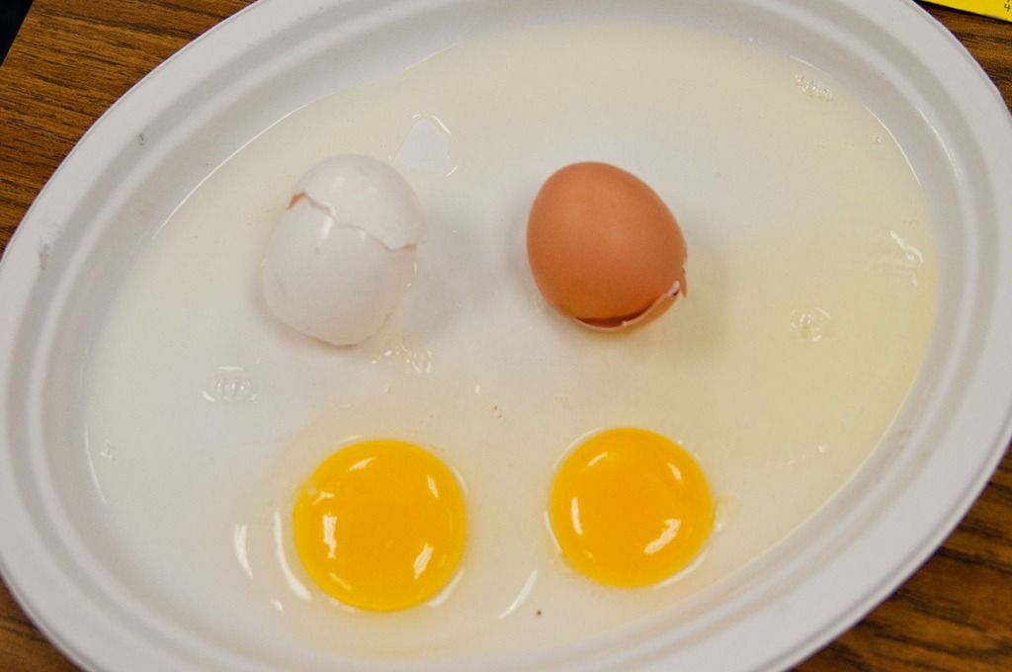
What do you notice about the inside of the eggs?

Slide 4
How are these children like the eggs?

Slide 5
