Slide 1
January Social Studies Assessment
________ help keep people safe and make a community a fair place to live?
rules
bully
Community
2. A tradition is special way of doing something that is past down from generation to generation.
True False
3. Why is it important to work together to
resolve conflicts
spend time with your friends
chose elected officials
4. Communities change over time.
True False
5. Which is not something you find on a map?
Map key
Number line
Symbol
6. A map can used to
Give page numbers
Find places
Help you spell

Slide 2
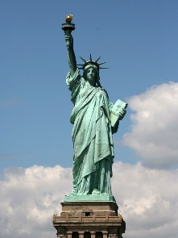
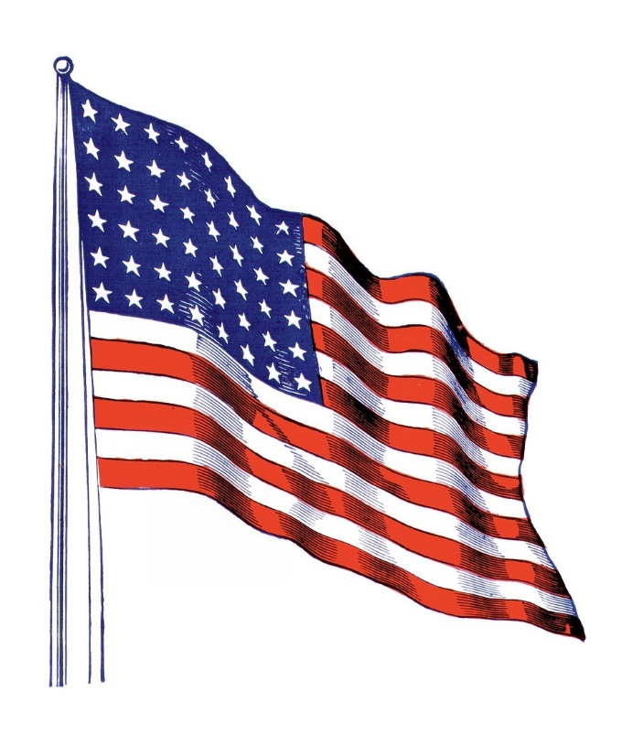
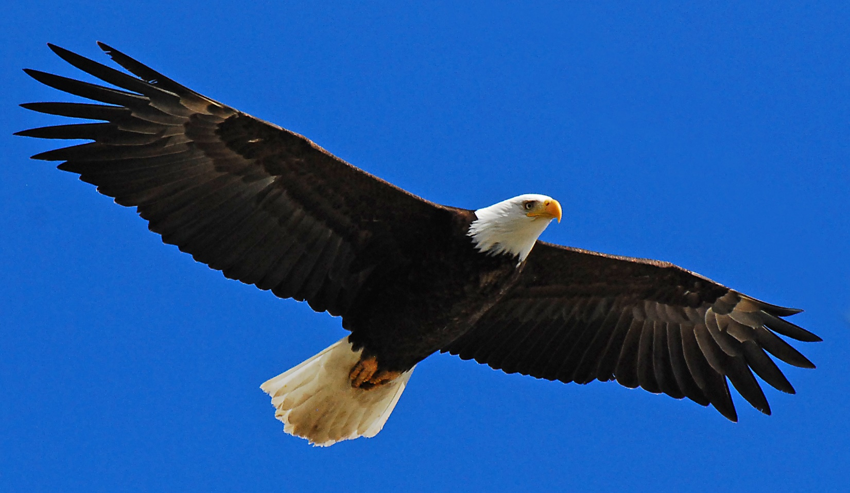
7. What would NOT be an example of a map?
a. state b. globe c. video clip
8. All the pictures below are national symbols.
True False
9. What is a national holiday where we honor and celebrate those who serve our country?
Halloween
4th of July
Veteran’s Day
10. Something you cannot live without is a
Need
Want
Video game

Slide 3
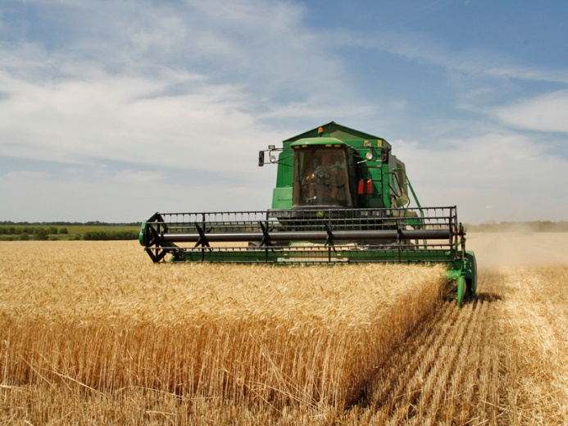
11. Drag the word producer to the picture of a producer and the word consumer to picture of a consumer.
12. People work to ____________ money.
a. save
b. earn
c. spend
d. All of the above

Slide 4
May Assessment for 2nd grade SS
1. The president and other leaders in charge are ______ by people the community?
citizen
elected
schools
2. Citizen is a person who lives, works, and plays in a community.
True False
3. What is an example of a boycott during the civil rights moment?
Refusing to ride a bus until laws were charged
Paying for bus rides
Eating lunch in the cafeteria
4. Who of the following is NOT part of the Civil Rights Movement?
Martin Lither King JR.
George Washington
Rosa Parks
5. What is the difference between globes and maps?
A globe is flat, a map is a round sphere
A map is flat, a globe is a round sphere
Globe shows school classrooms

Slide 5
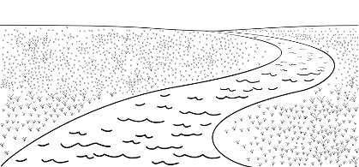
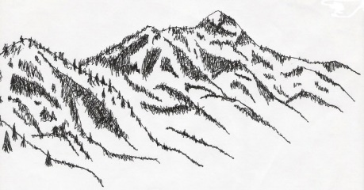
6. What is a large body of salt water?
pond
valley
ocean
7. Circle the picture of a river?
8. ______________ are different shapes of land on Earth.
Landforms
Landmarks
Monuments
9. What state do we live in?
a. Williamstown
b. United States
c. New Jersey

Slide 6
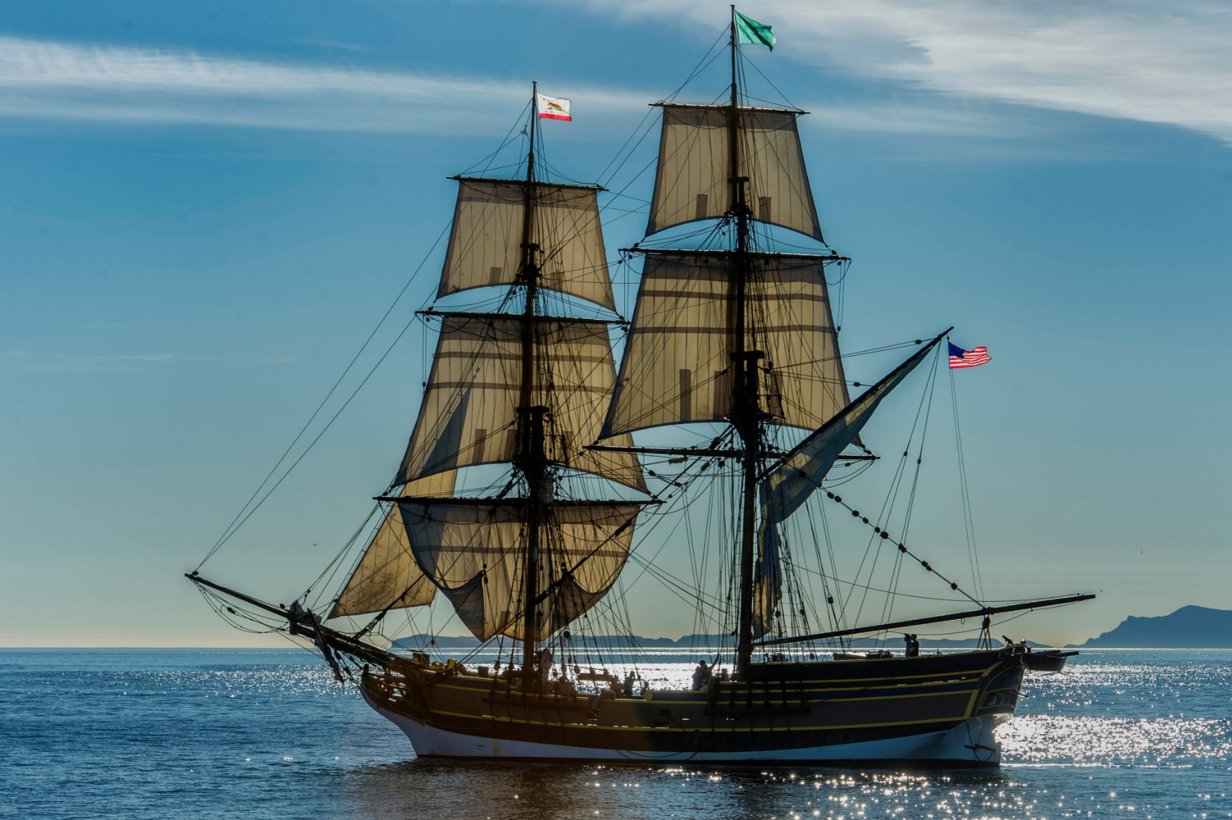
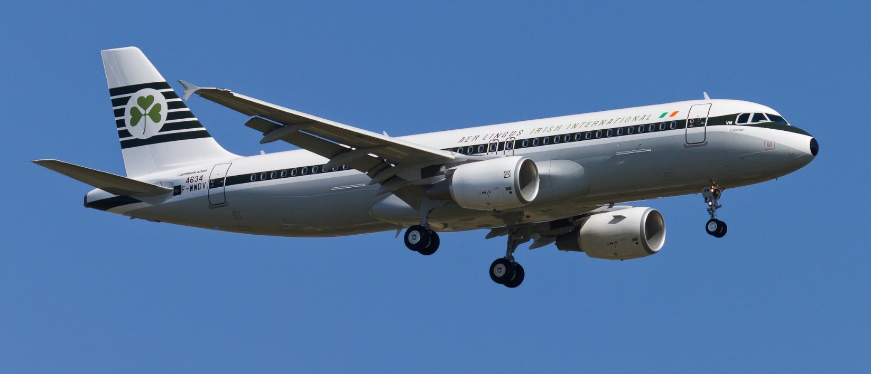
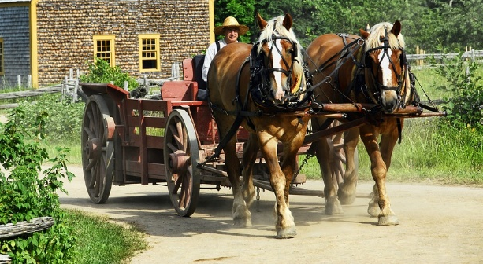
10. ____________________________ was the first president?.
George Washington
Abraham Lincoln
Ben Franklin
11. Who was president during the Civil War?
George Washington
Abraham Lincoln
Ben Franklin
12. Prejudice can lead to conflict.
True False
13. What invention has improved communication?
train
phone
letter
14. Which picture shows transportation commonly used today?

