Slide 1
Evaluating Websites
Use the C.A.R.S. checklist to evaluate every website you use for research
C - Credibility - Who wrote the information on the website? Are they a credible authority?
A - Accuracy - Is the information current, complete, and correct?
R - Reasonableness - Is the source truthful and unbiased?
S - Support - Does the website have verifiable information? Is there a bibliography or list of sources?
Model evaluating a website
Notes:
Before going to next slide, click “Model evaluating a website” and model the thought process to students using CARS

Slide 2
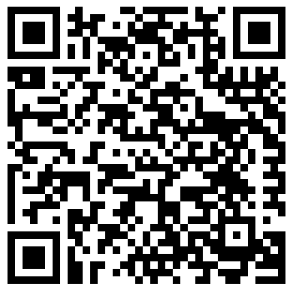
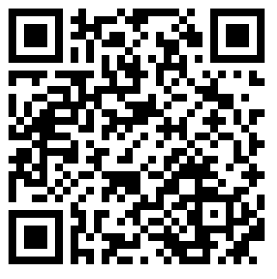
Evaluating Websites
Source 1
Source 2
https://www.artinstitutes.edu/about/blog/the-history-and-evolution-of-cell-phones
http://bpastudio.csudh.edu/fac/lpress/471/hout/telecomHistory/
Notes:
Students will scan the QR codes (one at a time) and discuss with their groups the validity of the website using CARS. After 3 minutes, discuss as a class.

