Slide 1
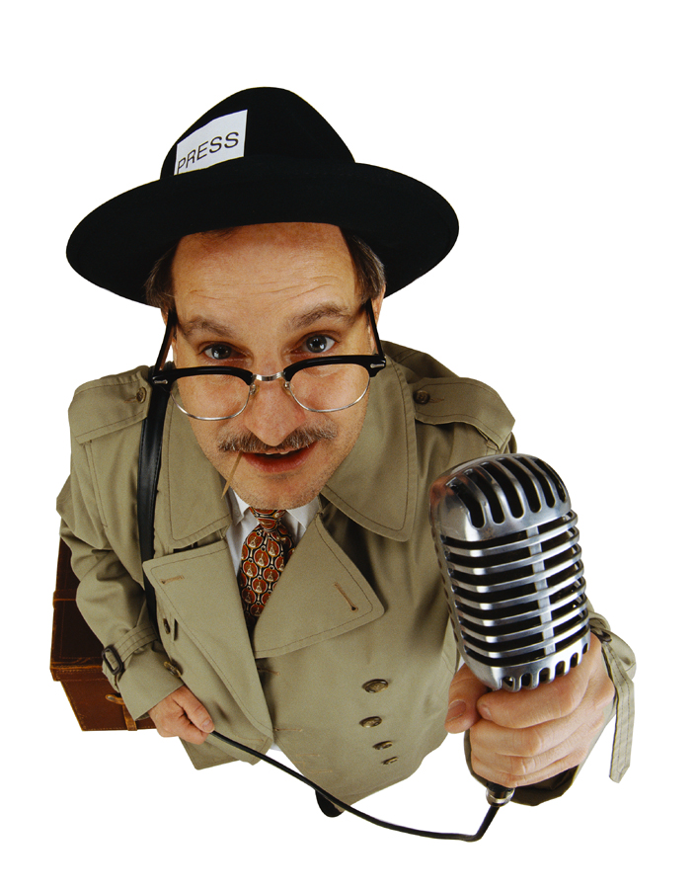
Bias in the News

Slide 2
What do you already know about bias?
What is bias anyway?
Favoring one side, position, or belief – being partial, prejudiced,

Slide 3
Bias vs. Propaganda
Bias …
is prejudice; a preconceived judgment or an opinion formed without just grounds or sufficient knowledge
Propaganda …
is a systematic effort to influence people's opinions; to win them to a certain side or view

Slide 4
What is biased language and what is not?
Not biased, just an objective observation
Frank spends very little money.
Biased favorably:
Frank is thrifty.
Biased unfavorably:
Frank is a cheapskate.

Slide 5
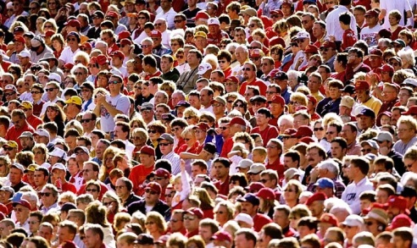
Can bias be found in the news?
Consider these two sentences in a news story:
1. “A crowd of more than 900 attended the protest.”
2. “Fewer than 1,000 showed up to protest.”
How could you say this in a neutral (unbiased) way?
http://www.bvallc.com/pensionblog/uploaded_images/Crowd-702052.jpg

Slide 6
How to Detect Bias in the News
Every news story is affected by:
    thoughts
    opinions
    background
of these people:
    interviewer
    reporter
    photographer
    editor

Slide 7
How to Detect Bias in the News
Bias isn’t always on purpose – sometimes it just “creeps in”!
By looking for it, you can spot bias and become a better journalist and a better reader.

Slide 8
Let’s Look at Bias through …
  Omission
  Placement
  Photos
  Names and titles
  Statistics
  Word Choice & Tone
  Source Control

Slide 9
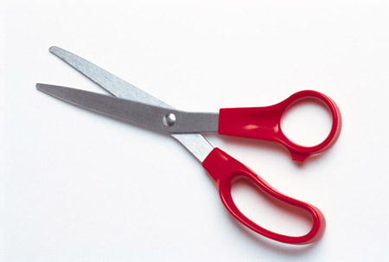
1. Bias through Omission
Sometimes, certain facts or details will be cut out of a story, and others will be included.
This can change how readers or viewers think about the story.
Make sure to read several different sources to get the full story!

Slide 10
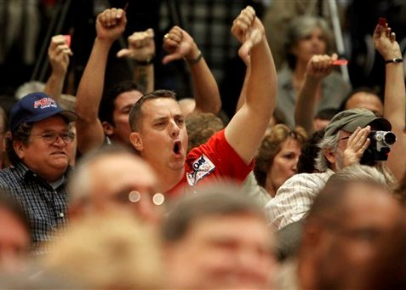
Bias through Omission
A news story can be written about people booing during a speech.
“The president’s remarks were greeted by loud jeers.”
“A small handful of people disagreed with the president’s remarks.”
http://media.cnsnews.com/resources/53412.jpg

Slide 11

2. Bias through placement
Usually, the stories that are chosen to be put first are seen as more important.
Stories in the back of the paper or at the end of the news broadcast are seen as less important.

Slide 12
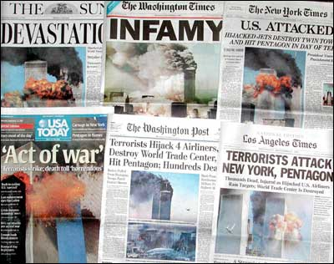
2. Bias through placement
For example, if a story about the disaster in Samoa is on the front page of the paper, it will be seen as more important.
If the story about Samoa is buried at the back of the paper, it will be seen as less important.
http://amhist.ist.unomaha.edu/module_files/Collage%20of%20Headlines.jpg

Slide 13
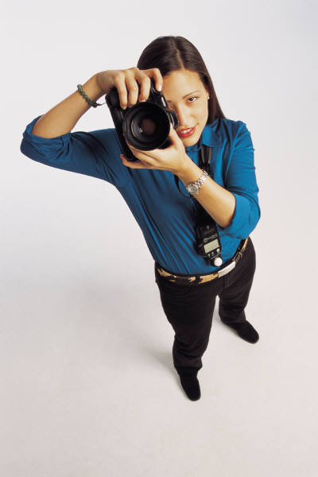
3. Bias through photos
Some photos can make the subject look serious, attractive, healthy, etc. and other photos can be really unflattering and make them look silly, ugly, sick, etc.
The images of someone in the news can influence how we think about them.

Slide 14
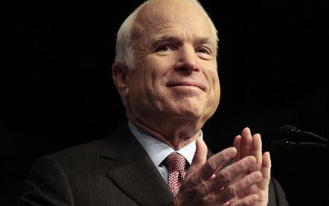
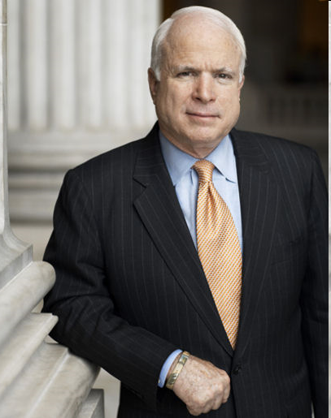
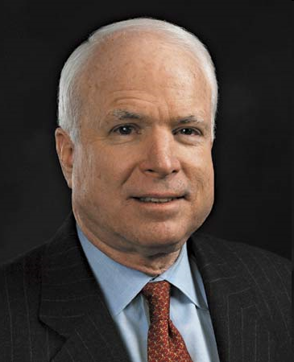
Bias by photos
Compare these…

Slide 15
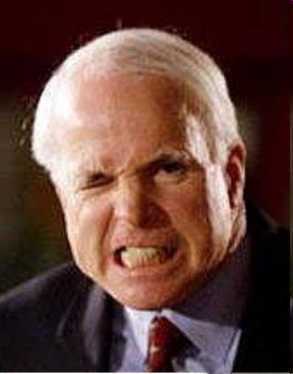
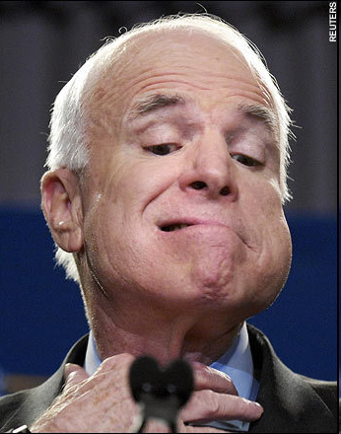
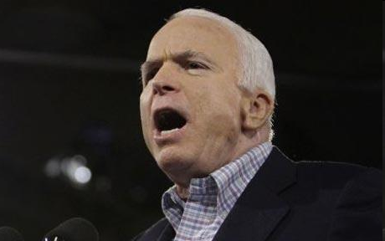
Bias by photos
…to these!

Slide 16
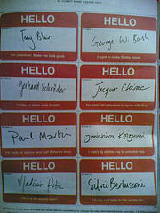
4. Bias through names and titles
The way a person is described or labeled can influence how we think about them.

Slide 17
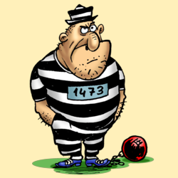
Bias through names and titles
“John Doe, an ex-con, is now running for office.”
“John Doe, who was convicted 20 years ago for a minor offense, is now running for office.”
http://choosethecross.com/wp-content/uploads/2007/08/convict.png

Slide 18

5. Bias through Statistics
Numbers and statistics can be manipulated to change the way we think about them.

Slide 19
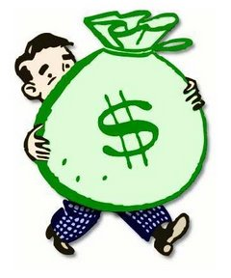
Bias through Statistics
“The fundraiser for the school earned only $1,100.”
“The school’s successful fundraiser raised over $1,000.”
http://confettidreams.files.wordpress.com/2009/08/saving-money-clip-art.jpg

Slide 20
6. Bias through word choice
The words and tone the journalist uses can influence the story.
Using positive or negative words can change how we feel about the news story.
We can also be influenced by a news broadcaster’s tone of voice.

Slide 21
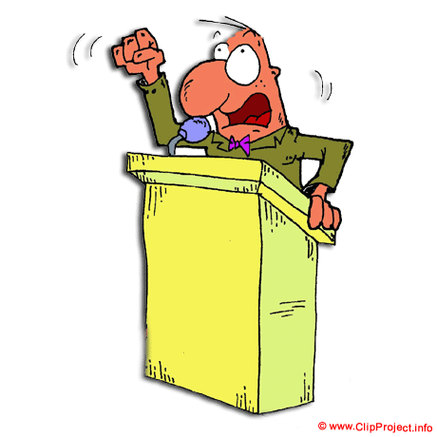
Bias through word choice
“The politician presented his well-thought out and intelligent plan to Congress.”
“The politician presented his shoddy and disorganized plan to Congress.”

Slide 22
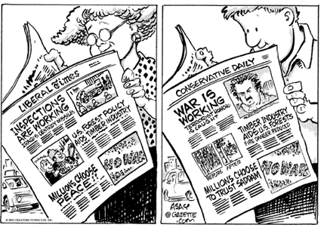
Word Choice

Slide 23
Here are the headlines and lead paragraphs of two articles which came out on the morning of March 11, 2003. They are covering the same incident:
New York Times 3/11/2003
USA Today 3/11/2003
Iraq forces suspension of U.S. surveillance flights
UNITED NATIONS (Reuters) -Iraqi fighter jets threatened two American U-2 surveillance planes, forcing them to return and abort their mission and return to base, senior U.S. officials said Tuesday.
U.N. Withdraws U-2 Planes
WASHINGTON (AP)-U.N. arms inspectors said Tuesday they had withdrawn two U-2 reconnaissance planes over Iraq for safety reasons after Baghdad complained both aircraft were in the air simultaneously.

Slide 24

Here are hockey game coverage headlines from the two home towns of the opposing teams:
The Denver Post
red wings 5, avalanche 3
Injury begins Avs' tumble
The Detroit News
Red Wings 5, Avalanche 3
Wings are too much for Avalanche
Article 1: http://www.denverpost.com/Stories/0,1413,36%257E24761%257E1247763,00.html?search=filter
Article 2: http://www.detnews.com/2003/wings/0303/15/sports-109480.htm
http://school.mapleshade.org/ravizius/period7/Crossley-Joshua/red-wings.jpg
Notes:
Word Choice Analysis:
Here we have a humorous example of how Geographic Bias can play out in word choice. This may seem somewhat of a trite example, especially since these sports writers do not pretend to be as unbiased as general news writers, but it serves as a good example to plainly show the same phenomenon as Example 1.

Slide 25
St. Petersburg Times (Florida) 3/25/2003
Dar Al-Hayat
4/1/2003
The Red Cross, one of the few aid groups with staff operating in Iraq, hopes to negotiate access to the main power station, which is said to be under control of U.S.-led coalition forces. But neither local staff nor specialists in neighboring Kuwait have been cleared to go because of continued clashes.
Iraq said its troops were battling U.S.-led invasion forces inside Nassiriya and on the city's outskirts on Tuesday and inflicting heavy casualties.

Slide 26
7. Bias through controlling the source
Where does the story originate?
Who is the source of the story?
Whose point of view are you hearing or reading?

Slide 27
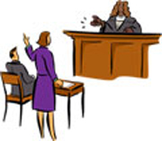
Bias through controlling your sources
How would the information look if you interviewed each team during a murder trial? What would happen if you only interviewed the prosecution for your article?
Defense team
Prosecuting team
http://www.nvbar.org/LRE/courtroom4b.jpg

Slide 28
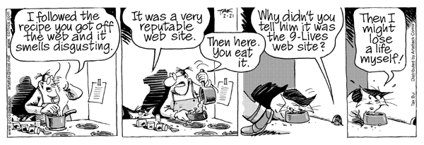
Bias through controlling your sources
Sources are important! You cannot always trust information from all sources.

Slide 29
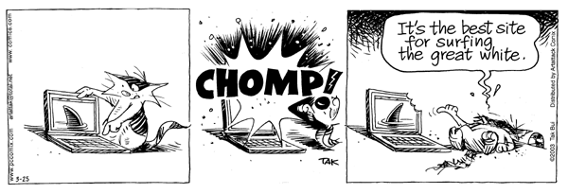
What influences news bias?
Geography
Ideology
Institutional Affiliation
What kind of Medium is used

Slide 30
1. Geography
Our perception of everyday life can vary from country to country. Therefore our biases creep into what is reported.

Slide 31
Geographical Bias
American Sources such as CNN have labeled the conflict the "War In Iraq"
Arab sources such as Dar Al-Hayat regularly call the conflict the "War On Iraq"

Slide 32
2. Institutional Affiliations
(who you work for or groups to which you belong)
Who is paying the writer? Does the payer have a bias that the writer has to use?
We see this in political groups and media that is liberal or conservative.
The next 2 articles show the difference in 2 news companies and how they report.

Slide 33
  Washington Post
  Poll: Americans Ambivalent About Support for Iraq War Monday, March 3, 2003
Surveys conducted since the Sept. 11, 2001 terrorist attacks have consistently showed that a majority of Americans favor military strikes against Iraq. But this general agreement that force should be used is neither absolute, unconditional nor uniformly shared by key voting groups, an analysis of recent …
The poll found that 59 percent of respondents favor using military force against Iraq, even without the support of the U.N. Security Council. But four in 10 supporters also said they had reservations about the looming conflict with Iraq. When these doubters are combined with opponents of military action, the result suggest that more than six in 10 Americans harbor at least some doubts about using force while only a third are unequivocally behind going to war.
Notes:
These two very different perspectives on the desire for war were reported within a day of each other - one says that Americans "have had enough of the recent protests in various cities at home and abroad" while the other states that Americans are "ambivalent about support for Iraq war" (what does this say about the Sources that have been chosen?). The Washington Post has a reputation of having a liberal slant. FOX News has a reputation of having a conservative slant. FOX News is owned by News Corp, all of which is owned by Rupert Murdoch who is commonly associated with conservative politics

Slide 34
    FOX News
    ‘Pro-War’ Movement Springs Into Action
    Sunday, March 2, 2003
NEW YORK – As time runs out for Iraqi leader Saddam Hussein to disarm or face a military thrashing from the United States and its allies, “pro-war” – or “anti-anti-war” – Americans are saying they have had enough of the recent protests in various cities at home and abroad.
“We decided we can’t sit idly by while President Bush’s agenda, specifically his continuing efforts on the war on terror, specifically Iraq … while they … Democrats, the left wing and Hollywood … conduct a well-coordinated, well-organized, well-financed effort to undo the president and really to destroy him, because that’s their goal,” David Bossie, president of Citizens United, told Foxnews.com.

Slide 35
4. The medium
Not all mediums of information are equal. Some mediums present information ready to digest, while with other mediums one must be more careful while digesting information.
Taken from http://www.unitedmedia.com/wash/pcnpixel/archive/pcnpixel-20030325.html, ©2003 Thach Bui, reproduced for educational purposes only.

Slide 36
The medium
Leading story from a 30 minute Evening News program
Front page article of the New York Times Newspaper
What would be the difference in how the same news might be reported? Video on TV might have a different impact than words describing the scene. The length of an article is able to give you more details.
How might an article on a devastating earthquake be different on TV verses the newspaper?

Slide 37
Media – The internet
While the internet is very low cost which allows many people to publish news and articles, it also makes it easier for people with biases to put their view on the internet and makes it much harder for the reader to figure out what the bias may be.

Slide 38
Bias

Slide 39
Unintentionally biased
Sometimes non-essential words are used simply to make the language more colorful. Journalists are not just deceitful word jugglers, conspiring to make you think what they want you to believe. They are people who are trying to write to hold onto a job. So, when being critical of word selection, be sure to keep it in perspective.
The Red Wings played the Flyers last night in a hockey game and they won 4-3.
The Red Wings executed a decisive win (4-3) over the tempered Flyers, in last night’s heated game of ice hockey.

Slide 40
Clearly Biased
• Not all bias is easy to detect, but there are some media types that are always opinionated and meant to be biased:
    Editorial Page
    Letters to the editor
    Political cartoons
    Columns
• Purpose of Op-Ed or Editorial Page
  – Encourage thought and discussion
  – Influence action
  – Push for reform
  – Provide background and analysis
  – Allow the community to have a voice

Slide 41

Author’s Bias is reflected in their Tone

Slide 42
What is Tone?
The author’s attitude toward a subject, a character, or the reader which shows his/her bias
Choice of words and details convey the tone.
Examples: silly, sarcastic, angry, annoyed, dreamy, proud, interested, bored

Slide 43
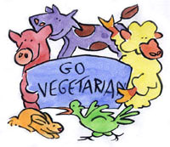
Hunting, stalking, and killing of animals, has been an American tradition since early man lived here. Today it exists as a "sport". There is no longer an excuse or reason for stalking and killing an animal in his or her habitat. However, people continue to hunt animals today and they feel they have every right to continue to do so. Animals need to be protected from this attack by humans.
What does the writer think about hunting? What in the article allows you to infer that?
What are his views or his bias?
What information did he leave out?

Slide 44
This writer believes that hunting animals is bad. His writing contains only information to persuade you NOT to hunt.
Hunting, stalking, and killing of animals, has been an American tradition since early man lived here. Today it exists as a "sport". There is no longer an excuse or reason for stalking and killing an animal in his or her habitat. However, people continue to hunt animals today and they feel they have every right to continue to do so. Animals need to be protected from this attack by humans.

Slide 45

I remember my first hunting trip with my dad. He taught me to aim and shoot straight. I remember how proud I was when I brought that first rabbit home and the family feasted on my "achievement". Today I continue to tramp through the fields or the woods. It brings back such fond memories of those trips with Dad. And I still get a feeling of satisfaction out of being able to bring something home--whether a small rabbit or a graceful deer. Hunting brings me great joy! I wish everyone had an opportunity to experience that feeling of accomplishment.
What does the writer think about hunting? What in the article allows you to infer that?
What are his views or his bias?
What information did he leave out?

Slide 46
This writer believes that hunting animals is good. His writing contains only information to persuade you to hunt.
I remember my first hunting trip with my dad. He taught me to aim and shoot straight. I remember how proud I was when I brought that first rabbit home and the family feasted on my "achievement". Today I continue to tramp through the fields or the woods. It brings back such fond memories of those trips with Dad. And I still get a feeling of satisfaction out of being able to bring something home--whether a small rabbit or a graceful deer. Hunting brings me great joy! I wish everyone had an opportunity to experience that feeling of accomplishment.

Slide 47
The author's purpose, or reason for writing, affects the content of what he/she writes. As a reader, you need to become aware of that purpose so that you can evaluate the content of what the author is writing.
In other words--YOU CAN'T BELIEVE EVERYTHING YOU READ--Think about why the author is writing as you read for information.

Slide 48
Critical thinking questions
Who created/paid for the message?
For what purpose was it made?
Who is the ‘target audience’?
What techniques are used to attract my attention & increase believability ?
Who or what might be omitted and why?
What do they want me to think or do?
How do I know what it means?
Where might I go to get more information?

Slide 49
Critical thinking questions
Why is this message being sent?
Who stands to benefit from the message?
Who or what might be omitted and why?
How might different people interpret the message differently from me?
What can I do with the information I obtain from the message?
What do you know; not know; like to know?

Slide 50
Critical thinking questions
Who produced and/or paid for the message?
What is the purpose of the message?
Who is the ‘target audience’ ?
What techniques are used to both attract attention and increase believability?
What lifestyles are promoted and why?
Does the message contain bias or stereotypes?

Slide 51
Now find some biases!
Flip through the newspaper and cut out examples of news stories, photos, and headlines that show bias.

Slide 52
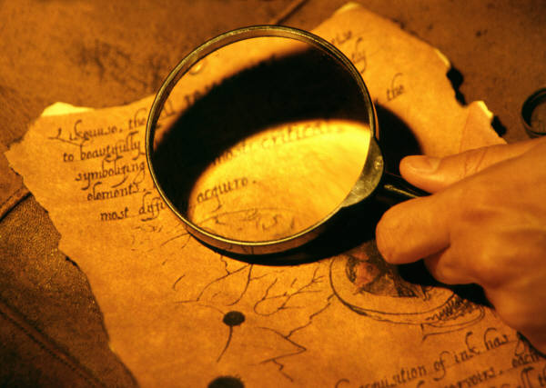
Now find some biases!
Bias through Omission (leaving stuff out)
2. Bias through placement (in the front or the back of the paper?)
3. Bias through photos (do they look good or bad?)
4. Bias through names (how do they label people?)
5. Bias through Statistics (do they mess around with the numbers?)
6. Bias through word choice (positive or negative words?)

Slide 53
Resources for this PPT
http://www.umich.edu/~newsbias/index.html
http://www.mediaawareness.ca/english/teachers/media_literacy/index.cfm
• "How to Detect Bias in the News | Handout."
Media Awareness Network | Réseau éducation médias. 6 Mar. 2008 <http://www.mediaawareness.ca/english/resources/educational/handouts/broadcast_news/bw_bias_in_the_news.c
fm>.
http://www.vnv.org.au/site/images/images/10reasonsveggo-animals.jpg
http://www.huntinglegends.com/wp-content/uploads/image/clipart_people_019.gif

