Slide 1
Irony
Defining Irony

Slide 2
What is situational irony?
Situational irony is when the opposite of what is expected occurs
  Example:
      The marriage counselor files for divorce
      The police station gets robbed
      The traffic cop got his license suspended because of unpaid parking tickets

Slide 3
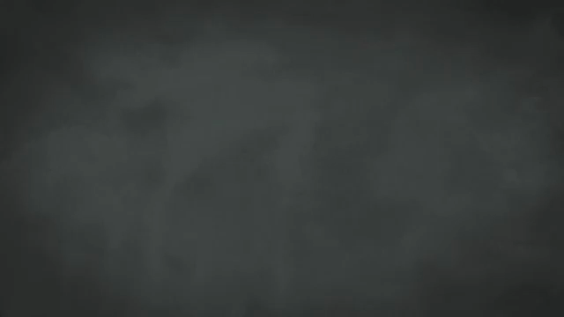
Situational Irony

Slide 4
Verbal Irony
Verbal Irony is when a person says something, but they actually mean the opposite. This can often be considered sarcasm.
  Example:
      The weather is as cool as July in Baltimore.
      This chair is as comfortable as sitting on nails.
      I enjoyed the movie as much as getting a root canal.

Slide 5

Verbal Irony

Slide 6
Dramatic Irony
Dramatic irony is when we the reader/ viewer know more than the characters in the novel or movie
  Example:
      In a horror movie, we the view know someone is the hiding in the closet, however the character does not know

Slide 7

Dramatic Irony

Slide 8
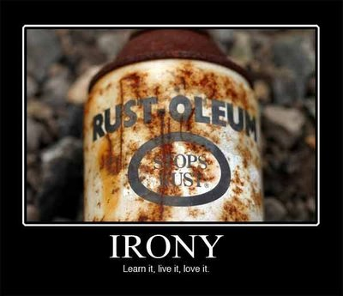

Slide 9
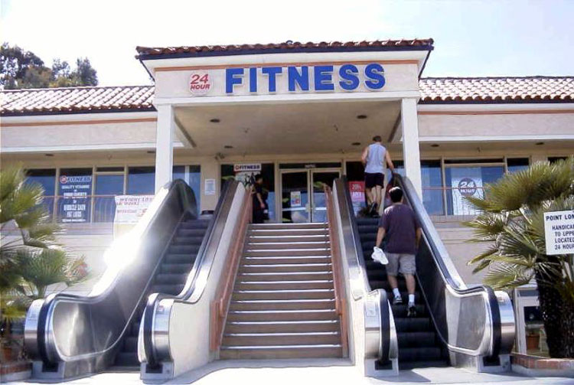
An escalator leading to a fitness center.

Slide 10
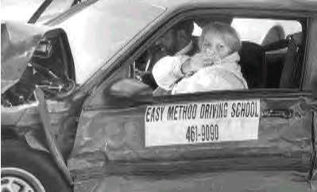
A wrecked car belonging to an "easy" driving school.

Slide 11
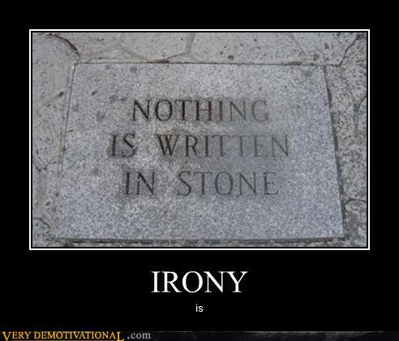

Slide 12
