Slide 1
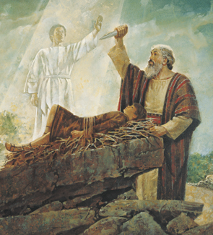
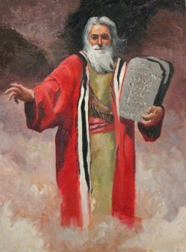
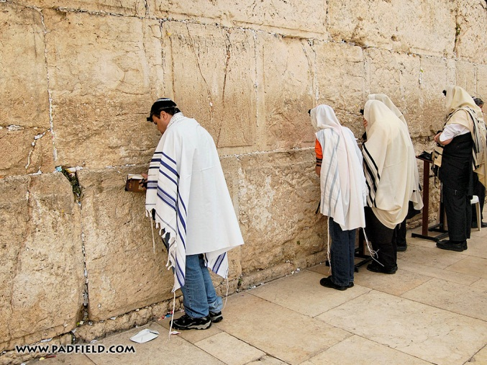
Judaism
15 million worldwide – mostly in Israel and the U.S.A.
Abraham
Ur (originally part of Sumer, was then part of Babylonia)
c. 1812 B.C.
“Father of Judaism”
covenant (contract) with G-d
Father of Isaac (laughter) – 100 year old Abraham and 90 year old Sarah were parents
Isaac
Was almost sacrificed by Abraham but was saved by an angel
Human sacrifice is banned in Judaism
Father of Jacob
Jacob
Had 12 sons
The tribes of Israel are the descendants of these sons
Moses
Egyptian prince / Jewish man

Slide 2
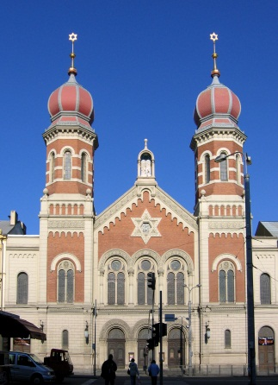
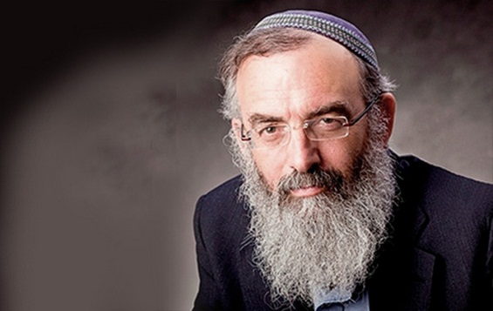
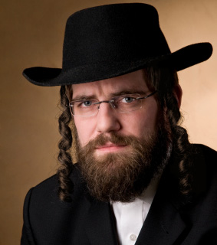
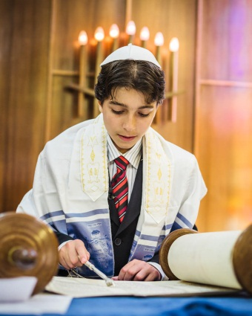
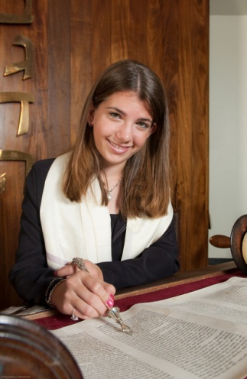
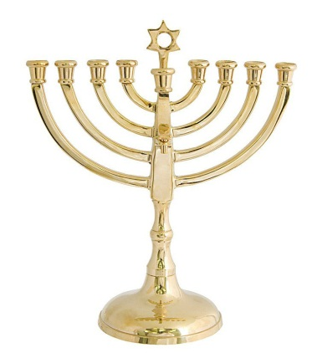
Judaism
Synagogues
Rabbis
Sabbath
Saturday
No work
The Torah
Jewish Law
First 5 books of the Hebrew Bible
Moses gave these laws to the Jews
1250 B.C.
Kosher food
No dairy and meat mixed, no pork, no shell fish
Meat: split hoof and chews cud
Orthodox, Conservative, Reform
Bar and Bat mitzvahs
Children become adults (12 for girls and 13 for boys)

Slide 3
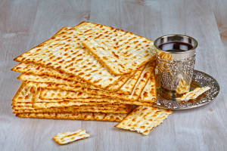
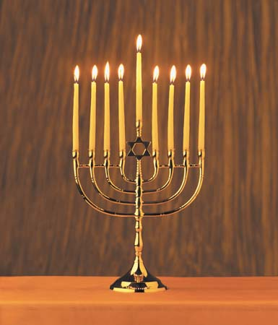
Major Holidays
Passover
“Pesach”
Commemorates Moses
Rosh Hashana
Jewish New Year
Yom Kippur
Day of Atonement
Hanukkah
Festival of Lights
Sukkot
The journey to the Promised Land

