Slide 1
Presidents’ Day
#Hyperdoc Template created by Kelly Hilton. Adapted by Susan Stewart

Slide 2
ENGAGE
Watch this Video!

Slide 3
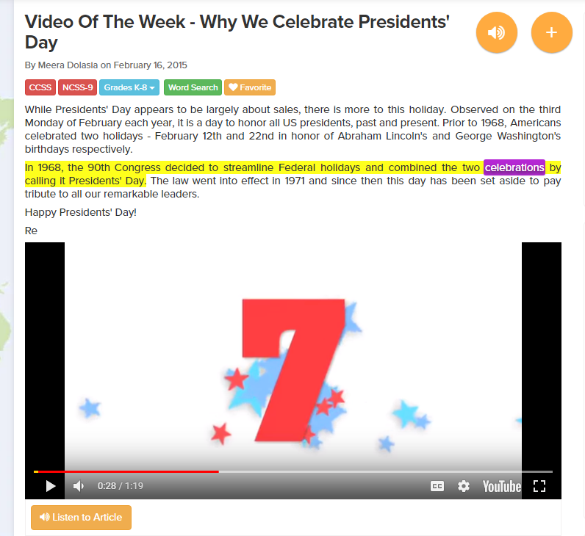
EXPLORE
Read this Article:
Why We Celebrate Presidents’ Day

Slide 4
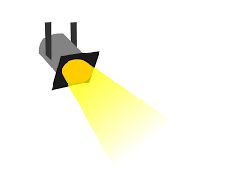
EXPLAIN
What are some of the jobs of the President of the United States?
Type your answer here.

Slide 5
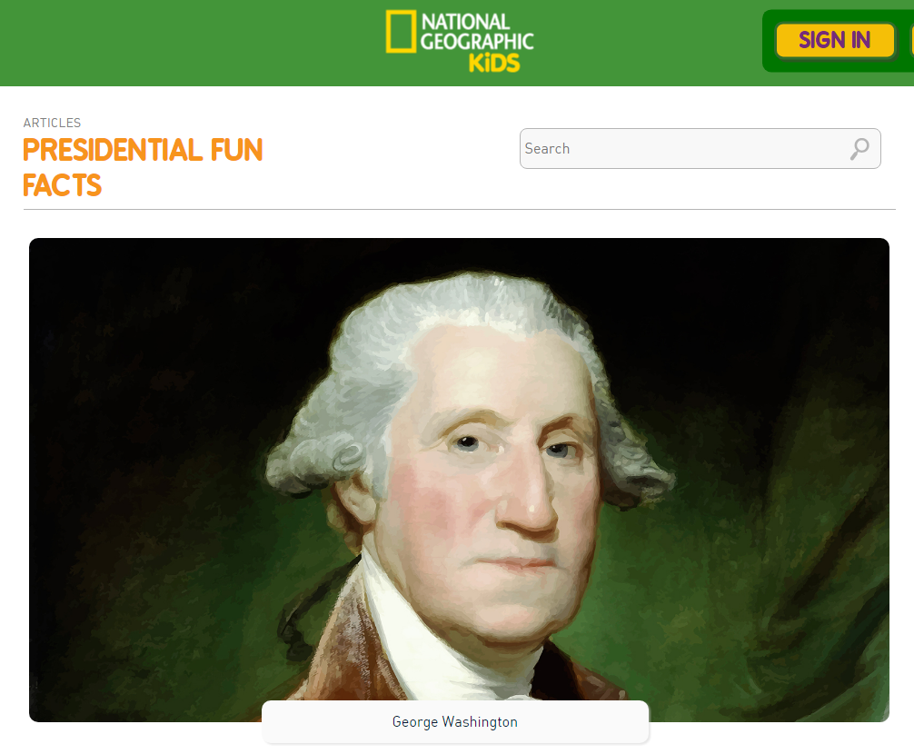
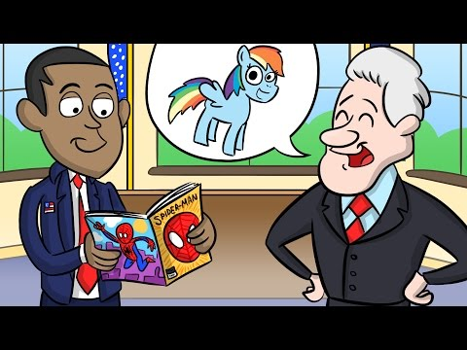
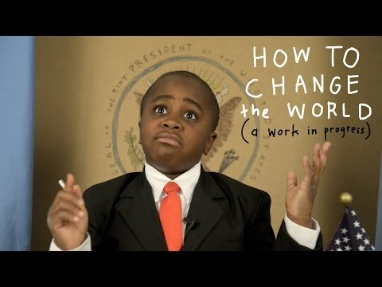
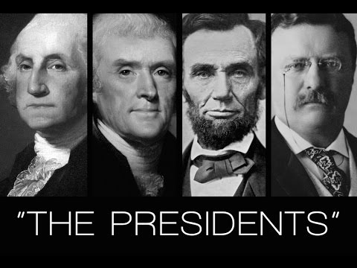
EXPLORE
Learn More About Presidents!
Presidential Fun Facts

Slide 6
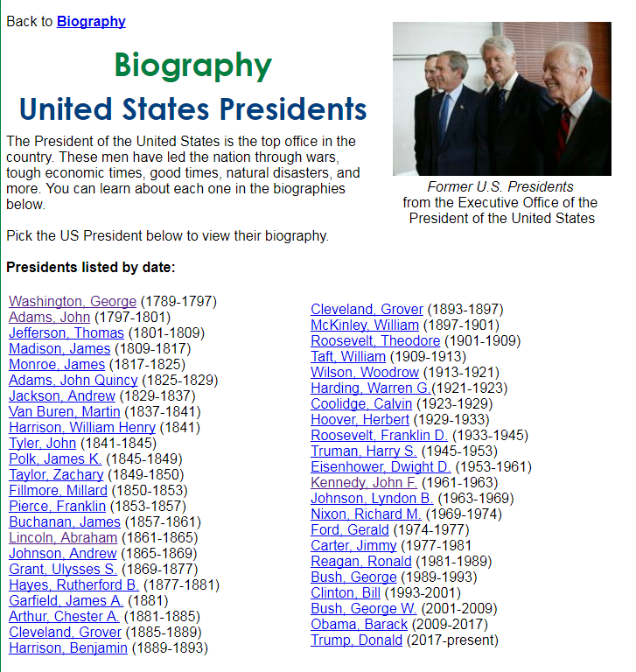
EXPLORE
More Information About Presidents:
Biographies Presidents on Pebble Go (Subscription) The American President: Kiddle Presidents Day Facts for Kids American President Fun Facts Presidents' Day Video Collection

Slide 7
Apply 1
President Picture
Make Your Own President Poster!
Fact One
Fact Two
Insert an image of a president.
Add facts and details about the president in each box.
Add a picture to go with each fact.
NAME HERE
Fact Three
Fact Four

Slide 8
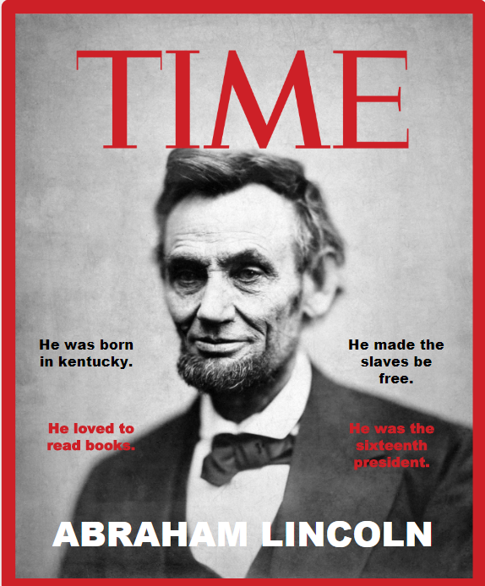
Apply 2
Make Your Own Time Magazine Cover!
Insert an image of a president.
Send the image back by selecting ORDER>Send to Back OR select the image and use the keyboard shortcut Control+Shift+Down Arrow
Add facts and details about the president as article headlines.
ARTICLE HEADLINE TWO
ARTICLE HEADLINE ONE
Article Headline Four
Article Headline THREE
NAME HERE

Slide 9
SHARE
Download or take a screenshot of your President Poster and SHARE it in our Seesaw Classroom!

Slide 10
Would YOU like to be President?
Why or why not?
Reflect
Type your answer here.

Slide 11
#Hyperdoc Template created by Kelly Hilton Adapted by Susan Stewart

