Slide 1
War of 1812
Mr. Paoletti

Slide 2
Can’t We All Get Along?
The War of 1812 was fought between the United States and Great Britain.
Sometimes called “The Second War of Independence.”
Great Britain was at war with France.
They blocked trade with the United States so they couldn’t trade with France.
The British Navy captured U.S. vessels and forced the sailors to join the British Navy!

Slide 3
What Happened?
The United States declared war on Great Britain on June 18, 1812.
The United States attacked a British colony first and LOST!
William Henry Harrison led an army and defeated a big Native American army led by Tecumseh, a Native American.

Slide 4
Bring in the Red Lobsters Again!
In 1814, the British began to fight back.
They used their navy to block U.S. trade and attack U.S. ports along the east coast.
In August 1814, the British attacked Washington D.C.!
They burned down the Capitol and the White House!

Slide 5
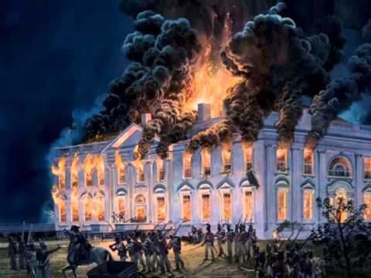

Slide 6
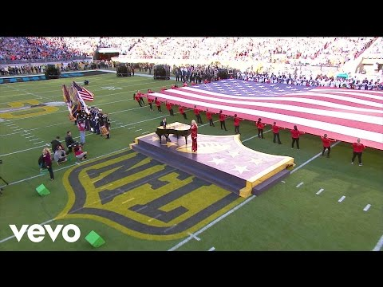

Slide 7
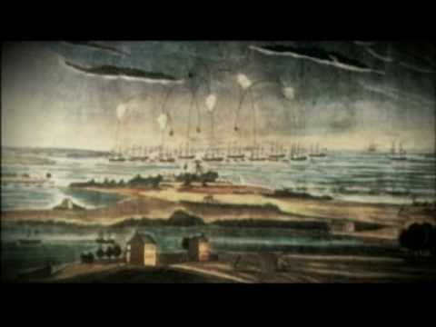

Slide 8
“Oh Say Can You See?”
The Battle of Baltimore lasted 3 days!
The British bombed Fort McHenry so they can make their way into Baltimore.
The soldiers at Fort McHenry held them off and the British surrendered!
Francis Scott Key watched the battle and wrote a poem that inspired “The Star Spangled Banner”.

Slide 9
A Peace for What?
The Treaty of Ghent ended the war between the United States and Great Britain.
The war ended in a stalemate. Both sides did not win or lose.
This treaty brought a long peace to both countries.

