Slide 1
The Civil War
Mr. Paoletti’s Class

Slide 2
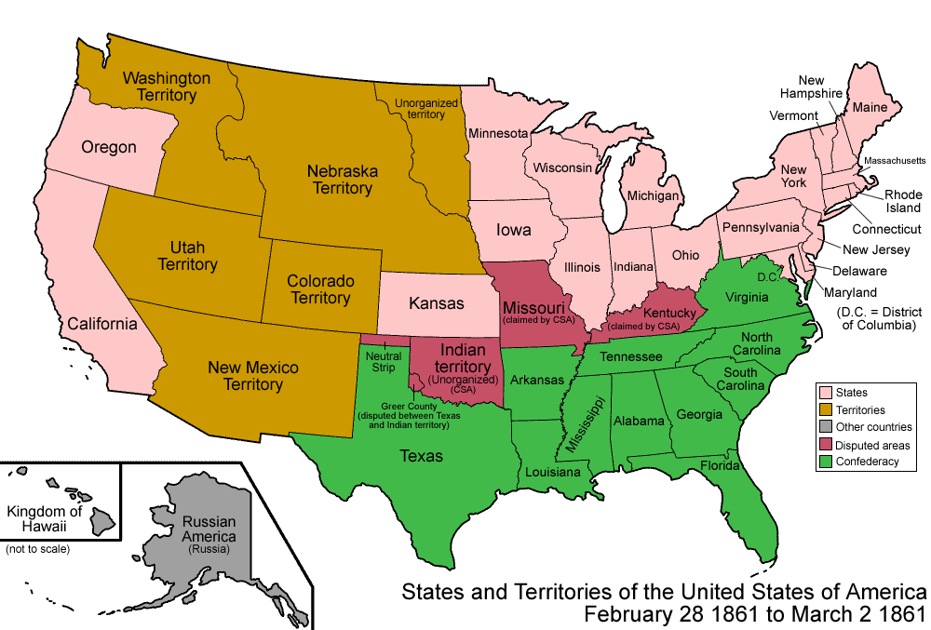

Slide 3
Vocabulary
Secession: The action of withdrawing from a political state or government. To Leave! See ya!
Union: The Northern states of the U.S.
Confederacy: The Southern states that formed the Confederate states.
State’s Rights: the rights and powers held by a single state
Slavery: the practice of being or owning a slave

Slide 4
North South
Banks and Factories
Experienced Government
More railroads
Large Navy
Larger Population
Trade with Europe
Best Military Officers
Fighting on own land
Farming and forests
More land

Slide 5
North or South?
More Railroads….
Farming and Forests….
Trade with Europe….
Large Navy….
Larger Population….
More Land….
Fighting on Own Land….

Slide 6
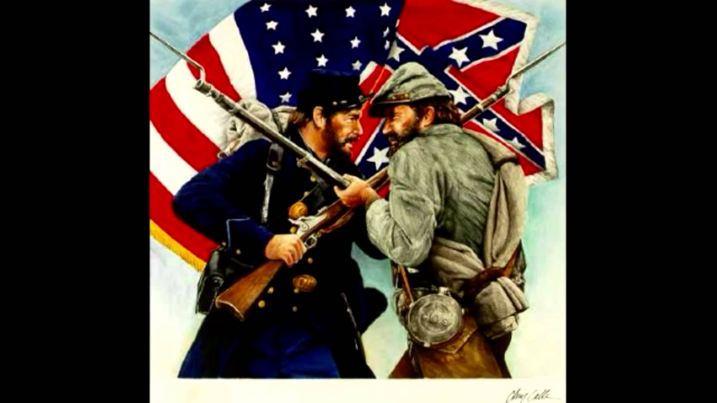
The Civil War Begins

Slide 7
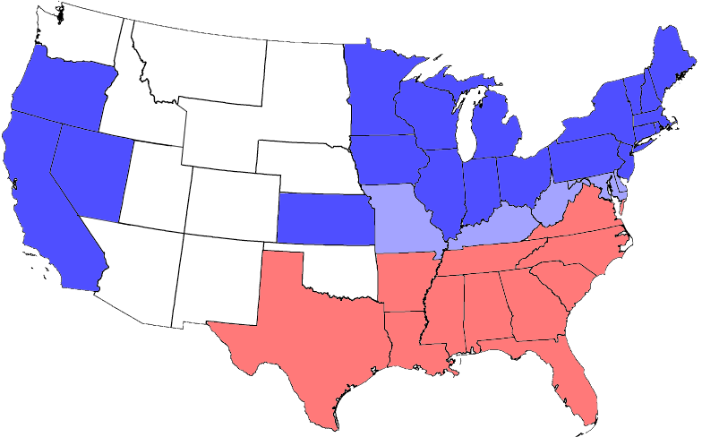
The United States Divided

Slide 8
The Battles of the Civil War

