Slide 1
Manifest Destiny
Mr. Paoletti

Slide 2
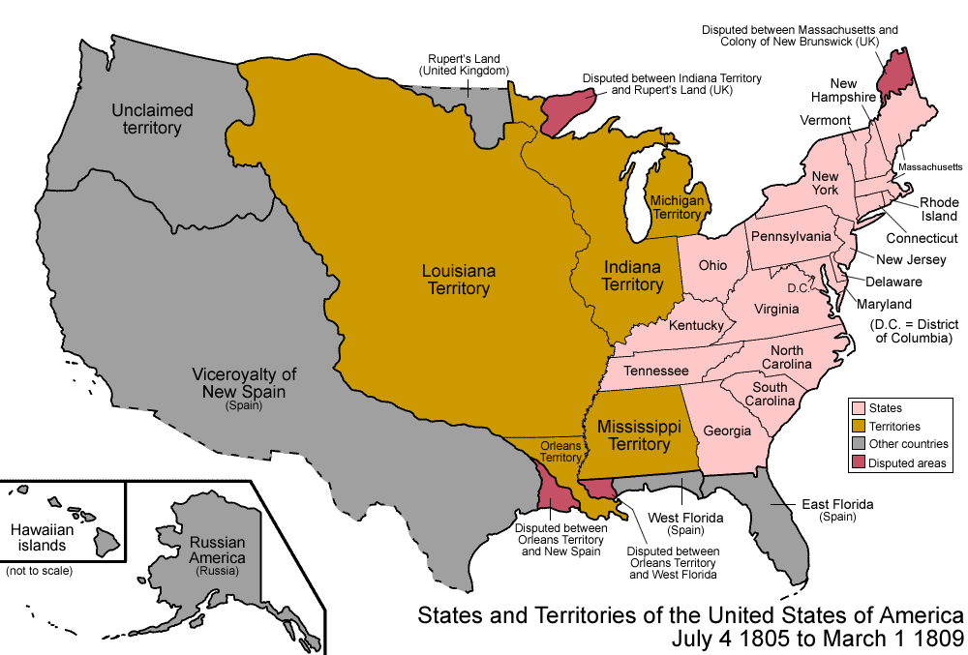
Where will we go next?

Slide 3
Where will we go?
The 13 colonies are on the Eastern part of the United States.
Their population is growing!
Which way will they have to go?

Slide 4
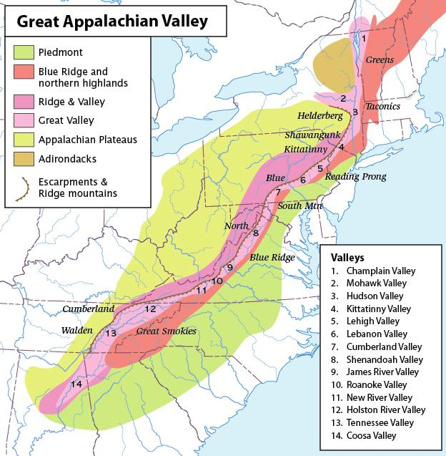
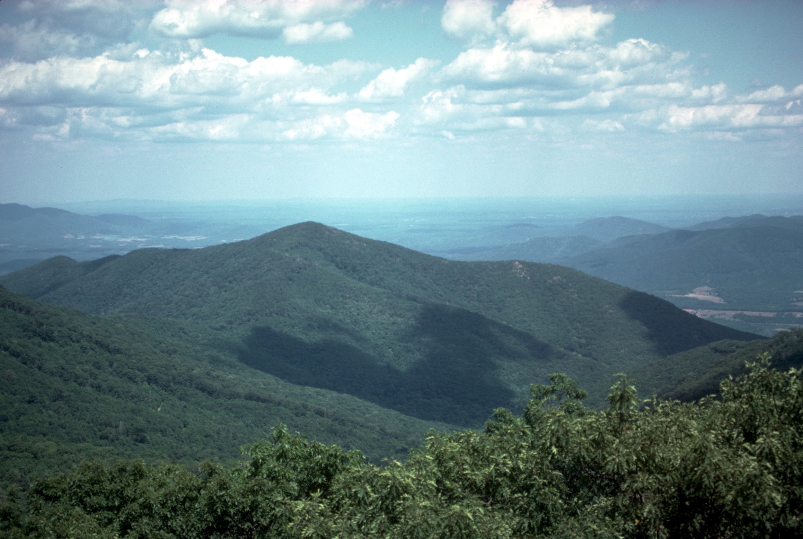
Road Block
The population started to migrate and build west.
They had a problem!
The Appalachian mountains were in their way.
Native Americans were living there too!

Slide 5
Hello from the Other Side
Settlers traveled over the Appalachian mountains and discovered land that was great for farming, fresh water, and rivers for transportation.
These settlers pushed the Native Americans out of their land again and started to migrate over the Appalachian mountains.

Slide 6
Louisiana Purchase: Who does it belong to?
American settlers started to move onto land owned by France.
Napoleon Bonaparte decided to sell the land to the United States.
President Thomas Jefferson bought the land for $15 million.
The country was growing and it created more opportunities.

