Slide 1
The 13 Original Colonies
Mr. Paoletti

Slide 2
What is a colony?
a country or area under the full or partial political control of another country.

Slide 3
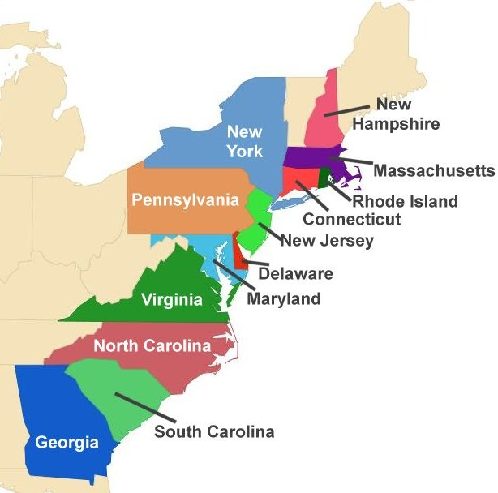

Slide 4
New England Colonies
-Connecticut
-Massachusetts
-New Hampshire
-Rhode Island

Slide 5
Middle Colonies
Delaware
New Jersey
New York
Pennsylvania

Slide 6
Southern Colonies
Georgia
Maryland
Virginia
North Carolina
South Carolina

