Slide 1
1861: The Country Goes to War

Slide 2
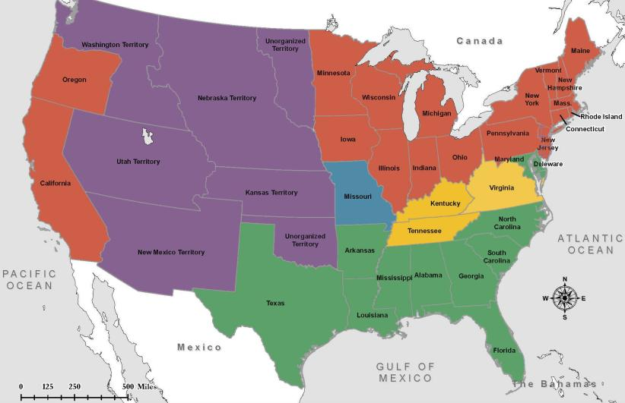
Lincoln Elected President
November 6, 1860
Red – Lincoln
Yellow – Bell
Blue – Douglas
Green – Breckinridge
Purple – Non-Voting Territories

Slide 3
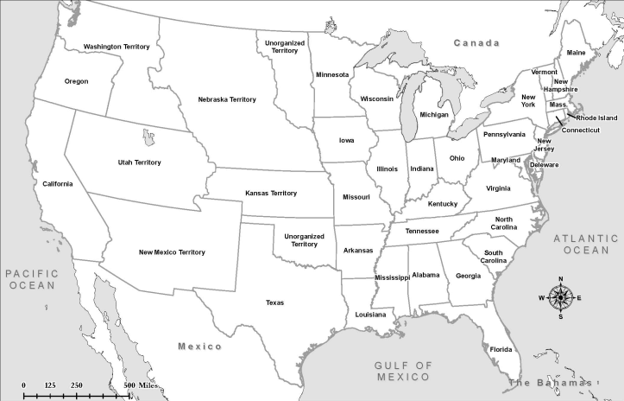
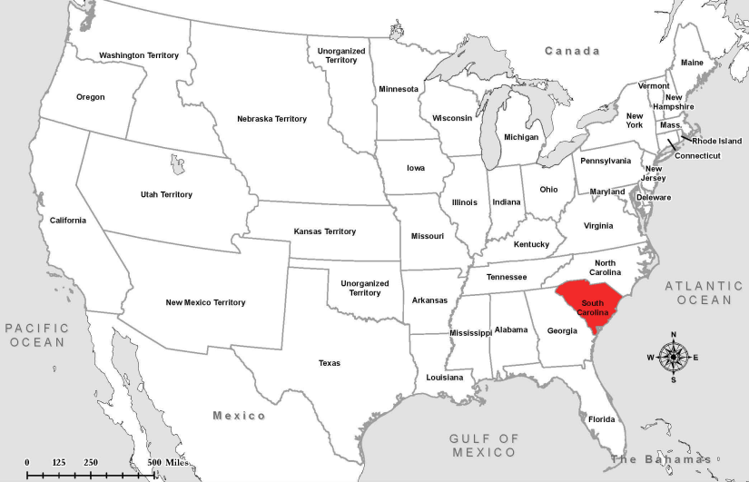
South Carolina Secedes
December 20, 1860

Slide 4
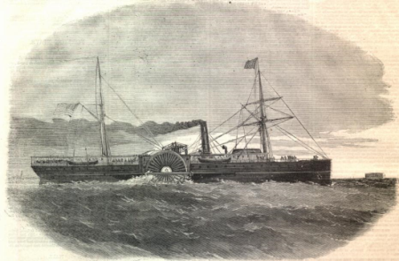
Shots Fired
January 9, 1861
Shots were fired at daybreak at the steamship Star of the West.
The 250 United States troops on board were attempting to enter the harbor of Charleston for the purpose of communicating with Fort Sumter.
The Star of the West returned to sea after South Carolina troops fired on her.

Slide 5
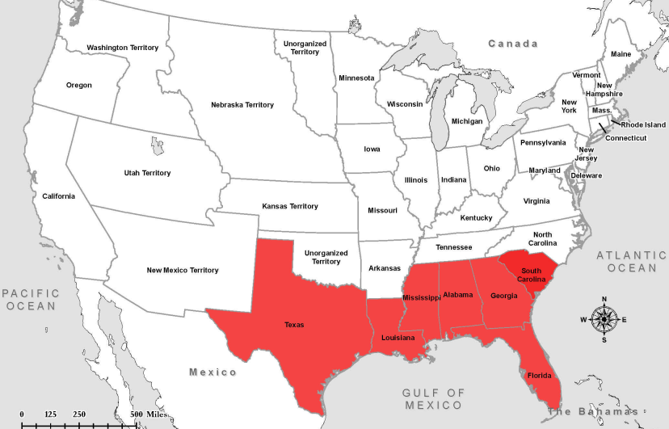
Secession January & February, 1861

Slide 6
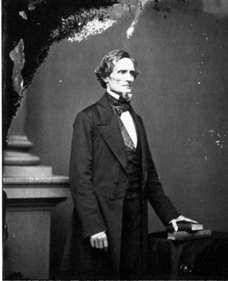
A President for the Confederacy February 9, 1861
Jefferson Davis is chosen as the President of the Confederate States of America.
He will be elected that November.

Slide 7
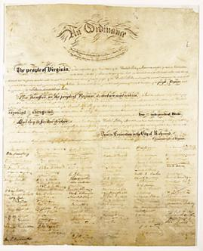
Constitution of the
Confederate States Of America
March, 1861
Preamble
“We, the people of the Confederate States, each State acting in its sovereign and independent character, in order to form a permanent federal government, establish justice, insure domestic tranquility, and secure the blessings of liberty to ourselves and our posterity invoking the favor and guidance of Almighty God do ordain and establish this Constitution for the Confederate States of America.”

Slide 8
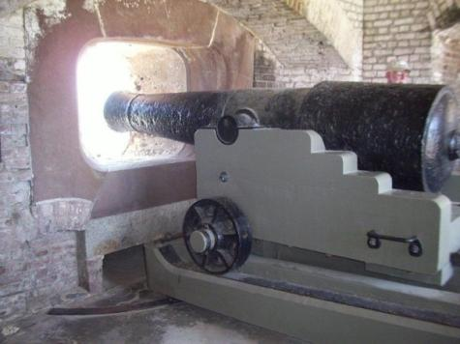
Fort Sumter
April 12, 1861
Confederate forces fired on the fort, which was unable to effectively fight back. The United States surrendered Fort Sumter, Union forces left the following day.
The firing upon Fort Sumter was the opening engagement of the American Civil War.

Slide 9
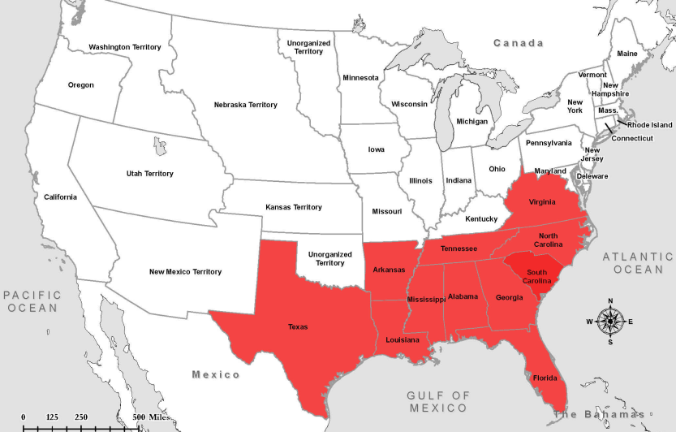
Secession
April - June 1861

Slide 10
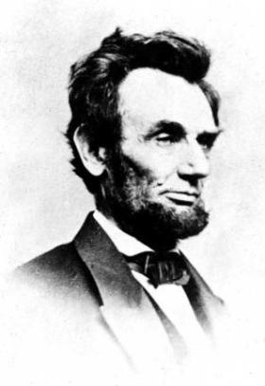
Excerpt, First Inaugural Address Abraham Lincoln, President of the United States of America
In your hands, my dissatisfied fellow-countrymen, and not in mine, is the momentous issue of civil war. The Government will not assail you. You can have no conflict without being yourselves the aggressors. You have no oath registered in heaven to destroy the Government, while I shall have the most solemn one to "preserve, protect, and defend it."

Slide 11
Excerpt from the Inaugural Address Jefferson Davis, President of the Confederate States of America
I enter upon the duties of the office to which I have been chosen with the hope that the beginning of our career as a Confederacy may not be obstructed by hostile opposition to our enjoyment of the separate existence and independence which we have asserted, and, with the blessing of Providence, intend to maintain. Our present condition, achieved in a manner unprecedented in the history of nations, illustrates the American idea that governments rest upon the consent of the governed, and that it is the right of the people to alter or abolish governments whenever they become destructive of the ends for which they were established.

