Slide 1
1864-1865: Bringing the War to an End

Slide 2
Bringing the War to an End
Images courtesy of Library of Congress
Notes:
Image information:
Left – Ulysses S. Grant
Right – Robert E. Lee

Slide 3
Bringing the War to an End
Date | Name
May-June 1864 | Overland Virginia Campaign
May-Sept, 1864 | Atlanta Campaign
Nov 1864 | Reelection of Abraham Lincoln
Sept - Dec 1864 | Sherman’s March to the Sea
July 1864 – April 1865 | Siege of Petersburg
April 9, 1865 | Lee’s army surrenders
April 14, 1865 | Abraham Lincoln is assassinated
April 26, 1865 | Joseph Johnston’s army surrenders
Activity Place each of the final events of the Civil War in chronological order on your timeline.

Slide 4
Bringing the War to an End
Activity
As we discuss the final events of the war you will label each of the events and their date on your map.

Slide 5
Bringing the War to an End
Abraham Lincoln appointed Ulysses S. Grant as commander of all the U.S. forces.
Image courtesy of the Library of Congress

Slide 6
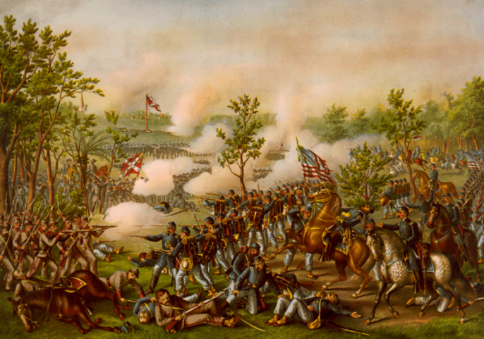
Bringing the War to an End
Notes:
Grant decided to fight the war on five fronts, with the biggest numbers toward Richmond and Atlanta.

Slide 7
Overland Campaign
The Wilderness was the first battle of the Overland Campaign and was fought in Orange County, Virginia May 5-7, 1864. Following the battle Union troops moved south to fight the next battle at Spotsylvania Court house just a day later.
Find Orange County, Virginia on your map and label it The Wilderness.
Image Courtesy of the Library of Congress

Slide 8
Spotsylvania Court House
The next battle began on May 8, 1864 and continued until the 21 at Spotsylvania Court House, Virginia.
Find Spotsylvania County on your map and label it Spotsylvania Court House.
Notes:
Image information:
Spotsylvania Court House, 1864

Slide 9
Cold Harbor
The final major battle of the Overland Campaign was Cold Harbor, fought in Hanover County, Virginia on May 31- June 12, 1864. Confederates won the battle. There were many battles in the Overland Campaign and the National Park Service estimates that the total casualties were more than 70,000.
Find Hanover County on your map and label it Cold Harbor.
Notes:
Image information:
Union troops preparing to charge

Slide 10
Atlanta Campaign
The Atlanta Campaign was a series of battles fought throughout Georgia during the spring and summer of 1864. Union Maj. Gen. William T. Sherman invaded Georgia, opposed by the Confederate general Joseph E. Johnston. Johnston's Army of Tennessee withdrew toward Atlanta. Davis replaced Johnston with John Bell Hood, whose army was eventually besieged in Atlanta. The city fell on September 2, but casualties numbered over 66,000.
Find Atlanta on your map and label it The Atlanta Campaign.
Notes:
Image information:
Union Maj. Gen. William T. Sherman and his staff in the trenches outside of Atlanta

Slide 11
Election of 1864
Notes:
With the war raging and the fate of the country hanging in the balance, the 1864 election had particular significance. Abraham Lincoln sought reelection in his campaign against former Union General George B. McClellan.
Image information:
Left – Democratic Candidates
Right – Republican Candidates

Slide 12
Election of 1864
Abraham Lincoln argued that the war must be won, the slaves freed, and the Union preserved at all costs.
George McClellan argued that the war had gone on long enough and that the South should be allowed to secede in order to save American lives. This meant that slavery would continue in the Southern states.
Notes:
Abraham Lincoln argued that the war must be won, the slaves freed, and the Union preserved at all costs.
McClellan argued that the war had gone on long enough and that the South should be allowed to secede in order to save American lives. This meant that slavery would continue in the Southern states.

Slide 13
Election of 1864
Image courtesy of the Library of Congress
Notes:
At this time in the war, many Americans asked why the war was being fought and whether it was worth it.

Slide 14
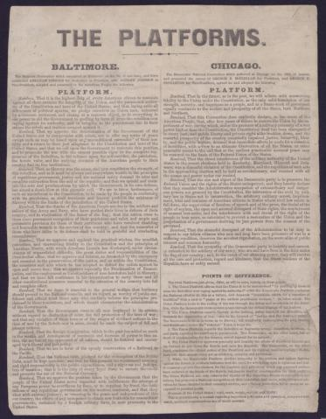
Election of 1864
Activity
Students considering the war from the perspective of Abraham Lincoln will read the Baltimore Platform

Slide 15
Election of 1864
Activity Students considering the war from the perspective of George B. McClellan will read the Chicago Platform

Slide 16
What do you think?
Not knowing who will win or lose, is it worth continuing the war, no matter how many casualties?
You will now break into two groups. Group 1 – Lincoln Group 2 – McClellan
Read your platform as a group.

Slide 17
What do you Think?
If you were Lincoln and chose to continue fighting the war…
How will you win?
Will you continue to try to spare civilians as the war wages around them?
How will you persuade the Northern public to support the effort?
How will you persuade Congress to financially support the war effort?
If you win, will you punish all of the people of the Confederacy or just those who “took up arms” against the United States or neither? (How will you be able to tell the difference?)
Notes:
After reading the platforms consider the following military, political, and economic factors

Slide 18
What do you Think?
If you were McClellan and chose NOT to continue the war…
How will you defend your new southern border?
How will you address the issue of runaway slaves from the South?
Will you enact a law similar to the Fugitive Slave Act in order to appease the new southern Confederacy?
How will you deal with the expanding western border and the current U.S. territories such as Oregon and Oklahoma?

Slide 19
What do you Think?
Activity Now, we will have a group debate between the Lincolns and McClellans
Notes:
Debate Questions:
Mr. Lincoln – How do you suppose we will win this war?
Mr. McClellan – Do you think we can win the war? What would you like to do instead of fight the war?
Mr. McClellan – If we end the war and allow slavery to continue in the South, do we still have to return runaway slaves?
Mr. Lincoln & Mr. McClellan – What do you think the nation wants right now?

Slide 20
What do you Think
Raise your hand if you are voting for Lincoln.
Raise your hand if you are voting for McClellan.

Slide 21
What do you Think?
America chose, through the election of Abraham Lincoln, to continue fighting the war.
Word of the events in Georgia and Virginia soon reached the capital.

Slide 22
Sherman’s March to the Sea
Sherman’s men left the city of Atlanta on November 15, 1864, heading toward the port at Savannah, on what would become known as Sherman’s March to the Sea. Sherman believed that in order to end the war he must destroy all aspects of the Confederacy’s war machine. Therefore, as he made his way to Savannah, he tore up railroad lines and destroyed all war- related industry. Operating deep within enemy territory and without lines of supplies or communication, Sherman destroyed much of the South’s potential to wage war.
Find Savannah on your map and label it Sherman’s March to the Sea.
Notes:
Image information:
Four men with crowbars prying up a rail, destroying the Confederacy’s ability to transport troops and supplies.

Slide 23
Lincoln Wins the Election
Lincoln gives his Second Inaugural Address March 4, 1865
Notes:
Image information:
Lincoln’s second inaugural address

Slide 24
Siege of Petersburg
The Petersburg Campaign was a series of battles around Petersburg and Richmond Virginia, fought between June 1864 and April 1865. Petersburg was crucial to the supply of Confederate Gen. Robert E. Lee's army and the Confederate capital of Richmond. Lee finally yielded and abandoned both Richmond and Petersburg in April 1865, leading to his surrender at Appomattox.
Find Petersburg on your map and label it The Siege of Petersburg. Find Richmond on your map and label it The Fall of Richmond.
Notes:
Image information:
Ruins of the State Arsenal at Richmond showing stacked and scattered ammunition.

Slide 25
Confederate Surrender
The armies of the Union were able to coordinate successfully with each other and Lee surrendered at Appomattox, Virginia on April 9, 1865.
Find Appomattox on your map and label it, Confederate surrender.
Image courtesy of the National Park Service

Slide 26
Confederate Surrender
Activity
Let’s read a portion of General Chamberlain’s account as a class and answer the discussion questions
Image courtesy of the National Archives
Notes:
General Joshua Lawrence Chamberlain was present at the surrender. His account made it appear as though Abraham Lincoln’s wishes for “charity” toward the former Confederates was likely.

Slide 27
Johnston Surrenders to Sherman
Johnston surrendered to Sherman on April 26, 1865 in the home of James Bennett near Durham, North Carolina.

Slide 28
Rebuilding
After the surrender, the difficult task of rebuilding and reunifying the country began.
Image courtesy of the National Archives
Notes:
Image information:
Richmond in ruins.

