Slide 1
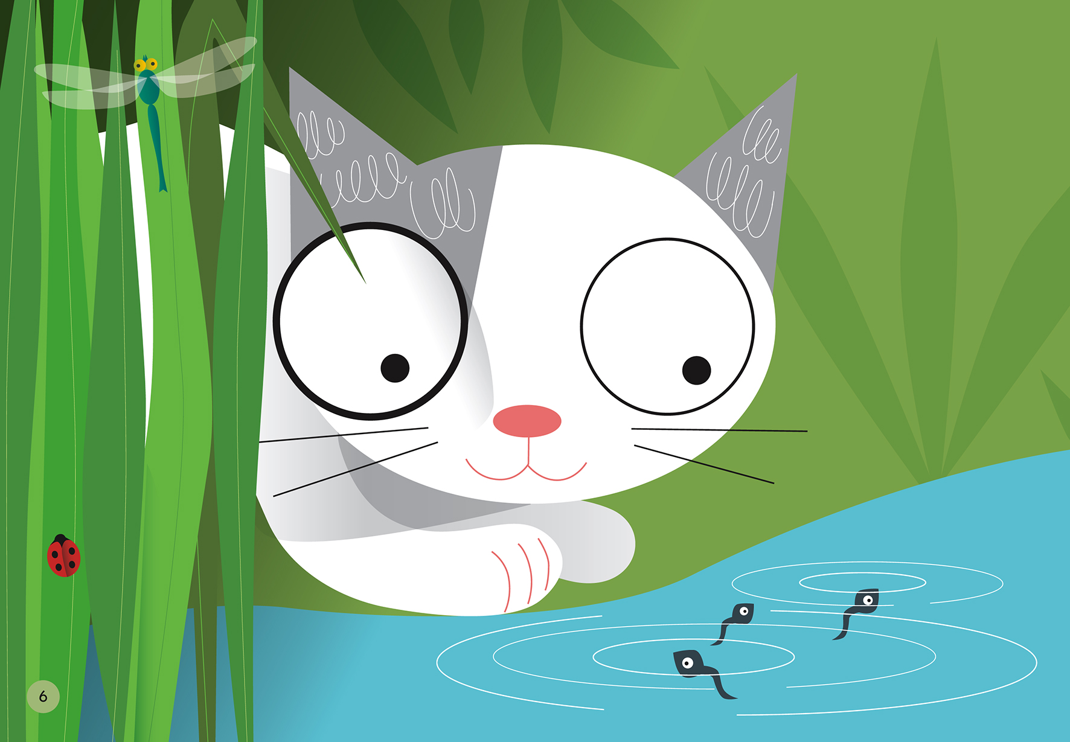
A Home for Oscar
A STEM Challenge

Slide 2
Challenge
Oscar’s mother told him that he would be a grown cat by winter and you are going to be the one to adopt him!
To get ready, you must design a living space for Oscar when he arrives.
You have $15 to spend on Oscar’s living space.
You will need to budget your money and defend how you spend it to make sure Oscar’s needs are met.

Slide 3
Cat Supply Store

Slide 4
Goals
Oscar must have everything to meet his basic needs.
  What are Oscar’s basic needs?
Oscar must be happy!
  What things might Oscar want in his space to make him happy?

