Slide 1
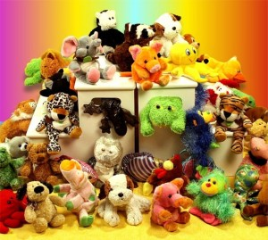
Beanie Baby
Animal Habitats
2nd Grade STEM Activity

Slide 2
Habitats
A habitat is the home of a living thing.
A living thing depends on its habitat for its food, water, and shelter.

Slide 3
Your Challenge
Your team will be assigned a beanie baby to build a habitat for.
You will need to find out what needs your animal has and meet those needs through your habitat.
Be sure to create a pattern to camouflage your animal!

Slide 4
By the end of the project
you will be able to say…
S | I can identify needs that are met by an animal’s habitat.
T | I can use digital camera to take a picture of our habitat.
E | I can use the Engineering Design Process
M | I can create patterns to camouflage the animals.

Slide 5



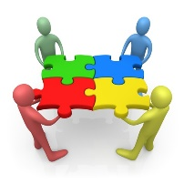
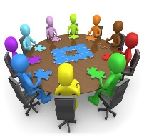
What is the engineering
Design Process?
 | Ask
 | Imagine
 | Plan
 | Create
 | Improve

Slide 6
Project Schedule
Week 1: -Introduce Project -Form Groups -Begin Project Journal (Ask, Imagine, Plan)
Week 2: -Create Habitat -Photograph Habitat
Week 3: - Read letters from animals - Draw blueprint for improvement - Improve Houses - Photograph Houses

Slide 7
Letters from your Beanies!
After you have built your habitat, your animal will write you a letter telling you what needs have been met and what you might want to rethink. Then you’ll get to work on perfecting your habitat to meet the animal’s needs.

