Slide 1
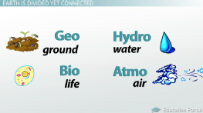
Impact on Earth’s Spheres

Slide 2
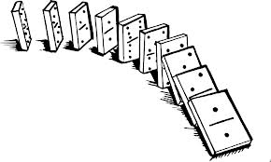
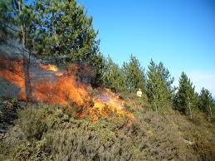
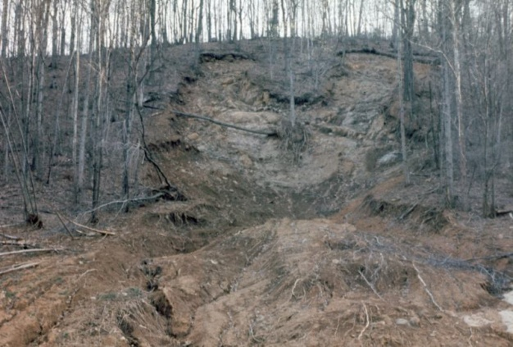
Interconnected Spheres
Spheres are closely connected
Changes are often chain reactions
A change in one sphere results in changes in others based on an event
Forest fire destroys plants in an area
Interactions between spheres
No plants => erosion

Slide 3
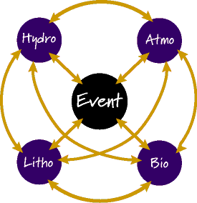
Event Sphere
Causes & Effects
Event Sphere
Sphere Sphere

Slide 4
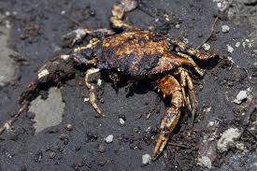
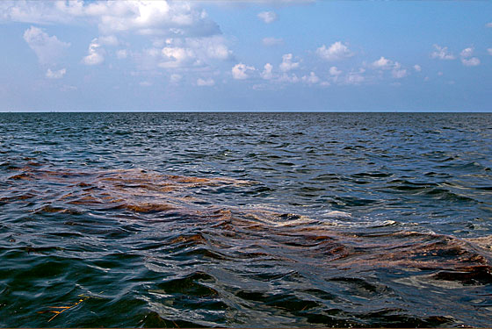
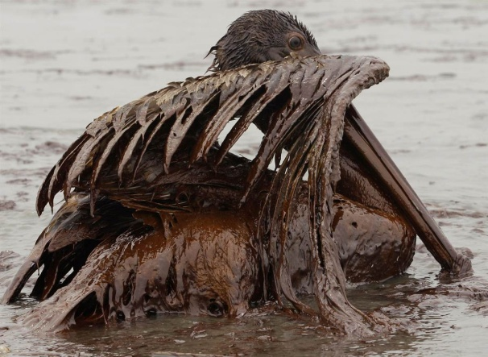
Earth’s Spheres Impact
Events
Cause - effect events
Natural events
Earthquake, hurricane, forest fires
Human caused events
Oil spill, air pollution, construction

Slide 5
Impact
What spheres caused the event?
Sphere Event
What are effects of the event on the spheres?
Event Spheres
How do changes in one sphere impact on other spheres?
Sphere Sphere

Slide 6
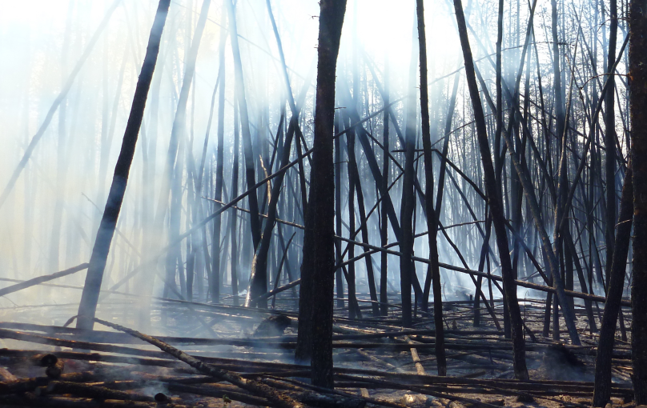
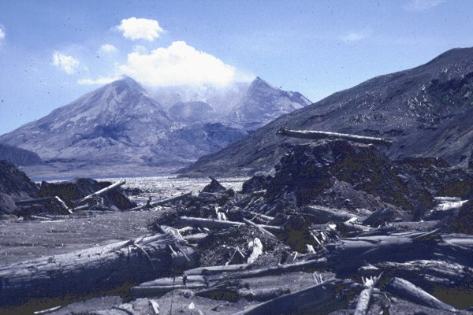
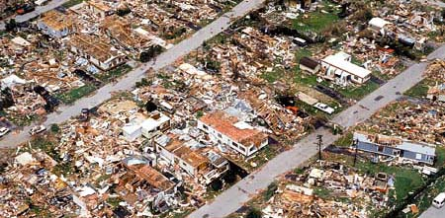
Impact Examples
Examples
Yellowstone Forest Fire, 1988
Mt St Helen’s eruption, 1980
Hurricane Andrew, 1992

Slide 7
Directions
Research your “event” with your group
Type a brief description of the event
where it happened
what happened
After understanding the event, discuss with your partner the sphere interactions and impact on each
Then type a paragraph explaining the sphere impacts on each other- impacts are positive and negative effects of the event (the cause)
Include a before and after picture of the event
Put both full names on the document with a title. Print two copies.

