Slide 1
Class Notes in CP US1
Anything written in green is important and you should copy it into your notebook.
Anything written in red is also important, but you don’t need to write it down. These are often quotes or questions. We will talk about them.
Notes:
Powerpoint created by Ms. Susan Pojer and edited by Ms. Margaret Gammie. Used with permission.

Slide 2
Class Notes in CP US1
Feel free to use shorthand. I write out full names and words on the slides, but you can feel free to abbreviate as you need to.
  Examples of shorthand:
  - b/c for because
  - ppl for people
  - w/ for with or @ for at
  - gov for government, ind for industry, ag for agriculture, col for colony, rev for revolution
  - Initials for people or places after you have written their name once (i.e. GW, JM, TJ or VA, NJ, PA)

Slide 3
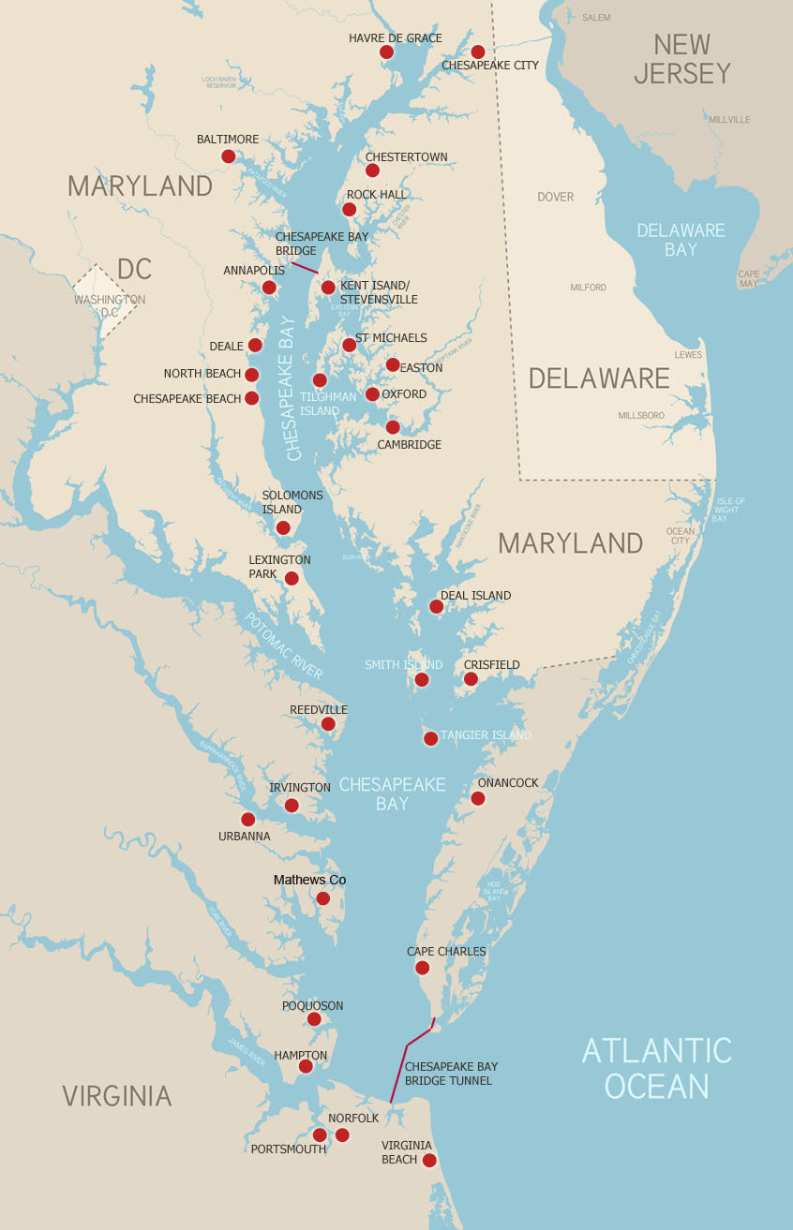
The Virginia Colony
Chesapeake Bay

Slide 4
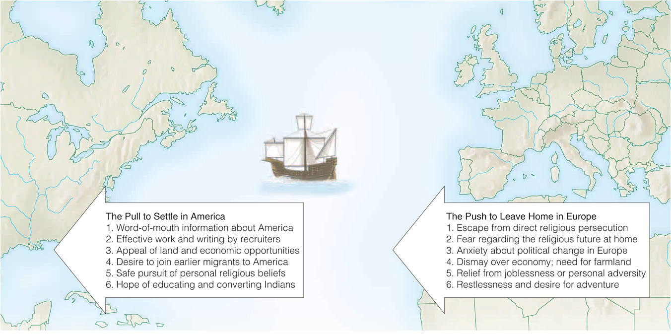
Why did Europeans migrate to North America in the 17th century?

Slide 5
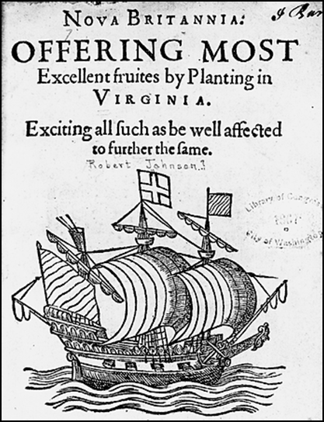

Founding Jamestown
What is a joint-stock company? Why did the English need one to settle Jamestown?
1606: King James I granted a royal charter for the Virginia Company to settle the Chesapeake
May 24, 1607:
104 men landed
at the James
River and
established the
first permanent
English colony in
North America. 40
had died at sea.
Notes:
Who was Jamestown named after?
In 1606, England had made peace with Spain. This gave James I the assurance he needed to feel comfortable establishing a colony again in North America (after Roanoke in the 1570s).
London merchants financed the colonies through groups like the Virginia Company. They would receive letters of patent from the king to establish the colony, so that if they faced a challenge for the land from another European power, they would have the force of the Crown behind them. Keep in mind that all of this was happening gradually, and when the Europeans first arrived, they did not imagine themselves taking over all of the land from the natives.

Slide 6
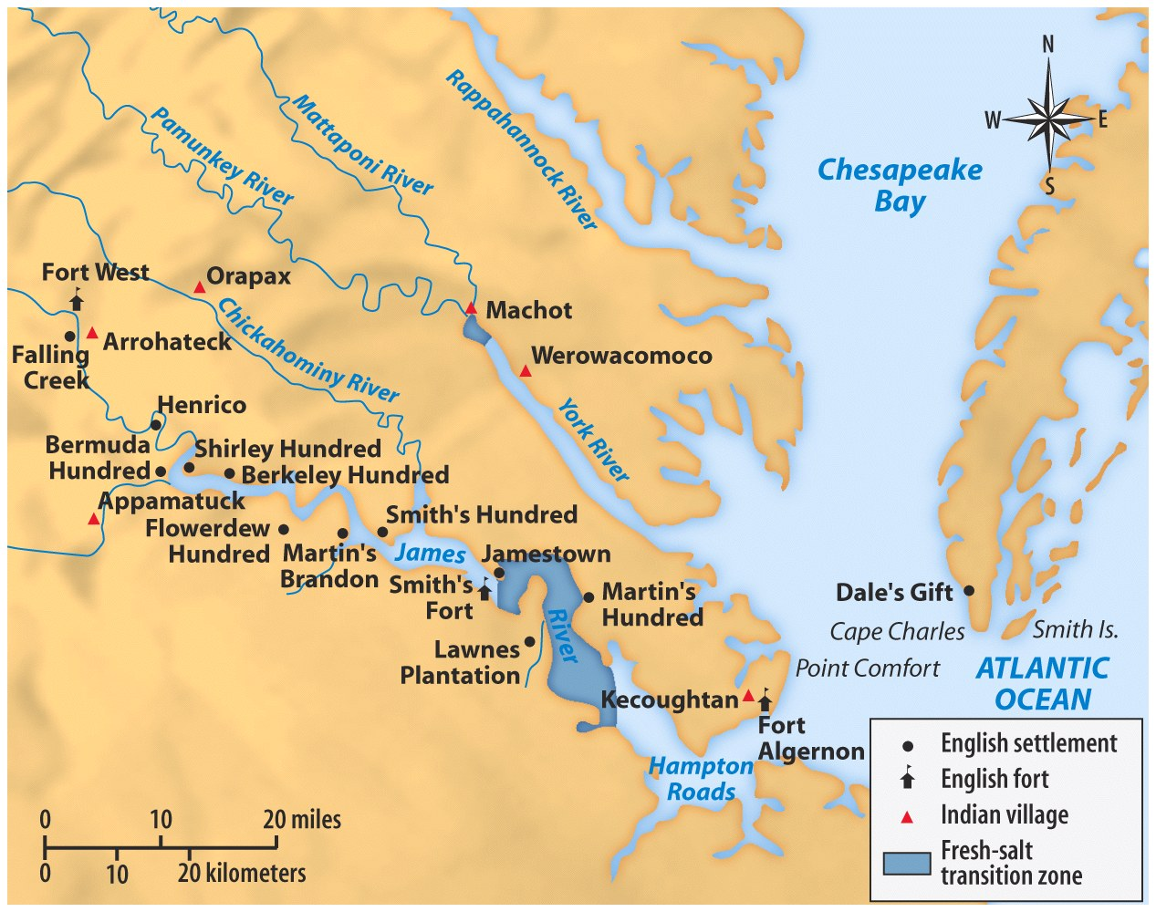
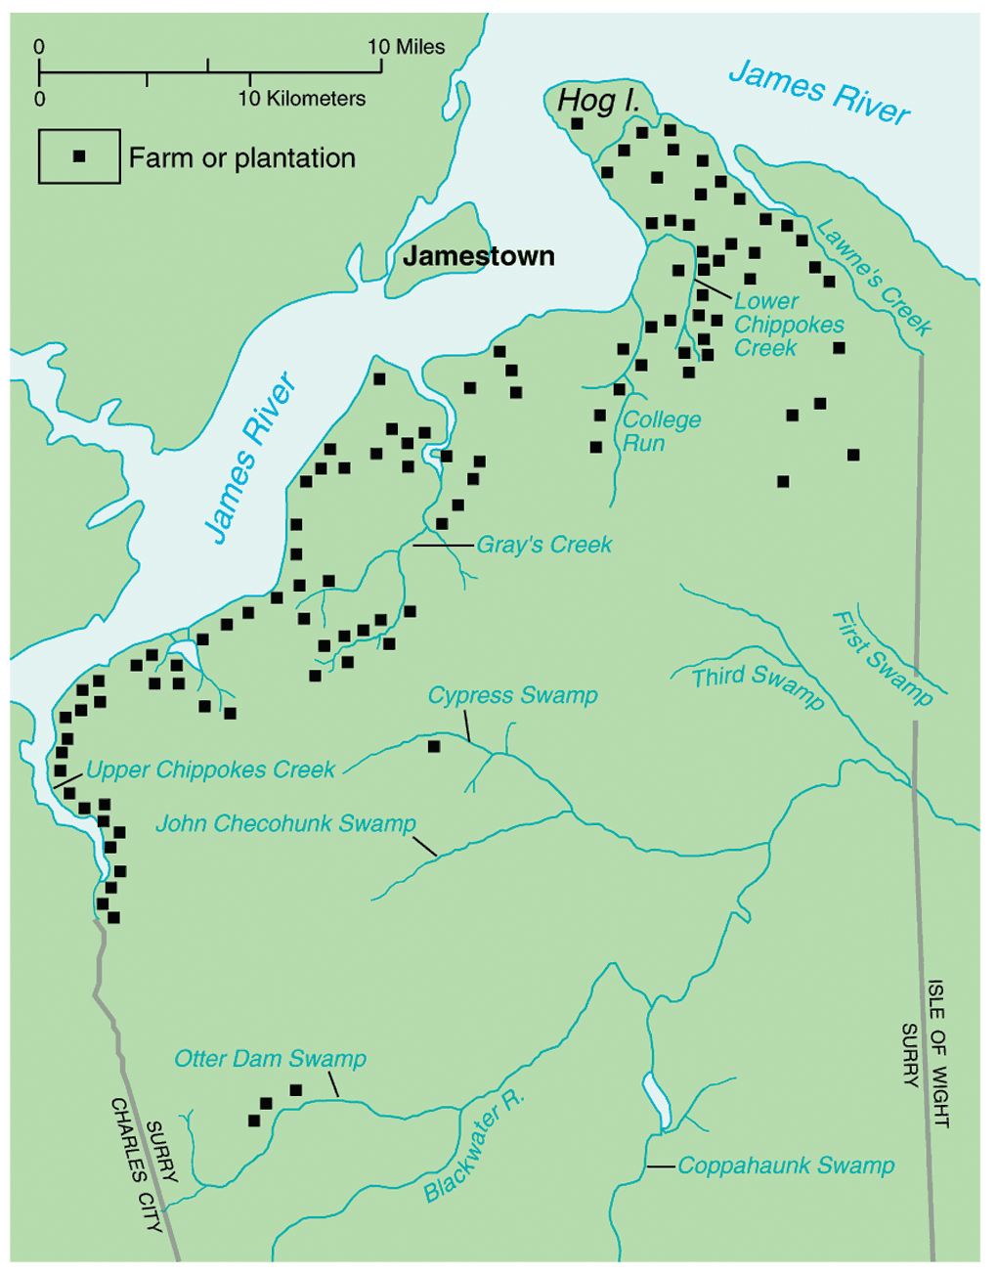
Why would they select Jamestown?
Notes:
Hoping they would be easily defended from attacks a bit further inland—mosquitoes (and therefore disease) an issue
Immediately built a fort, with one fortification looking inwards, to the natives, and 2 garrisons looking outwards because of the threat of attack from Spain. Imagine if the Spanish had decided to attack and establish their own colony!

Slide 7
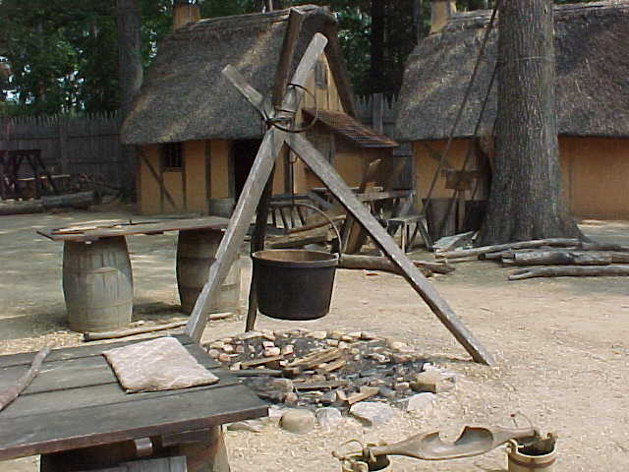
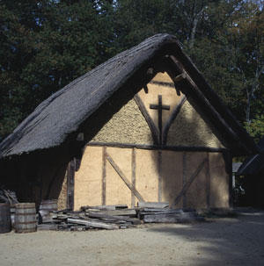
Jamestown Settlement
Notes:
Why is a chapel significant?

Slide 8
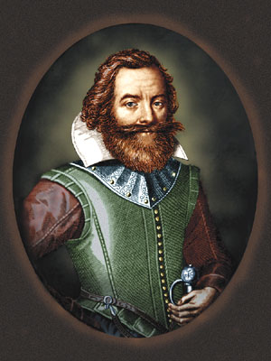
Early Trouble
Gentlemen refused to farm and wasted time looking for gold.
Captain John Smith restored order by forcing settlers to grow food. He declared that “he that will not work shall not eat.”
There was no talk…but dig gold, wash gold, refine gold, load gold…
John Smith
Notes:
http://www.smithsonianmag.com/smithsonian-institution/new-archaeological-research-jamestown-reveals-identities-four-prominent-settlers-discovery-180956028/?no-ist
Spring 1607: 104 colonists.
Spring 1608: 38 colonists

Slide 9
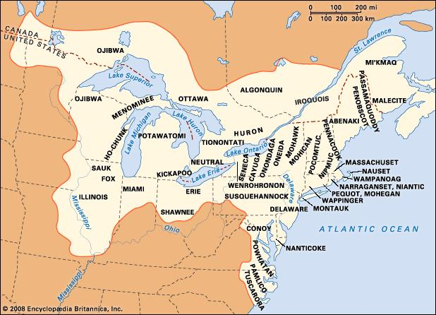
Which Native American tribe lived around the Chesapeake?
Notes:
Consider who was already there when the English arrived

Slide 10
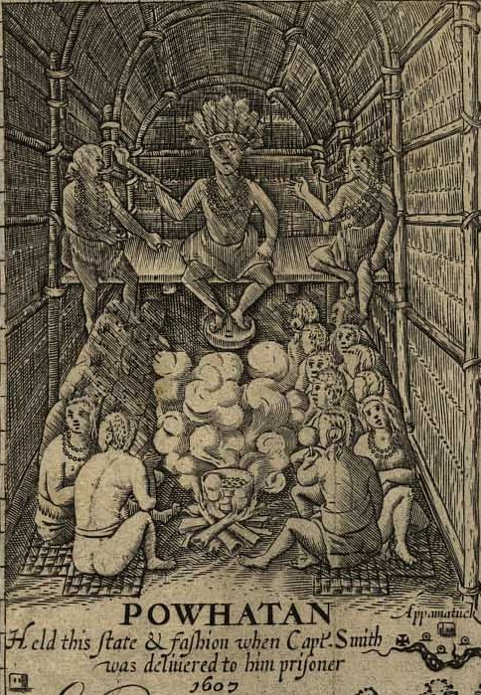
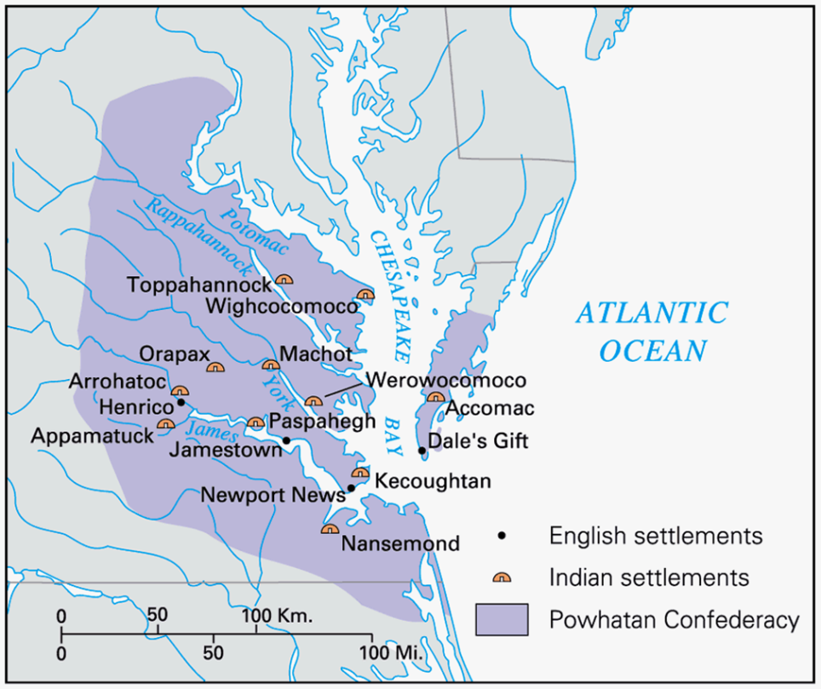
Powhatan Confederacy
  Led by Chief Powhatan, dominated the Chesapeake. Initially saw the English as potential allies.

Slide 11
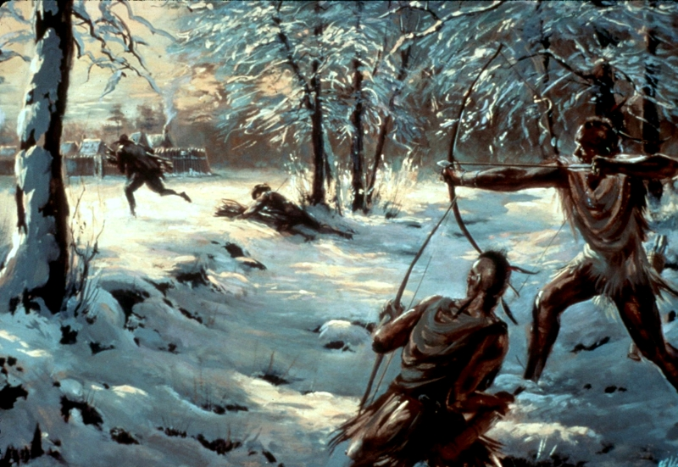
Alliance Failed
First Anglo-Powhatan War, 1610-1614
  Cultural misunderstandings (i.e. story about Pocahontas and John Smith).
  English raided Powhatan supplies
Notes:
Story covered tomorrow in the SHEG

Slide 12
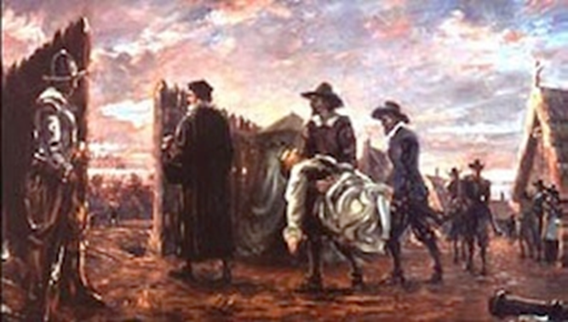
The Starving Time, 1609-1610
2/3rds of colonists died due to lack of food and wars with the Powhatan. A 7 year drought made supplies scarce for everyone in the region. Smith had returned to England in 1609 after a gunpowder accident.
Notes:
Jamestown Rediscovery archaeologists in 2012 uncovered the first forensic evidence of survival cannibalism in a European colony in North America.
George Percy was the leader of the colony (President of the Council) at that time.
Gunpowder he was carrying in a pouch exploded on his leg.
Later explored New England for the English

Slide 13
Due to their “crewell hunger,” the settlers entered the woods to “digge the earthe for wylde and unknowne Rootes,” but “weare Cutt off and slayne by the Savages.” Then, desperate settlers dug up “dead corpses outt of graves” to eat them, and others “licked upp the Bloode which had fallen from their weake fellowes.”
–George Percy
Notes:
Jamestown Rediscovery archaeologists in 2012 uncovered the first forensic evidence of survival cannibalism in a European colony in North America.
George Percy was the leader of the colony (President of the Council) at that time.
Reading 17th century writing is like reading a bad speller! No standardized spelling at that time.

Slide 14
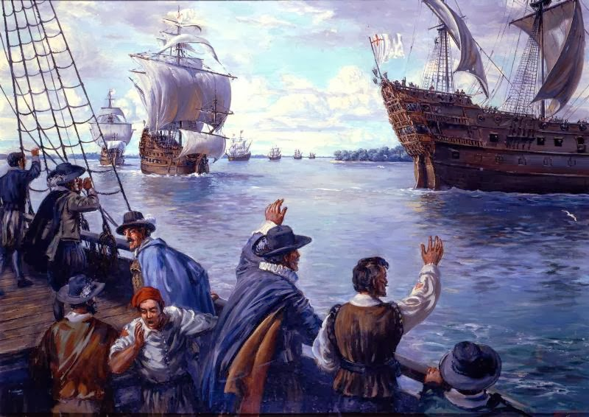
1610: Turning Point
The colonists decided to abandon the colony, but they encountered Lord De La Warr with more supplies as they left.
Notes:
De La Warr’s fleet had been blown off course and spent the winter in Bermuda before mustering the strength to make it to Jamestown
Later named Delaware after him

Slide 15
Search for a Cash Crop
The colonists had previously experimented with industries like silk, glass, lumber, sassafras, and tar to try to make money for the Virginia Company. They desperately needed a way to make the colony profitable. What was the solution?
Notes:
What would that important cash crop be?

Slide 16
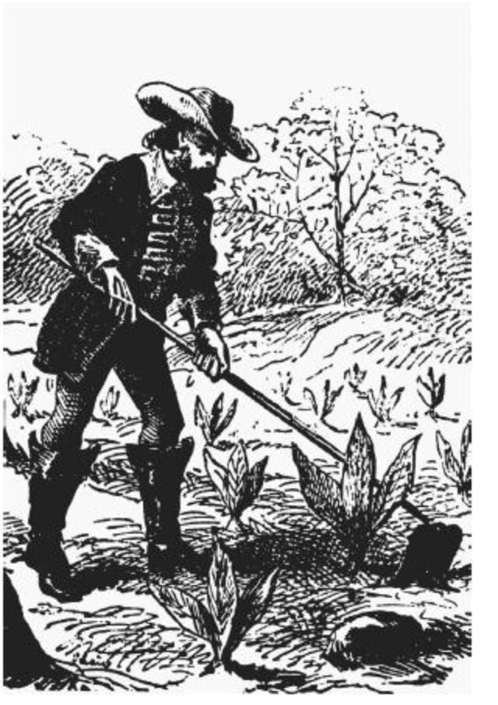
John Rolfe introduced tobacco → prosperity and stability for Virginia
Virginia’s gold and silver.
John Rolfe, 1612
Notes:
Comes after experiments with other industries: glass, lumber, silk. Tobacco had been found in the West Indies by the Spanish and taken to Europe, where it became fashionable. Intro in Virginia meant England could stop importing from Spain. The English also liked the Virginia brand of tobacco better than what they got from Spain.
Tobacco: Rolfe’s “pipe dream”!

Slide 17
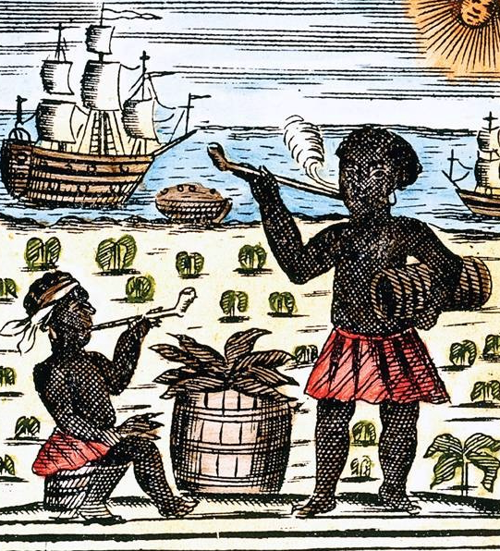
Success of Tobacco
1618 — Virginia produces 20,000 pounds of
tobacco.
1622 — Despite losing nearly one-third of
its colonists in an Indian attack,
Virginia produces 60,000 pounds of
tobacco.
1627 — Virginia produces
500,000 pounds
of tobacco.
1629 — Virginia produces
1,500,000 pounds
of tobacco.
Notes:
Note how quickly it increases! Allows the colony to survive and thrive. But also note that it makes the colony almost completely dependent on one crop, which could be devastating if the crop were to fail.

Slide 18
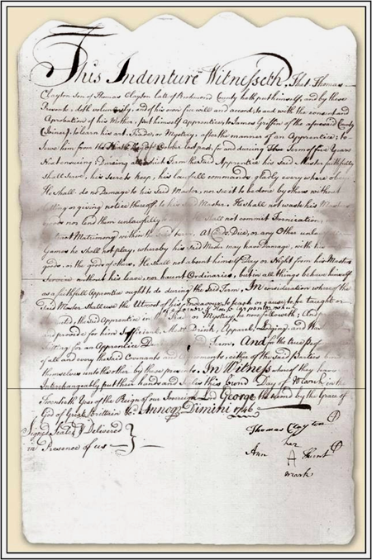
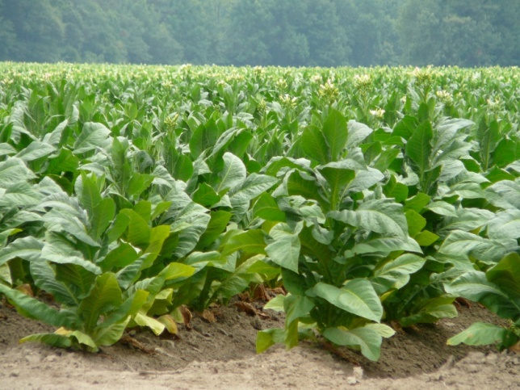
Tobacco → Demand for Cheap Labor
Headright System: English received 50 acres of land for each person that they paid to bring to America.
Indentured Servitude:
5-7 years of work in America in exchange for free passage. Received freedom dues at end of contract (land, money).
Only 1 in 10 outlived their indentured contracts. Why would someone become an indentured servant?
Notes:
Servant’s contract

Slide 19
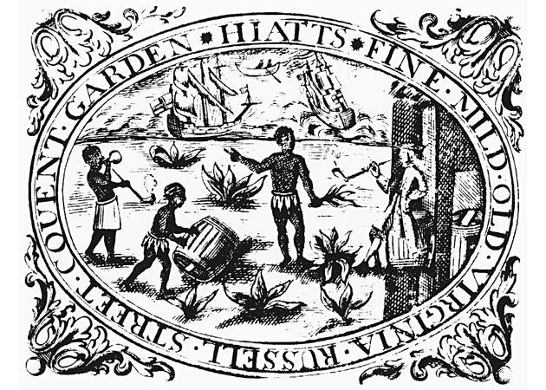

Slavery in Virginia
First Africans arrived in 1619.
  Status unclear → perhaps slaves, perhaps indentured servants.
  Slavery not prevalent in Virginia until end of the 17th c.

Slide 20
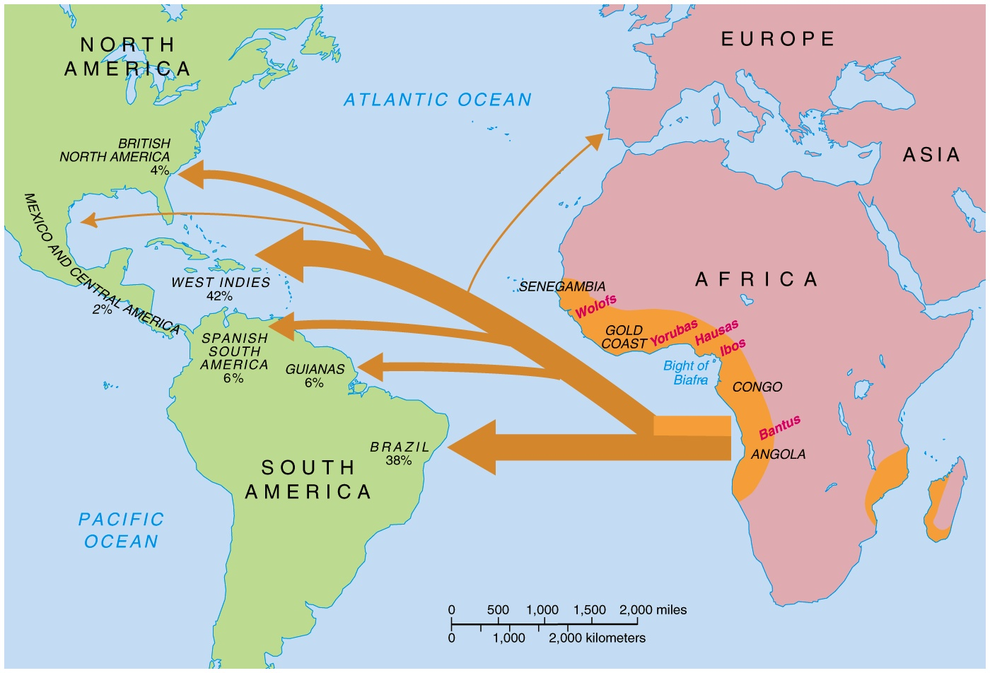
The Atlantic Slave Trade
Notes:
Slavery was starting to increase in other places

Slide 21
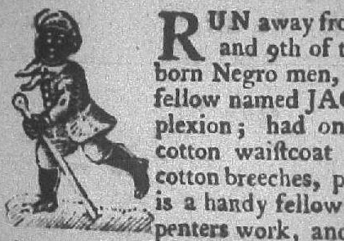
Colonial Slavery
Slavery became economic and racial over the 17th c. At the beginning of the century, the differences between a white indentured servant and a man captured in West Africa were unclear and they were largely treated the same.
1662: “Slave Codes” began to formally define their status.
  Blacks treated
  like property.
  Illegal to teach
  a slave to read or
  write.
Notes:
Slavery in the English world was originally equated with people who were considered “barbarians,” or non-Christians.
English had a strong sense of insiders and outsiders that they applied to slavery. Freemen often associated their liberty with the enslavement of others.
Slavery was a common punishment
Native Americans often enslaved by the English and sold to the Caribbean (a means of removal for up to 50,000 of them). Indians participated in the slave trade by enslaving enemy tribes in order to gain access to European goods.

Slide 22
17^{c} Population
in the Chesapeake
Large increase in black population! Turning point = Bacon’s Rebellion

Slide 23
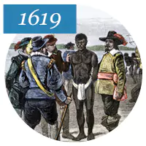
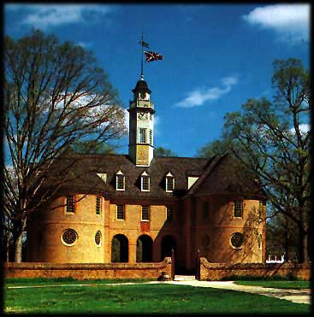
1619: A significant year in Virginian history for two reasons

Slide 24
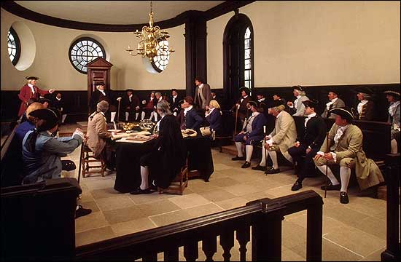
House of Burgesses, 1619
A local representative assembly that gave colonists control over financial and military concerns.
Representatives appointed by the royal governor and mostly powerful planters. But why is this group significant?
Notes:
Williamsburg, VA: colonial capital
First representative assembly in the colonies!

Slide 25
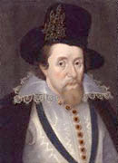
1624: Virginia becomes a royal colony
James I revoked the charter of the bankrupt Virginia Company.
Now Jamestown had access to more resources to fight the Powhatan.
Notes:
He distrusted the House of Burgesses and thought that the VA Company was mismanaging their duties.

Slide 26
Anglo-Powhatan Wars
Peace from 1614-1622, sealed by the marriage of Pocahontas and John Rolfe.
1622: Rolfe and 346 others killed in a raid. Virginia Company called for a “perpetual war” against the Powhatan.
1646: Powhatan forced off of their land. The English had grown stronger thanks to resources from the tobacco sales and royal intervention, allowing them to eventually overpower the Powhatan.
Notes:
Period of peace allows the English to grow their settlement
Marriage of Pocahontas and Rolfe not consensual because Pocahontas was kidnapped as a means of pressuring her father
1624: made a royal colony = resources to eventually overpower Powhatan

