Slide 1
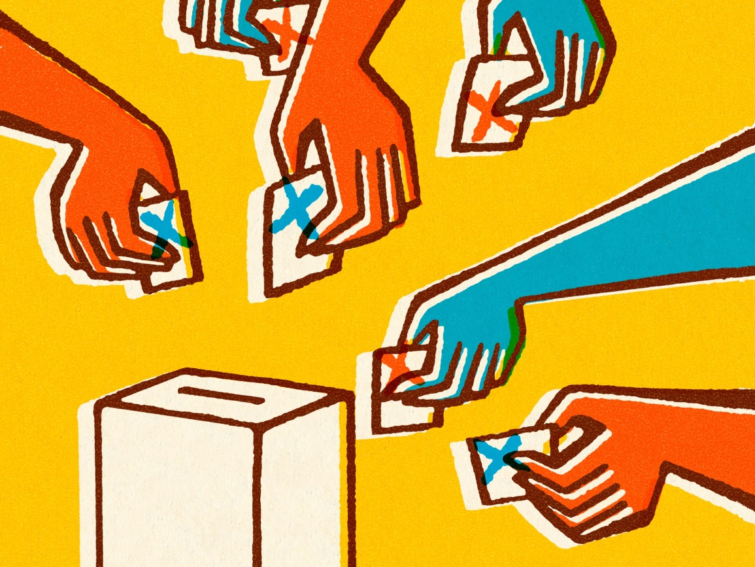
The Election of 1824

Slide 2
What Trend do you notice?
President A
President B
President C
President D
Previously Held Office
Vice President
Secretary of State
Secretary of State
Secretary of State

Slide 3
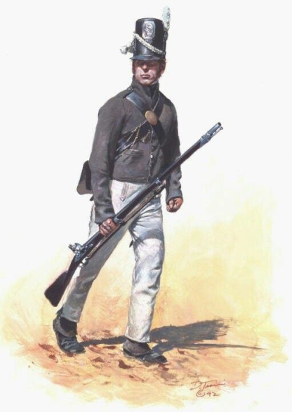



Who do you think is most and least qualified and why?
Candidate A
Candidate B
Candidate C
Candidate D
Qualifications
Secretary of State
Speaker of the House
Secretary of the Treasury
Military Hero

Slide 4
Election results: Who Won?
Candidate | Popular Results | Electoral Results
A | 108,740 | 84 (32%)
B | 47,136 | 37 (14%)
C | 46,618 | 41 (16%)
D | 153,544 | 99 (38%)

Slide 5

12th Amendment to the US Constitution
“If no person have such a majority [of electoral votes], then from the persons having the highest numbers not exceeding three on the list of those voted for as President, the House of Representatives shall choose immediately, by ballot, the President…”
Why is this amendment significant in the Election of 1824?
Notes:
So this is the second time in 24 years that the election goes to the HoR. And it has not gone to them since!

Slide 6
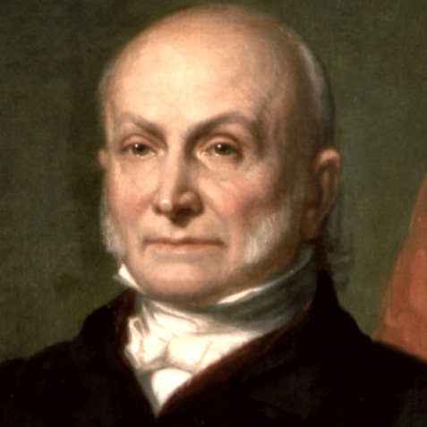
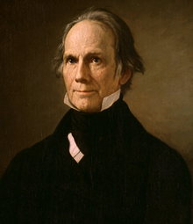
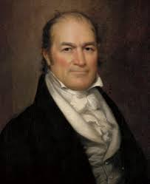
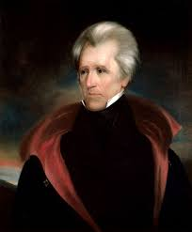
The Candidates Revealed
Candidate | Popular Results | Electoral Results
A: John Quincy Adams | 108,740 | 84 (32%)
B: Henry Clay | 47,136 | 37 (14%)
C: William Crawford | 46,618 | 41 (16%)
D: Andrew Jackson | 153,544 | 99 (38%)
Notes:
SoS for Monroe, Speaker of the House, SoT for Monroe, hero of New Orleans

Slide 7
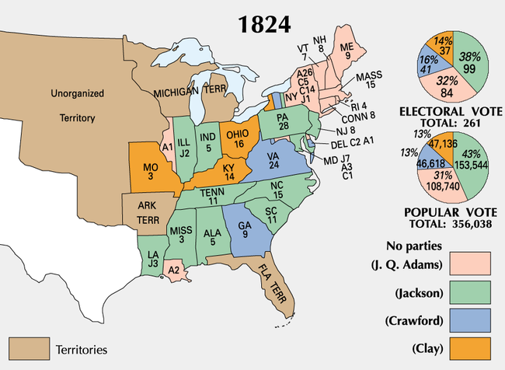
Notes:
Note the mosaic nature of the map—candidates are all over the place!

Slide 8
Election of 1824
No candidate received a majority of the electoral votes, although Jackson won a plurality (meaning he won the most, but it wasn’t the majority).
Under the 12th amendment, the election went to the House of Representatives.
The House elected John Quincy Adams.
3 days later, Adams appointed Clay to be his Secretary of State.
Jackson supporters claimed a “corrupt bargain” had occurred!
Notes:
A plurality = the most, but not the majority (51%). Usually this does not happen because usually you have 2 major parties running and the votes are split between the 2 main candidates.

Slide 9
Other Unusual Elections
Year | Candidate A | Candidate B | Actually Elected
1800: Electoral tie | Aaron Burr (73) | Thomas Jefferson (73) | Thomas Jefferson
1824 | Andrew Jackson 153,544 | John Q. Adams 108,740 | John Quincy Adams
1876 | Samuel Tilden 4,300,590 | Rutherford Hayes 4,036,298 | Rutherford B. Hayes
2000 | Al Gore 51,003,894 | George W. Bush 50,459,211 | George W. Bush

Slide 10
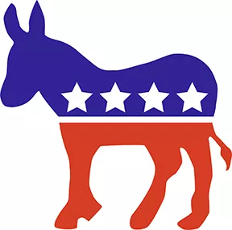
Effects of the Election of 1824
Led to the creation of the Democratic Party
Bitter campaign between Adams and Jackson in 1828
High opposition to Adams’s administration from Jackson supporters.

Slide 11
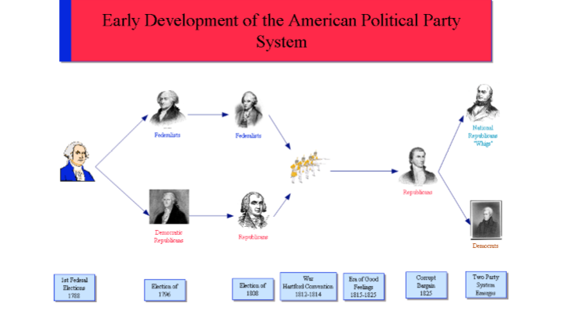

Slide 12

Essential Question
Did John Quincy Adams and Henry Clay arrange a “corrupt bargain”?

