Slide 1
Wednesday, October 3
Warm up: Dot Game
Notes:
Powerpoint created by Mr. Brian Thomas and edited by Ms. Margaret Gammie. Used with permission.
**Next year: use mini Q version of the same question**

Slide 2
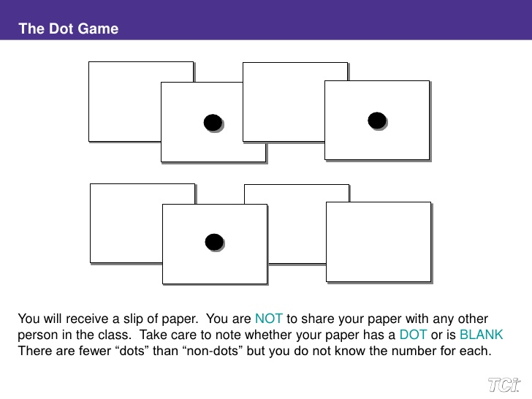
Instructions
You will receive an index card with either a dot or a square on it. Do NOT share the contents of your card with anyone.

Slide 3
Instructions
Square cards (Townspeople): You will have 5 minutes to create a group of as many square card people as possible. The largest group without a dot present will win, so be careful about who you choose to include!
You cannot show anyone your card!!!

Slide 4
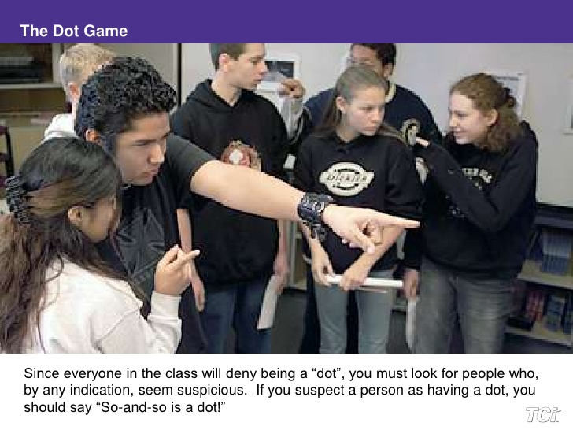

Slide 5
Instructions
Dot cards (Witches): Try to bluff your way into a square card group. If you manage to successfully infiltrate a square card group, you win!
You cannot show anyone your card!!!

Slide 6
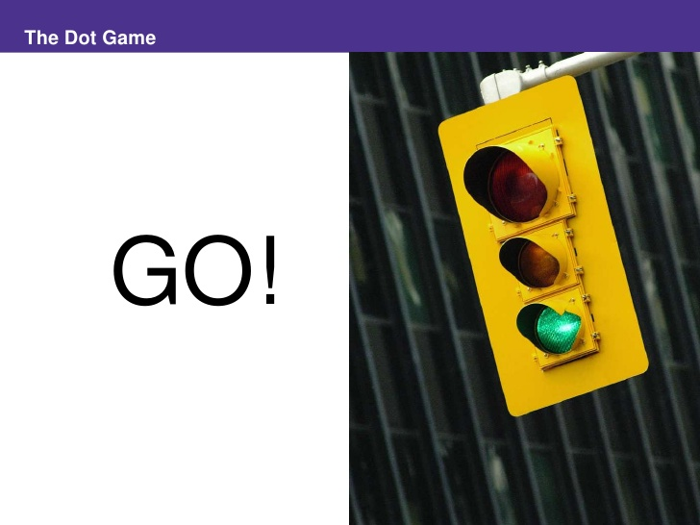

Slide 7
Warm Up (Answer on pink sheet)
Dots: How did it feel when you discovered you had a dot card? What was your strategy? Was it successful?
Squares: How did you try to identify the dot cards? Were you accused of being a dot? How did that feel?

Slide 8
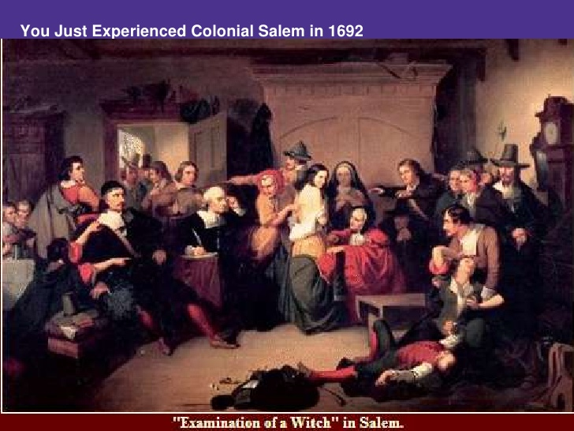
Read the passage about the Salem Witch Trials.
What happened in Salem in 1692?
Notes:
Read the first page of the packet, then ask: what happened in Salem in 1692?

Slide 9
Salem Witch Trials (1692)
Work with a partner to work through the documents and learn more about the Salem Witch Trials.
Essential Question: What caused the Salem Witch Crisis of 1692?
Notes:
How might Puritan social values have created an environment that encouraged witch hunting in 1692?
Encourage students to think about social conformity and pressure to be part of the group. Any outsiders, i.e. single women, might become targets during the witch hunt because they did not conform to social norms.

